Slide 1
ART 10 ART HISTORY I
Prehistoric Era
Paleolithic and Neolithic

Slide 2
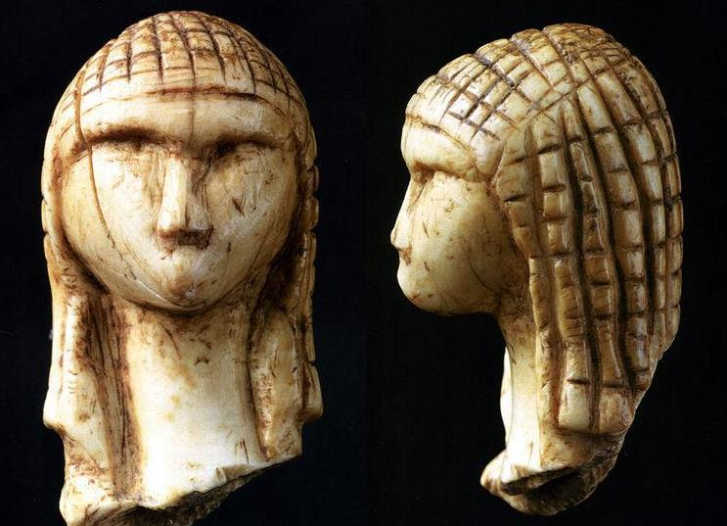
PALEOLITHIC PERIOD (circa 40,000 – 8000 BCE)

Slide 3
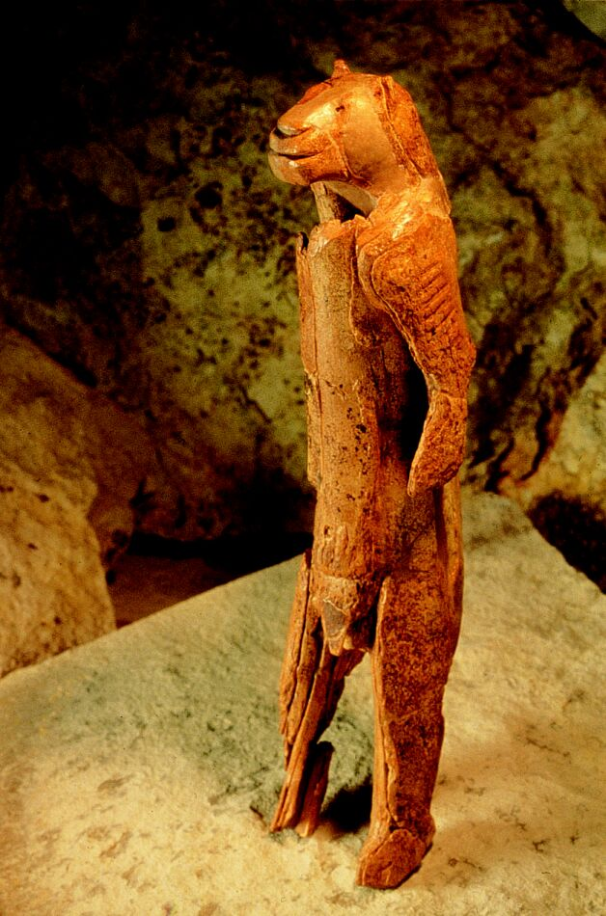

Slide 4
Page 1 Notes
1.a) Bone, stone, and clay
b) Yes and no. The lion and man are separately realistic, but put together they are not. The woman is simplified; her hair is patterned (curls or braids), & she has no mouth or eyes; she is tiny (1 ¼” high).
c) Sculptures may be ritualistic, eg. A man in a mask; an imaginary beast. Maybe used to tell a story; may be dolls/toys, or portraits, memorial sculpture (ie. of someone who died).
d) Creators possibly nomadic – articles small so cd be easily carried. Many of animals & women; was society matriarchal? Many are pregnant; concern with fertility, continuity of life? Do they reflect ideals of beauty at the time? If memorials, what did they think about death?

Slide 5
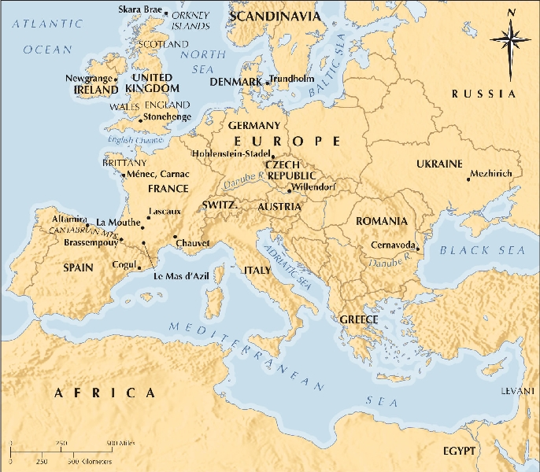
Map of Prehistoric Sites in Europe

Slide 6
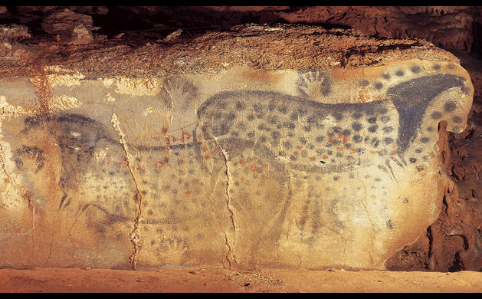

Slide 8
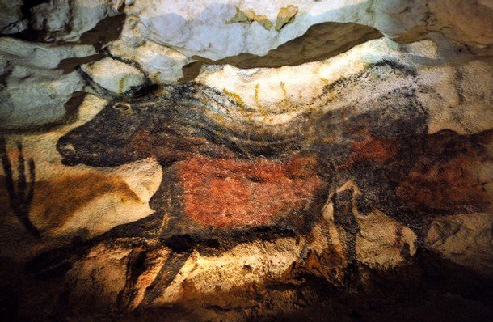

Slide 9
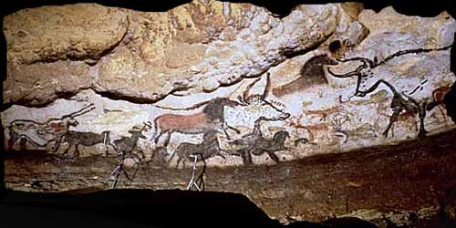
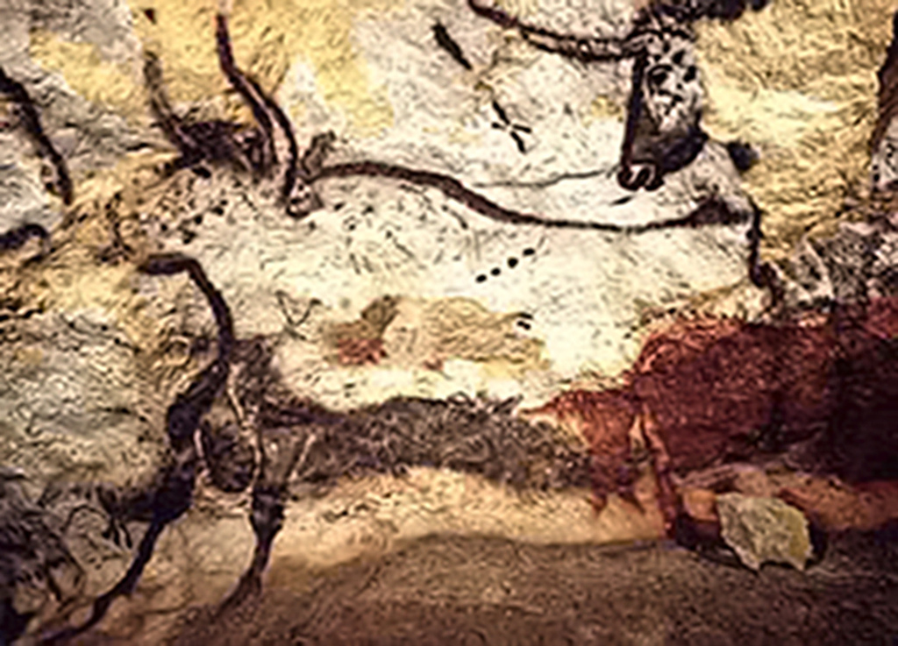

Slide 10
Page 2 Notes
2. a) Animals – bulls, horses, deer, bison (other ptgs. also show bears, owl, panther, aurochs, wooly-haired rhinos, ibex); hands, humans, spears.
b) Generally speaking, yes. Outlines are accurate, & colouring when applied. Use of stone formations to show 3D shows desire for greater realism.
c) Various materials were used for different colours; soot/charcoal for black, chalk/lime for white, manganese oxide for black, metallic oxides for res & yellow ochres, berries. Saliva was used for binding the pigments. Also stone lamps found (stone with depressions where oil wd be burned) & evidence of scaffolding).
d) Animals obviously very important; people probably hunted to survive. But were the ptgs. ritualistic, eg. “killed” before the hunt?; were there ceremonies in these caves to increase the fertility of animals?; were there ceremonies to strengthen clan bonds?; were these places of worship?
Two unusual circumstances : ptgs. often jumbled on top of each other, & they are usually found in obscure, hidden caves, well at the back. Why?

Slide 11
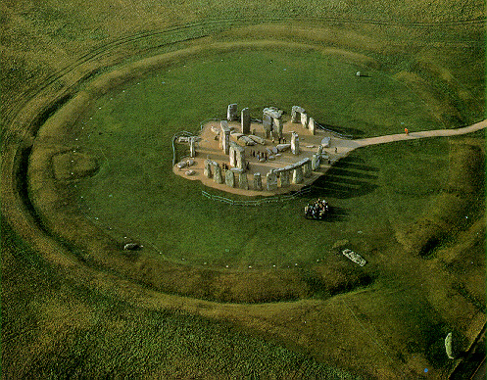
NEOLITHIC PERIOD (8000 – 2300 BC)

Slide 12
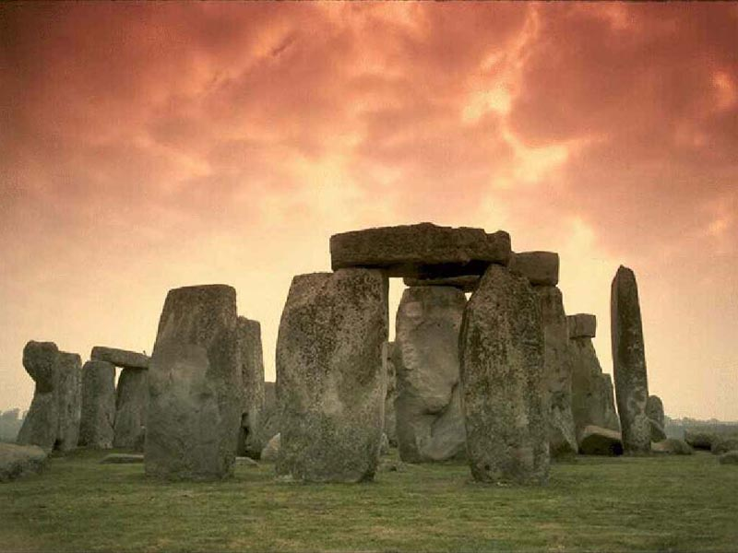

Slide 13
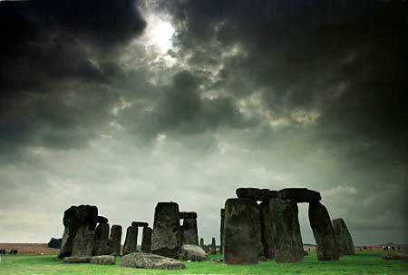

Slide 14
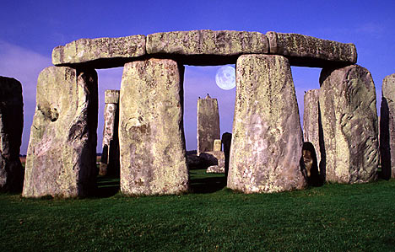
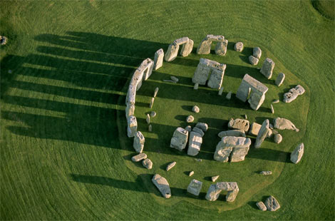
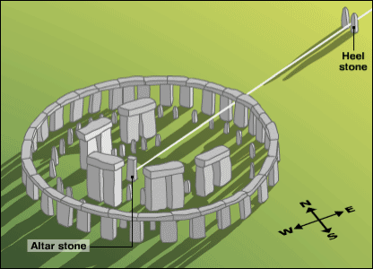

Slide 15
Neolithic Notes
Tallest Trilithon: 24 ‘ high
Lintel on top of Trilithon: 15’ long, 3’ thick
Sarsen circle stones (outside ring): 20’ tall, 50 tons each (circle is 106’ in diameter
Theories:
During Medieval times, it was thought to have been built by Merlin, the Magician.
Later on, it was thought to have been built by Druids, but the henge is 1,000 years older than Druidism.
In the 20th c., it was suggested that it had something to do with the sun, whether worship-oriented or astronomical isn’t clear. It was probably the site for major public festivals, eg. planting &/or harvest rituals. Standing in the exact centre of Stonehenge on summer solstice, you will see the sun rise directly over the HEEL STONE; was this to warn people of shortening days & the coming of winter?
ARCHEOASTRONOMY: study that relates archeology, anthropology & mythology with astronomy.

