Slide 1
ART 20/30 ART HISTORY I
Neoclassicism to Romanticism

Slide 2
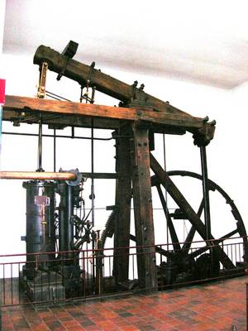
I The 18th Century: The “Modern” World
Two Major 18th Century Movements
Industrial Revolution – steam engine (James Watt); machines replacing human labour;
Society gradually changes
from agricultural to
industrial.

Slide 3
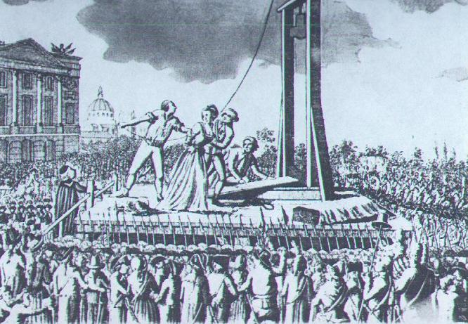
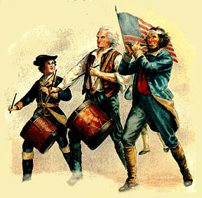
b) Political Revolution – American (1775-1784) and French (1789 – 1790s). Humans asserting right to freedom from monarchy, right to be citizens instead of subjects.

Slide 4
2. Characteristics of the Age
Faith in human reason and emotion.
“Age of Enlightenment” – so-called because humans finally able to see “truth” based on reason.
Established values and institutions questioned (ie. truth, beauty, church, monarchy); search from meaning outside these.
Increased individualism – artists vs. society instead of supported by it.
With increased individualism, many styles of art emerge, multiplication of –isms.

Slide 5
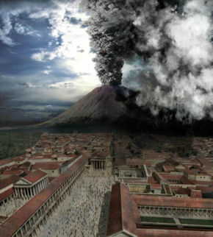
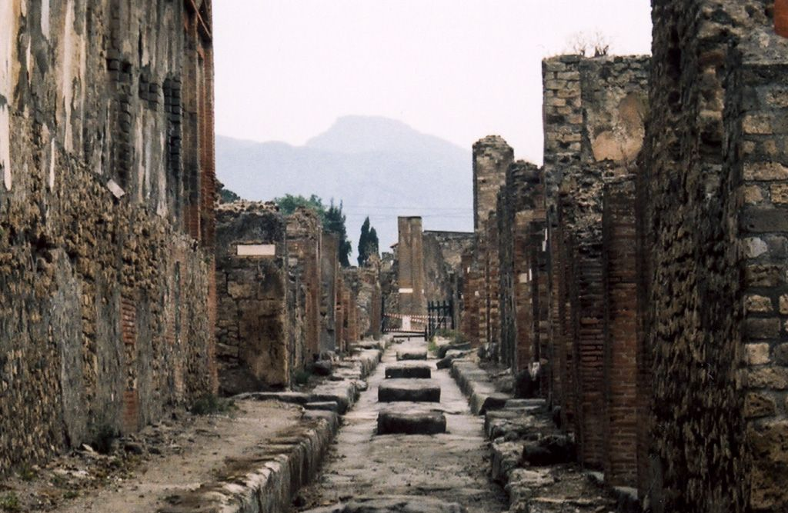
II Neoclassicism (Late 18th Century)
Neo = rebirth
Classicism = Greek and Roman Culture
Pompeii and Herculaneaum

Slide 6
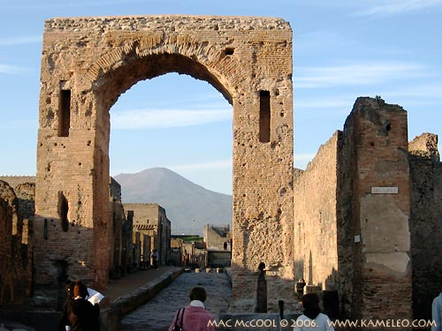
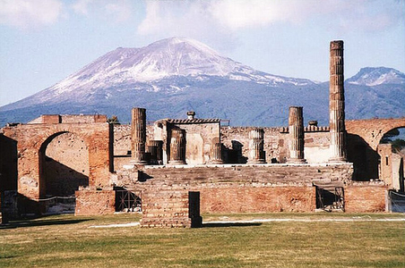
Renewed interest in
Greek and Roman art and
architecture

Slide 7
Characteristics of Neoclassicism
Usually expresses an intellectual idea (eg. patriotism)
“Severe”, ie. no embellishments, simple, subdued colour, controlled emotion
Compositions tend to horizontal/vertical
LINEAR, ie. emphasis on line, clean edges, static composition

Slide 8
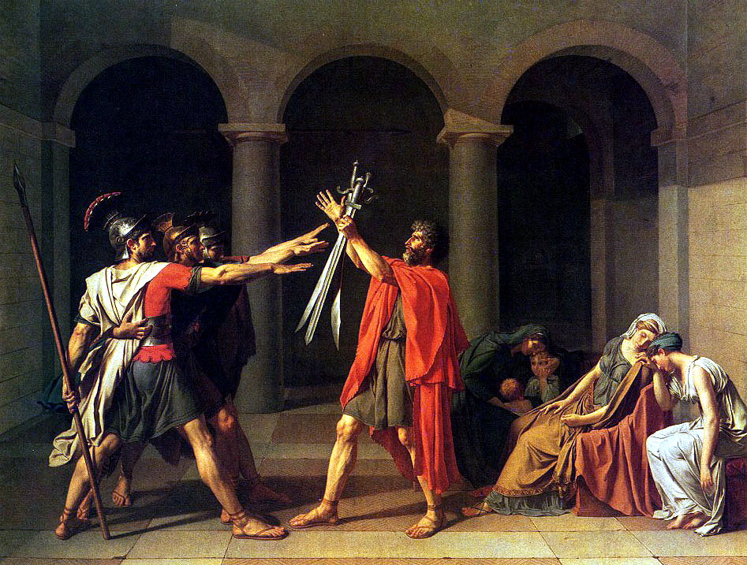
Jacques-Louis David (1748-1825)

Slide 9
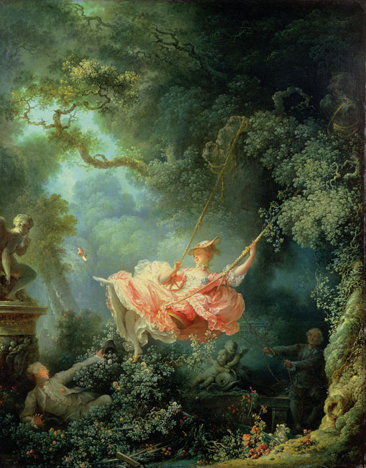
Rococo Paintings
Neoclassicism was
partly a reaction
to the frivolous,
decorative Rococo
style.
Fragonard

Slide 10
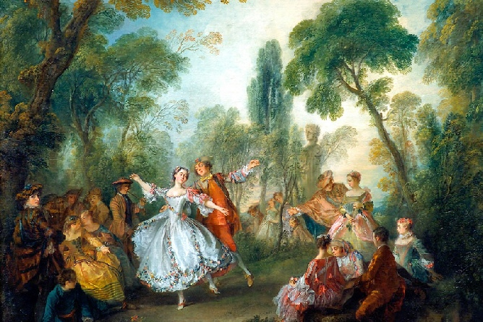
Boucher

Slide 11
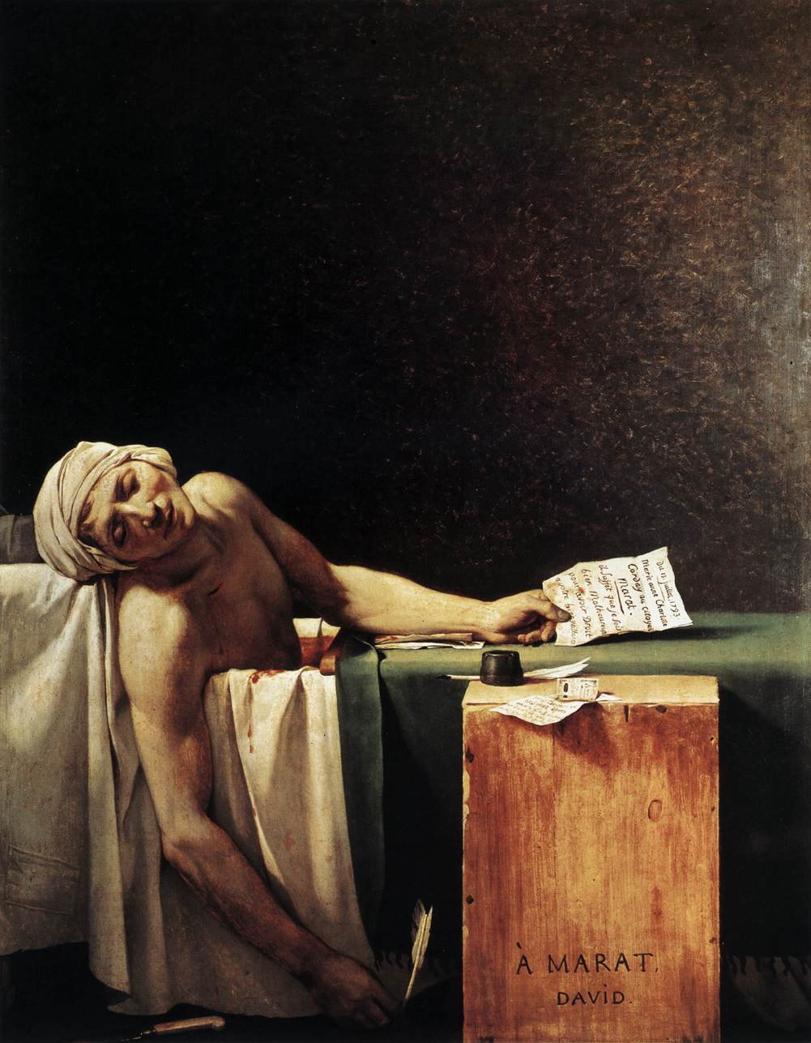

Slide 12
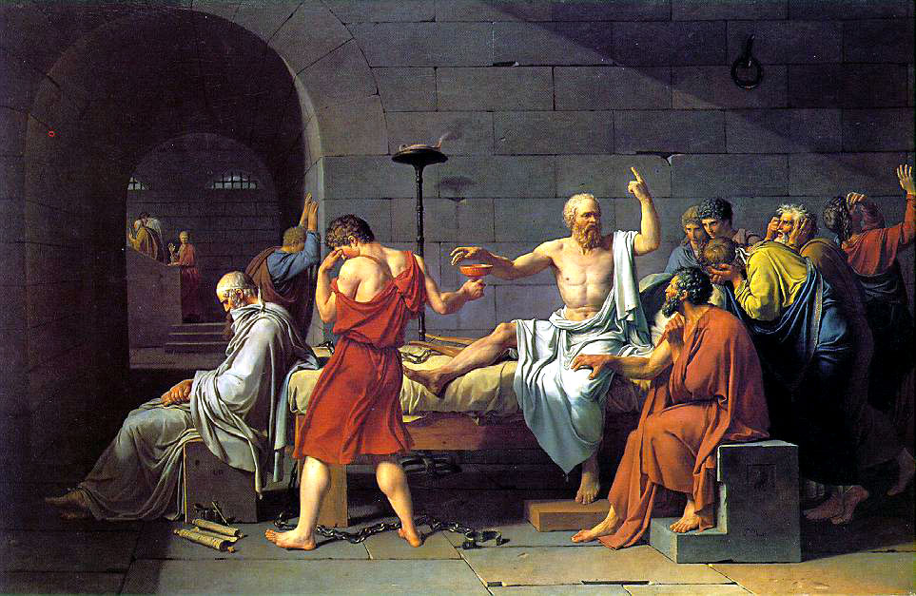

Slide 13
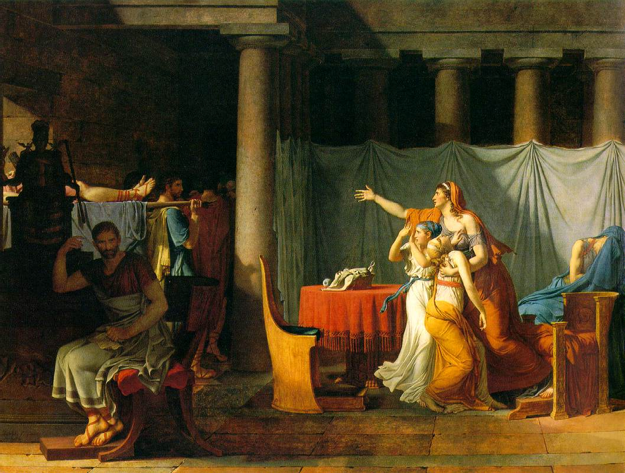

Slide 14
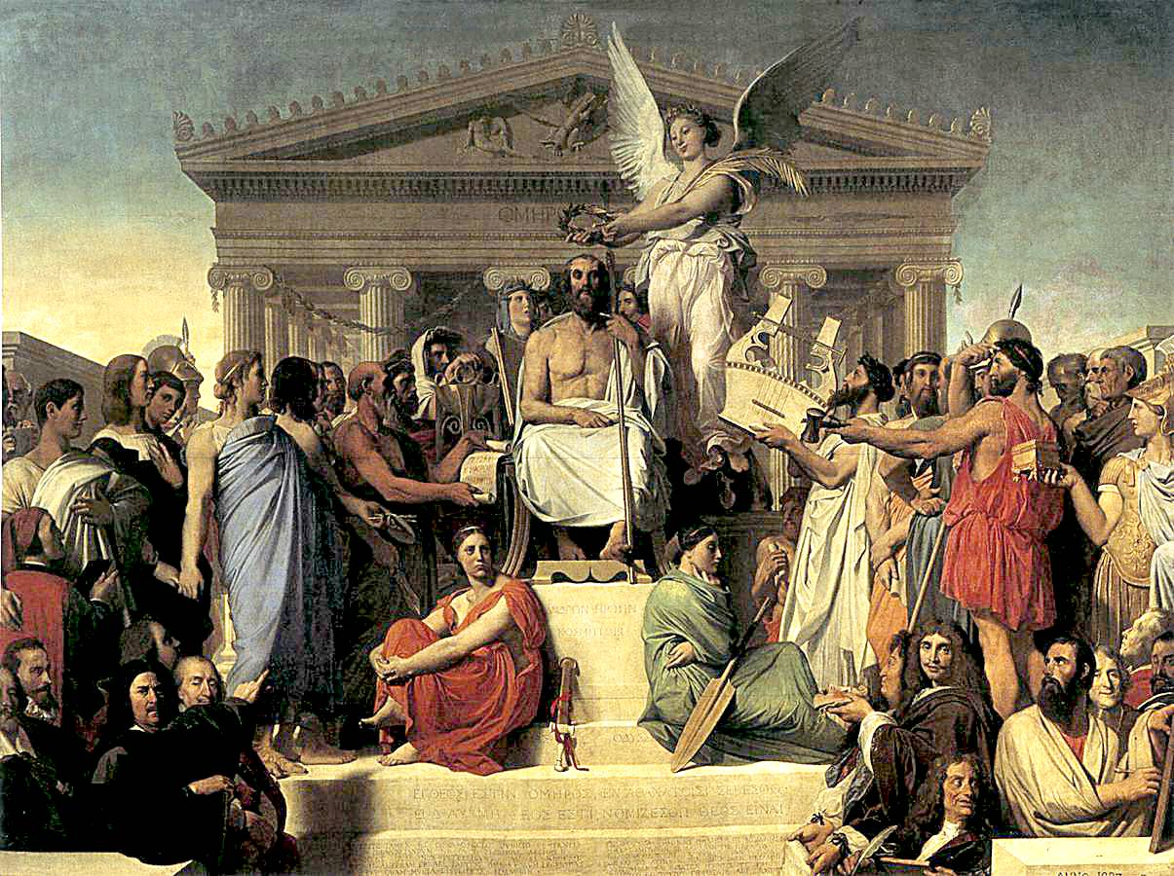
Jean Auguste Ingres

Slide 15
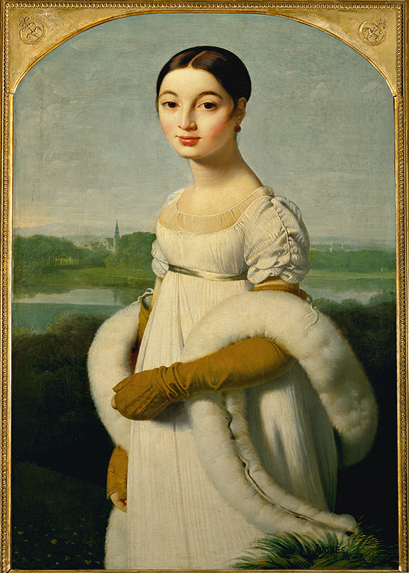
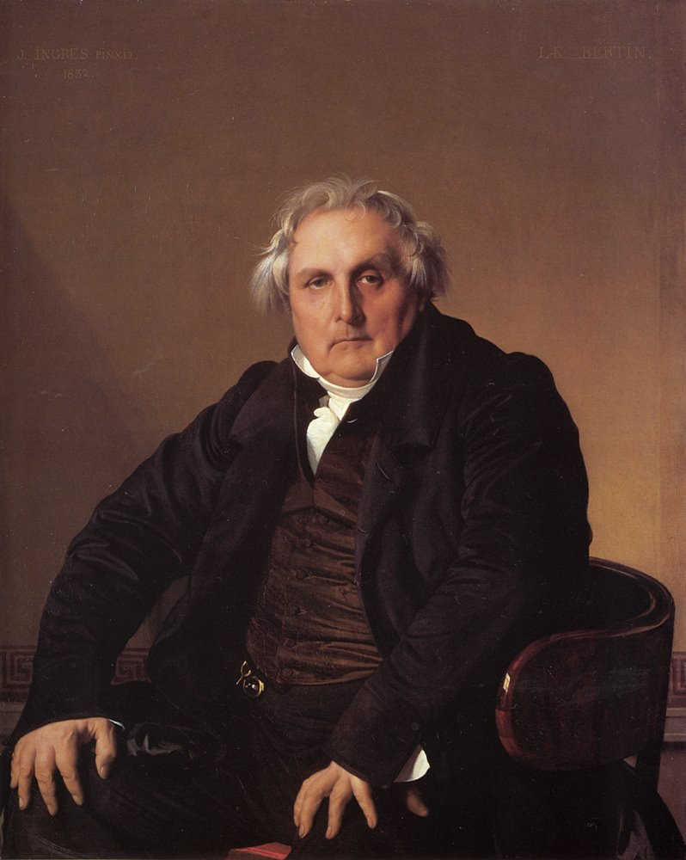

Slide 16
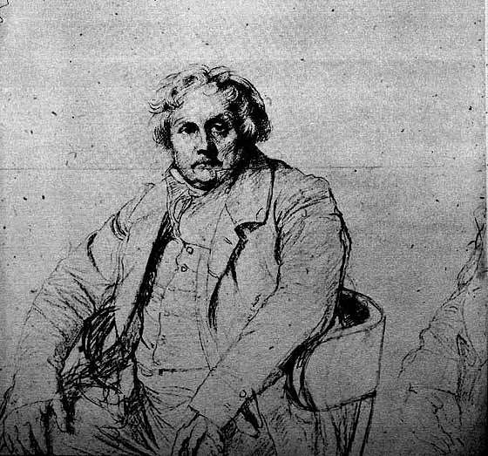

Slide 17
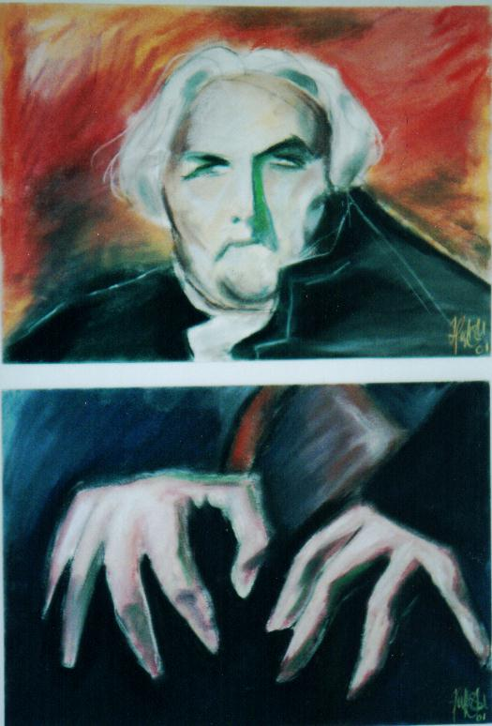
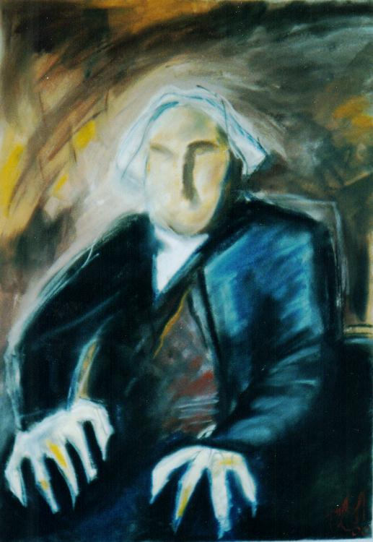

Slide 18
III Romanticism (Early 19th Century)
Characteristics of Romanticism
Feeling above reason: “Each Romantic artist found his home wherever he found himself emotionally involved.”
Strong chiaroscuro, less emphasis on form, dynamic composition – PAINTERLY (as opposed to Linear).
Humans often seen as hopeless victim, yet heroic, in the face of nature and events.

Slide 19
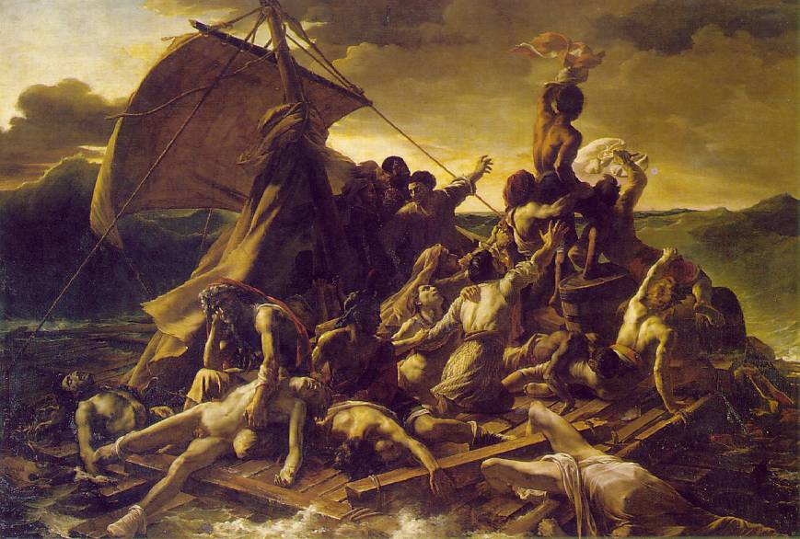
Theodore Géricault (1791-1824)

Slide 20
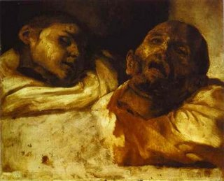
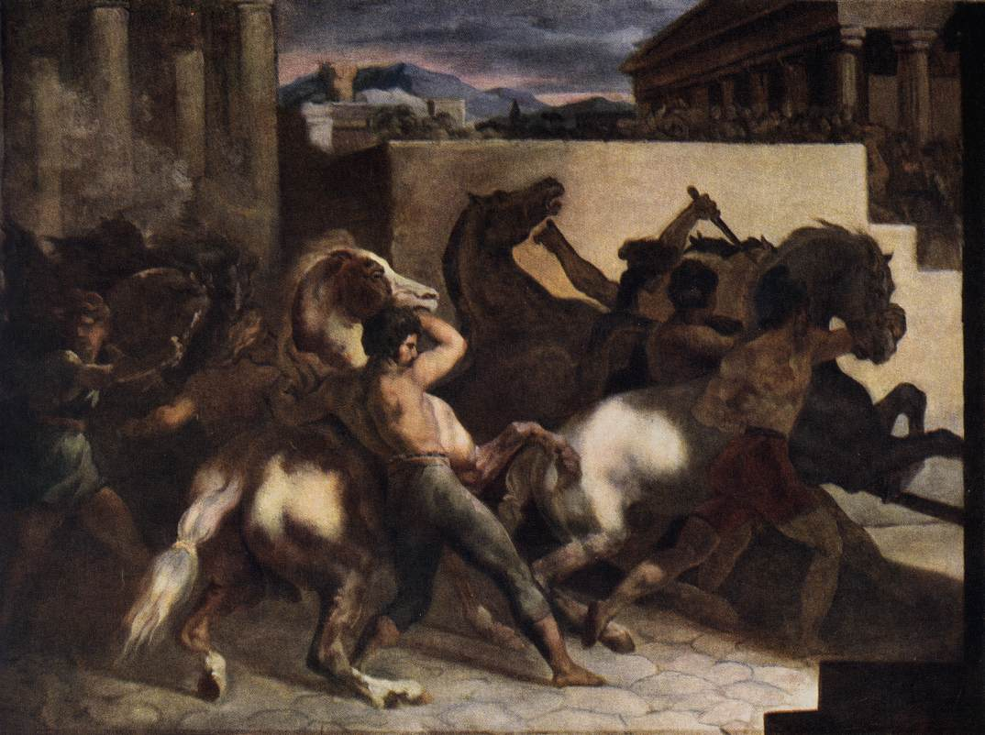

Slide 21
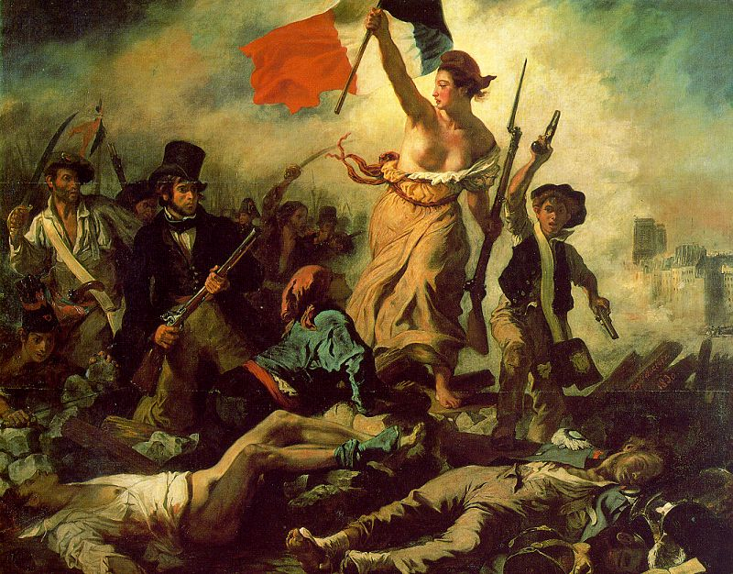
Eugene Delacroix (1798-1863)

Slide 22
Neoclassicism vs. Romanticism

Slide 23
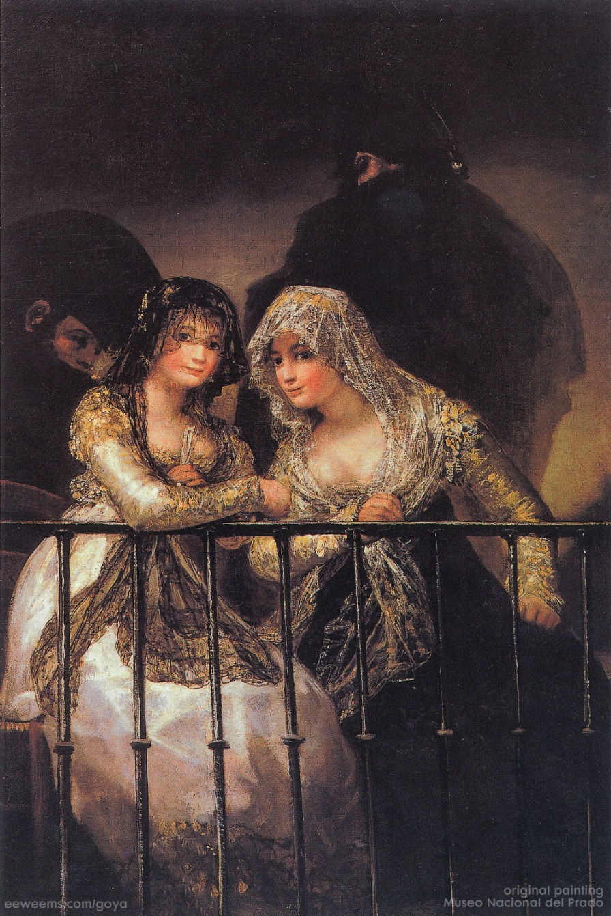
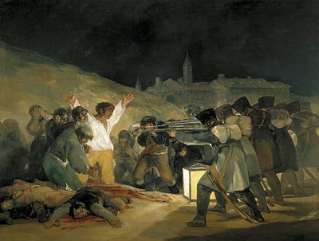
Francisco Goya (1746-1828)

Slide 24
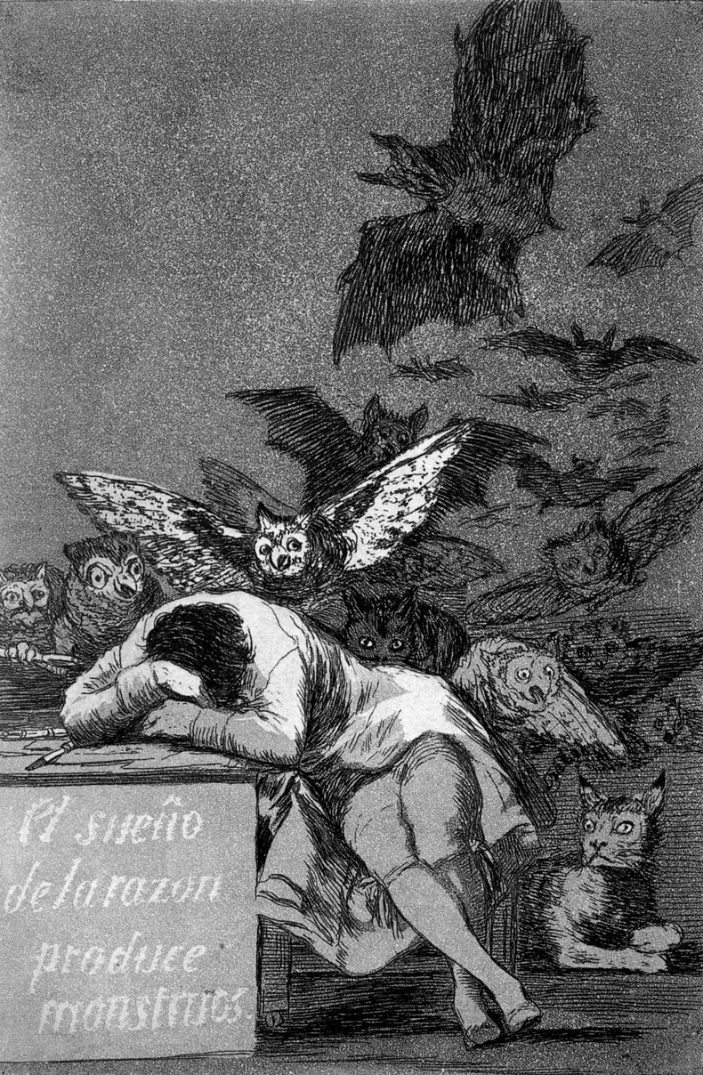
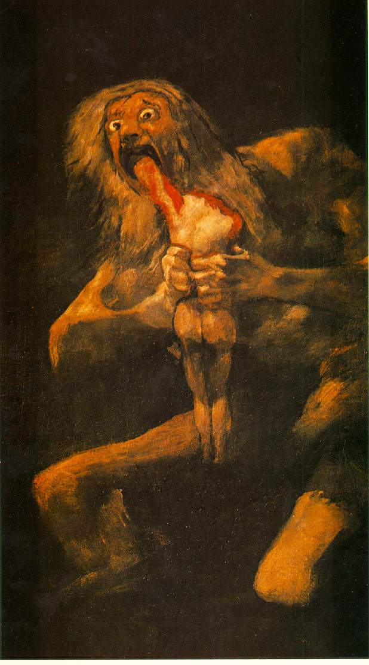

Slide 25
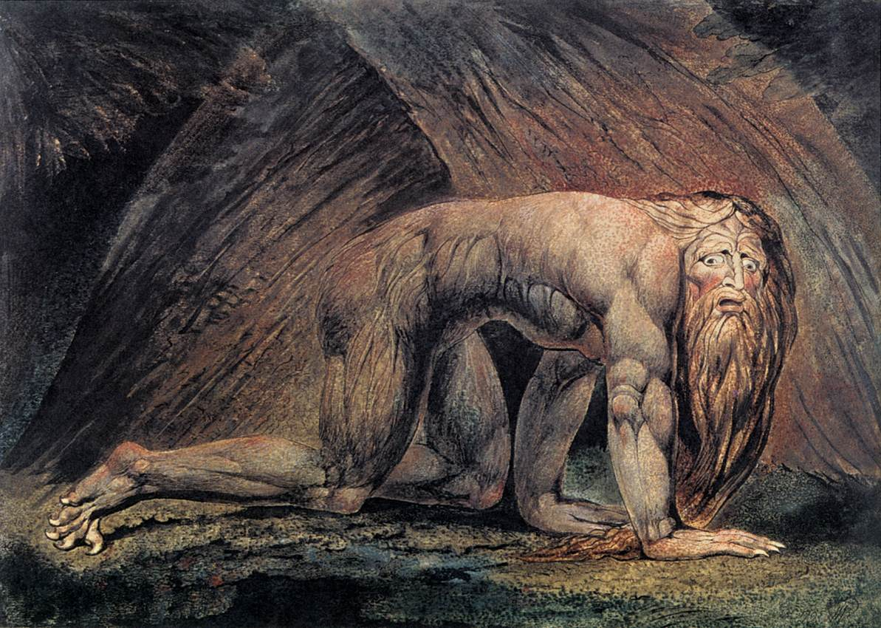
William Blake (1757–1827)

Slide 26
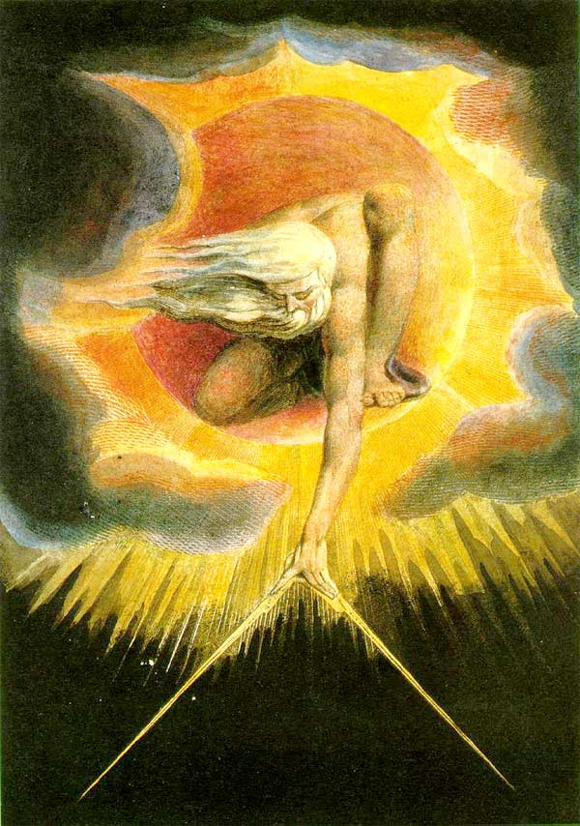

Slide 27
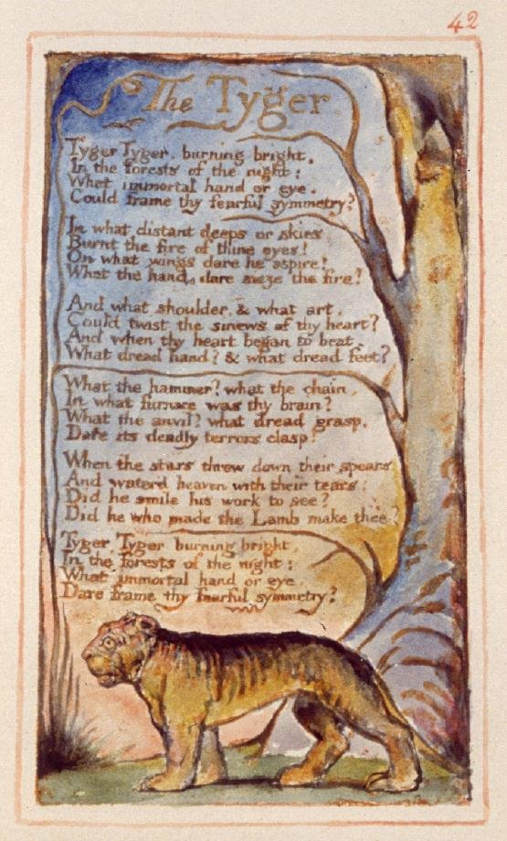
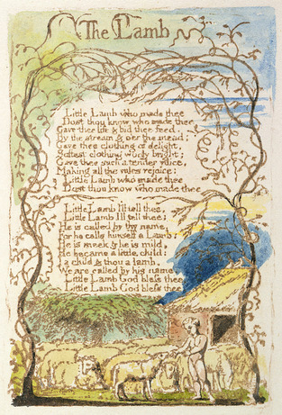
Blake’s Poetry

Slide 28
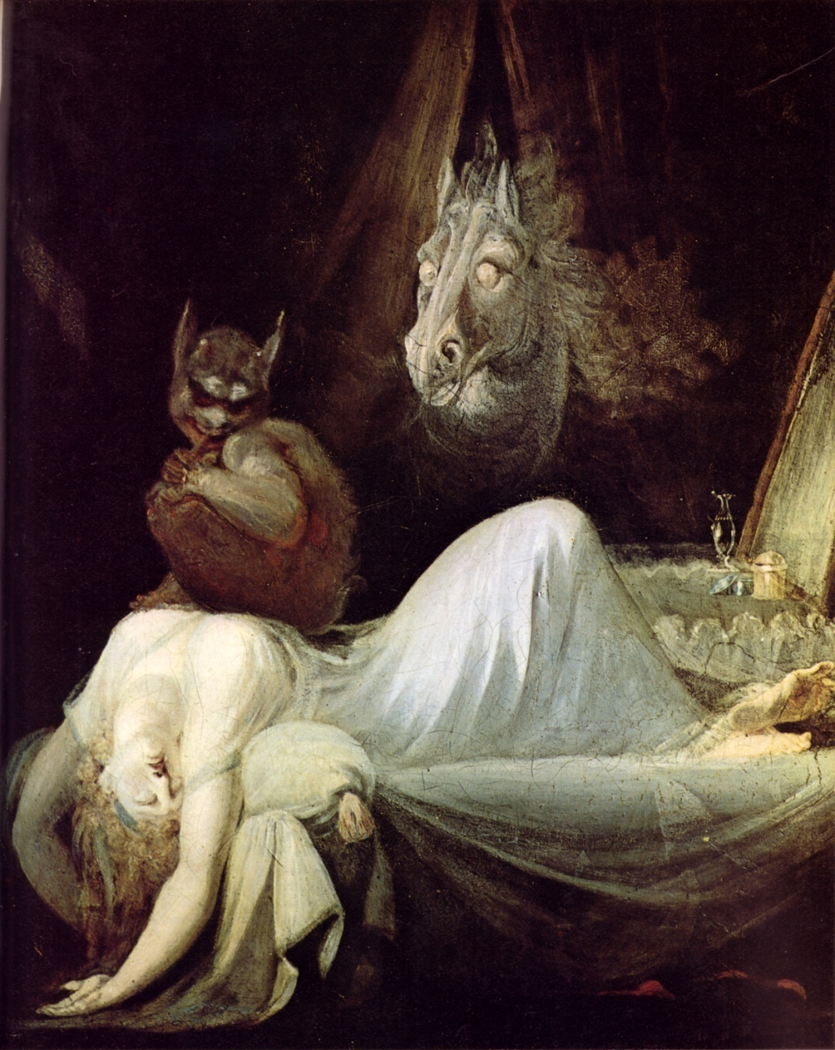
Henry Fuseli (1741-1825)

