Slide 1
ART 20/30 ART HISTORY I
Romantic Naturalism to PreRaphaelites

Slide 2
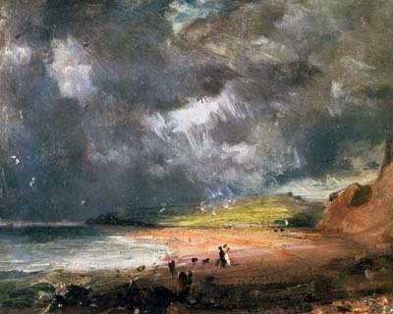
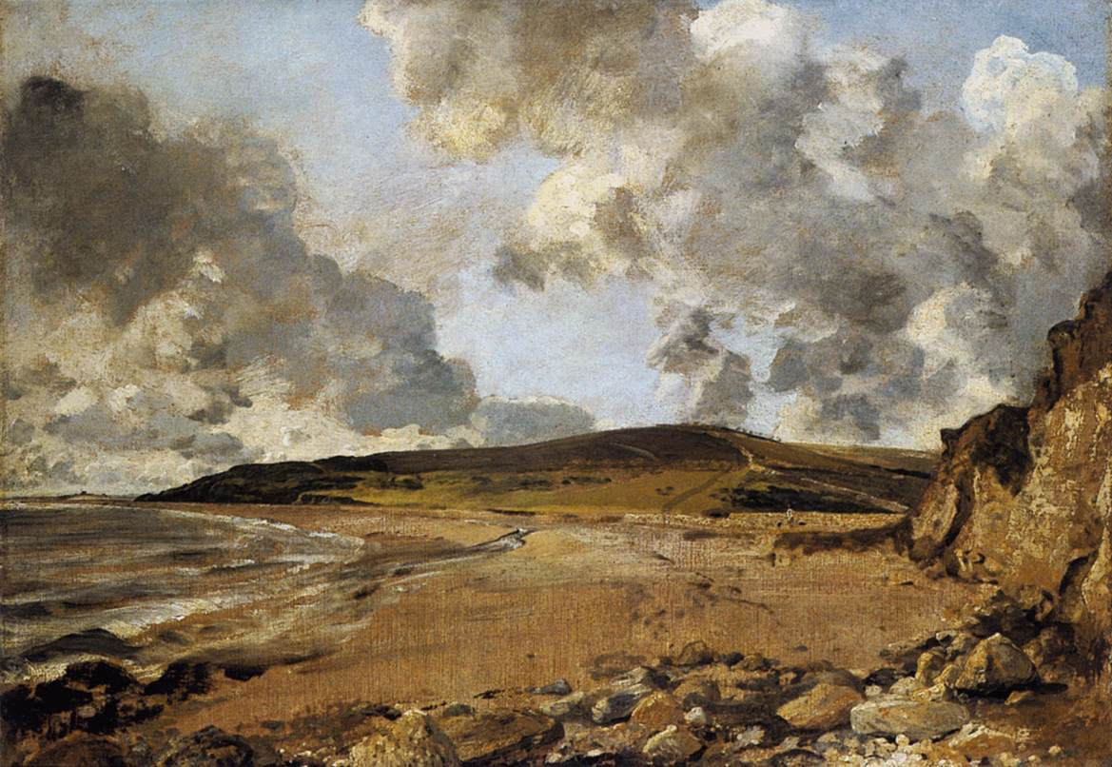
IV Romantic Naturalism John Constable (1776-1837)

Slide 3
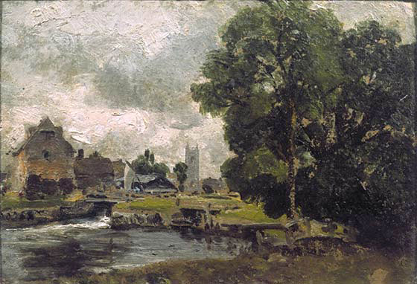
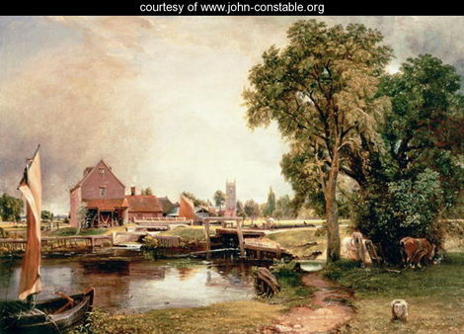

Slide 4
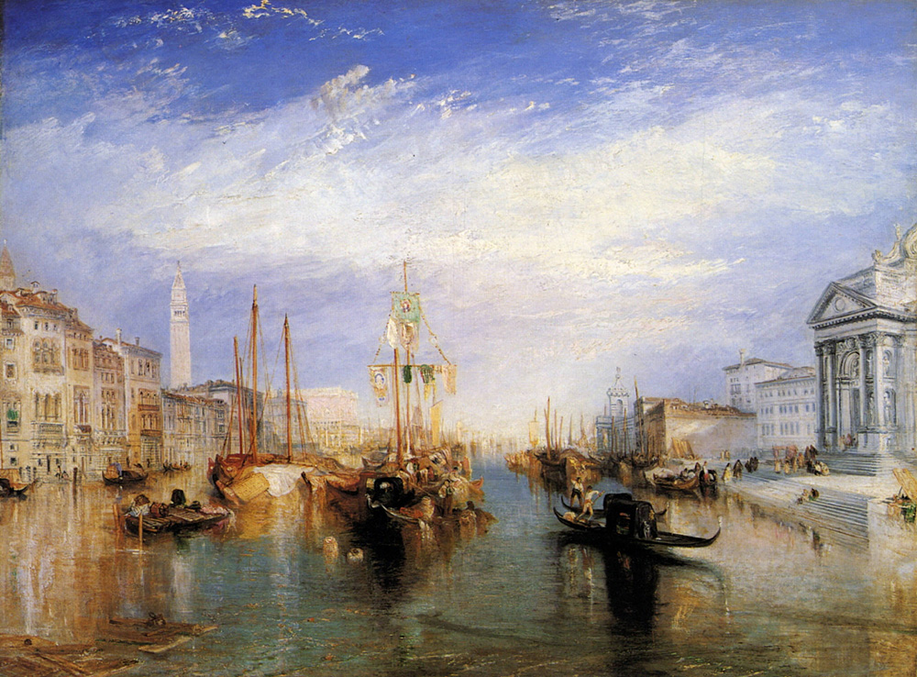
Joseph Mallord William Turner (1775-1851)

Slide 5
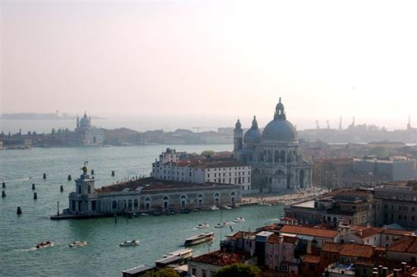
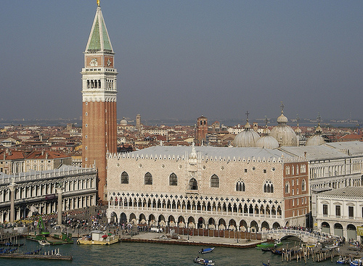
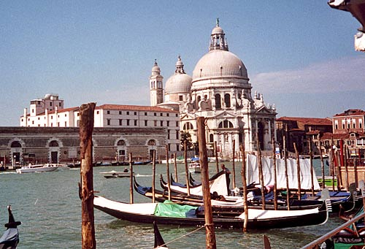

Slide 6
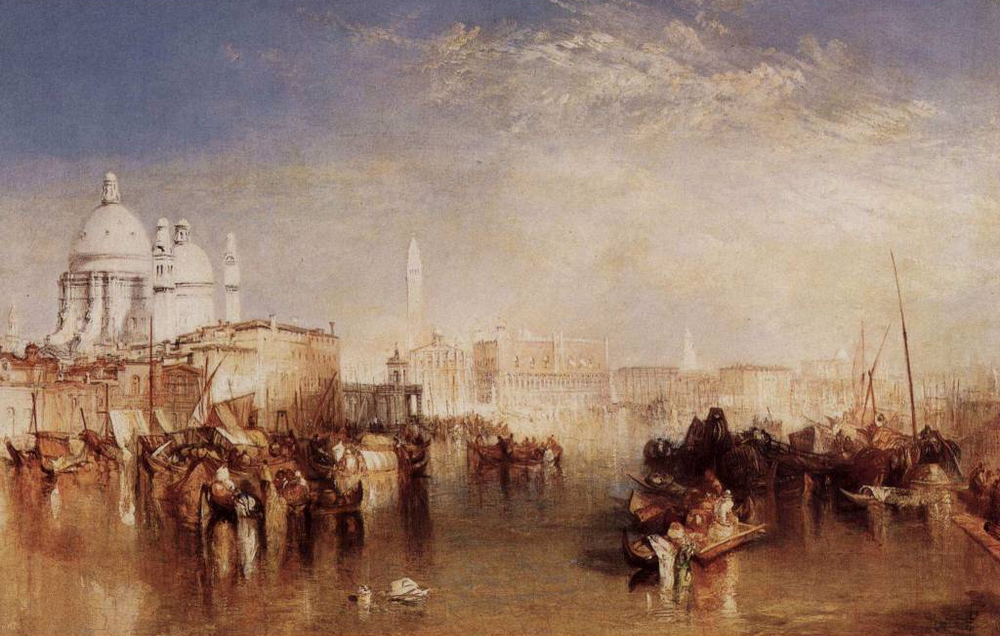

Slide 7
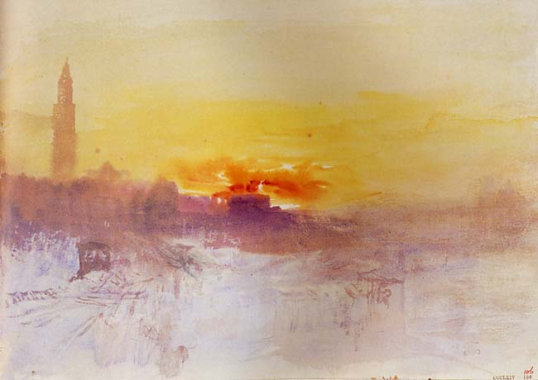

Slide 8
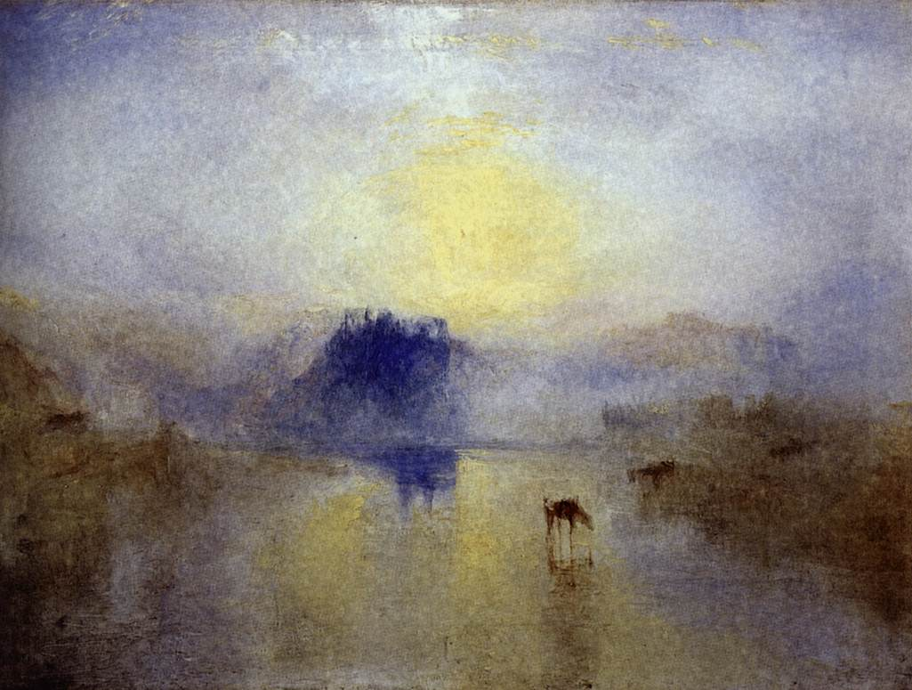

Slide 9
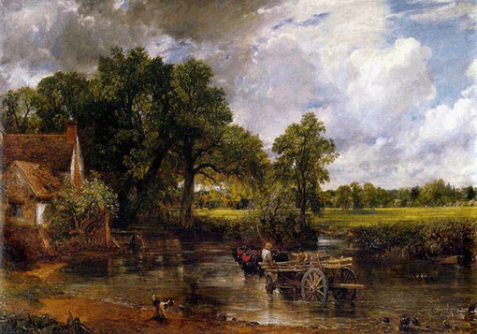

Slide 10
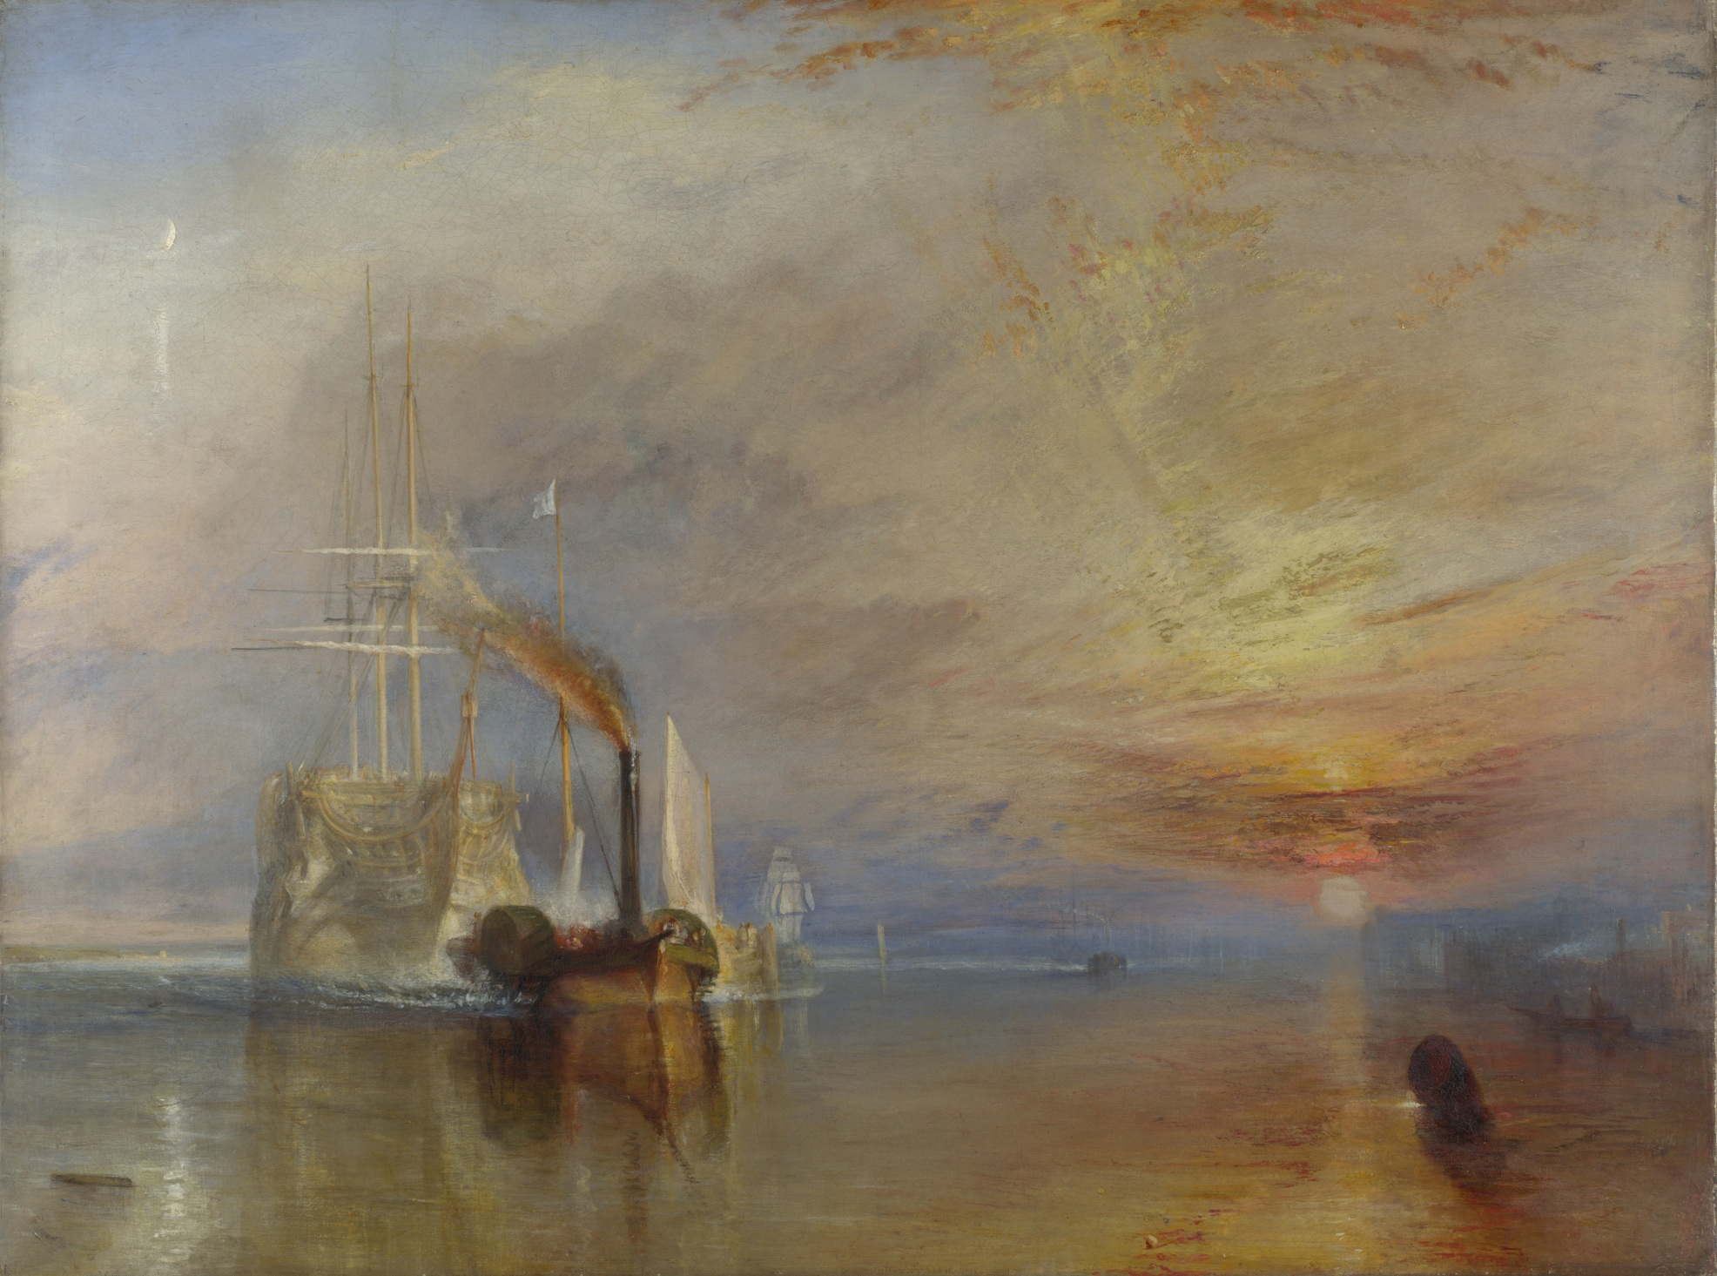

Slide 11
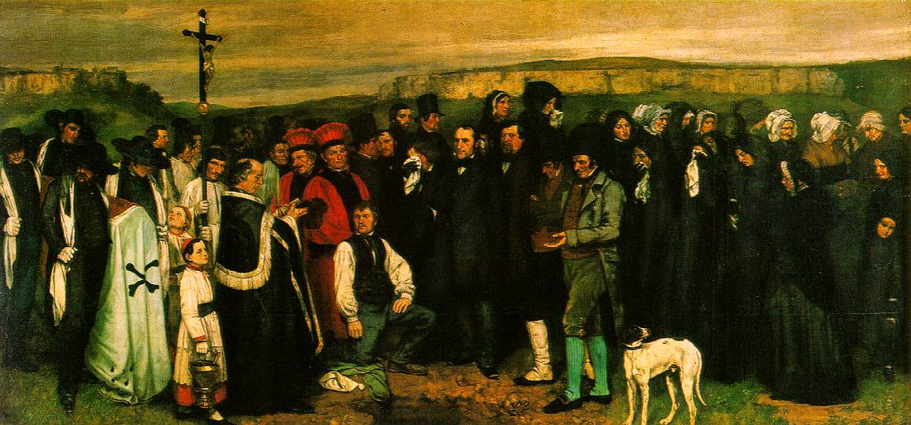
V Realism (mid-1800s)
Gustave Courbet (1819-1877)

Slide 12
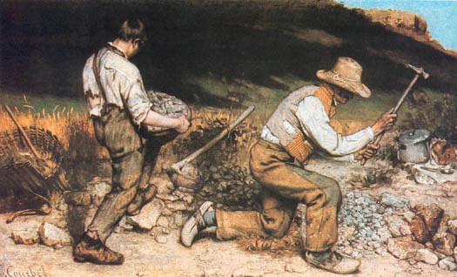

Slide 13
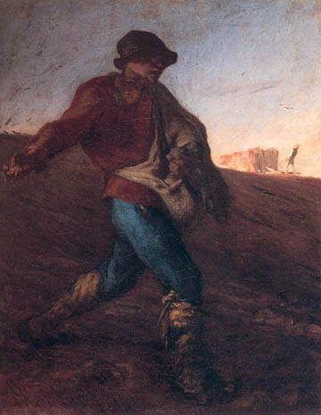
Jean-Francois Millet (1814-1875)

Slide 14
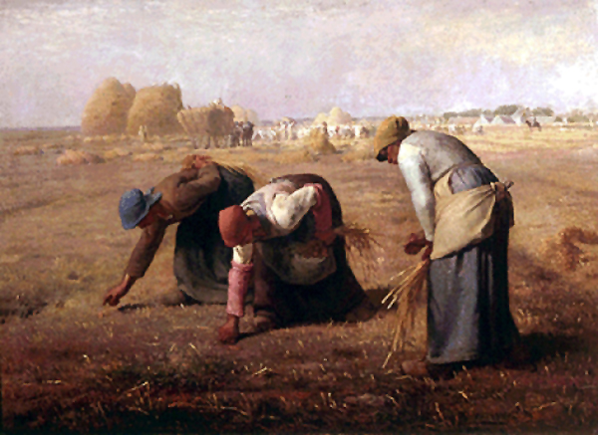

Slide 15
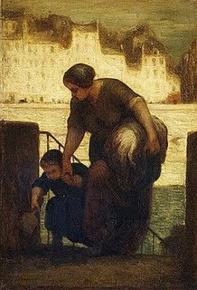
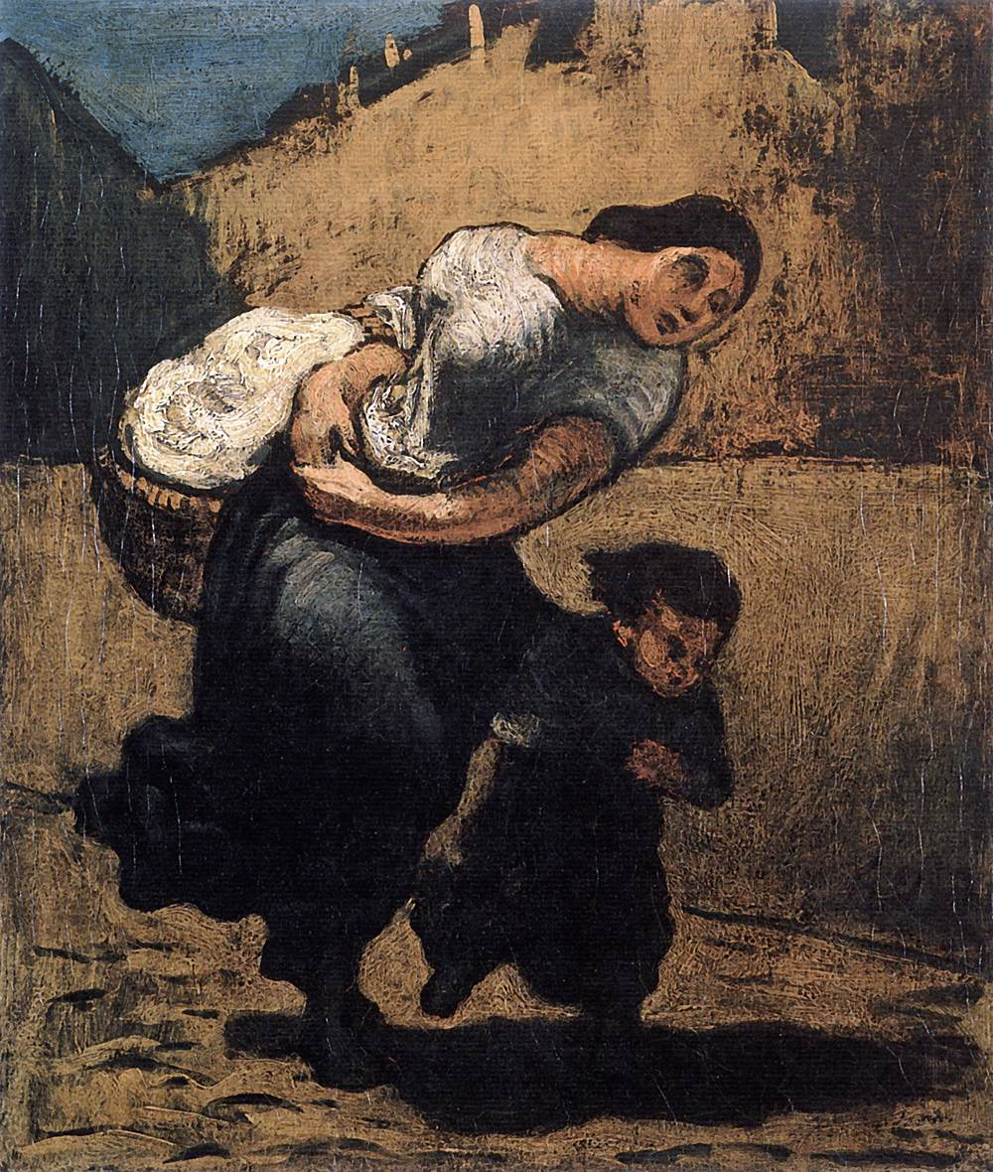
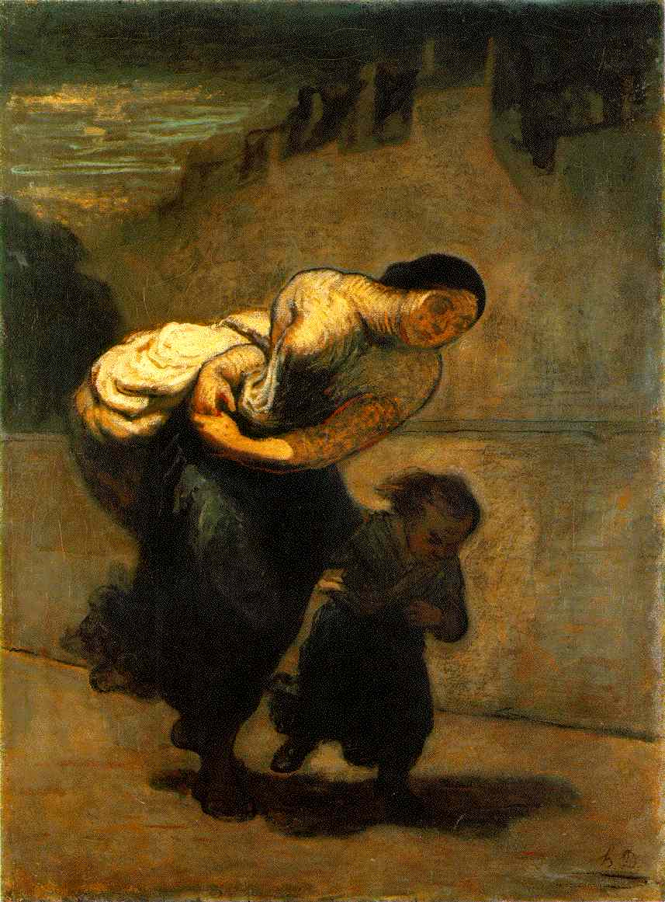
Honoré Daumier (1808-1879)

Slide 16
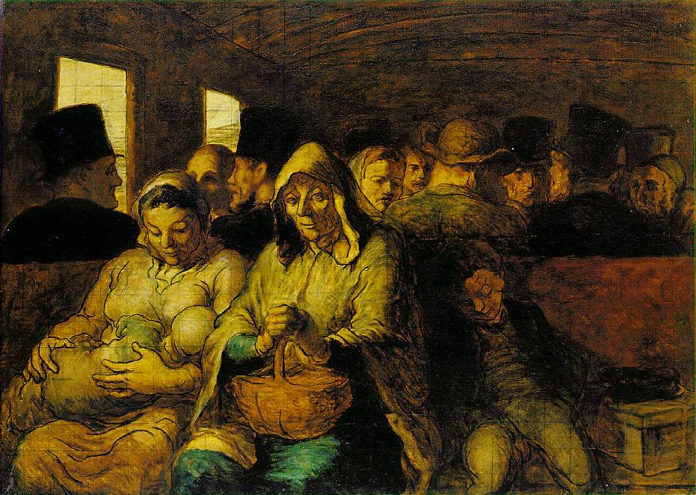

Slide 17
CHARACTERISTICS OF REALISM
According to traditional standards, subject matter is insignificant (not heroic)
Paintings show the “heroism” of common people (especially lower classes)
Figures are unidealized (unlike athletes and beauties of Neoclassicism and Romanticism)
Traditional ideals of composition, form, colour, and paint application generally ignored.

Slide 18
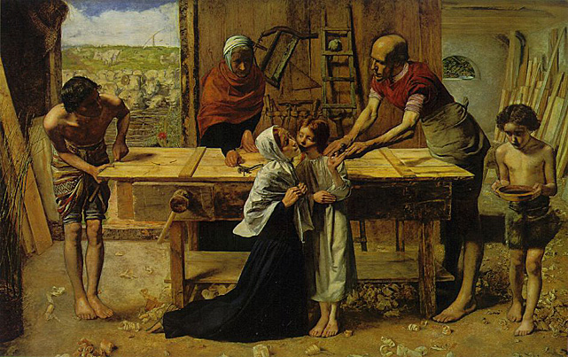
VI PreRaphaelite Brotherhood (mid to late 1800s)
John Everett Millais (1824-1896)

Slide 19
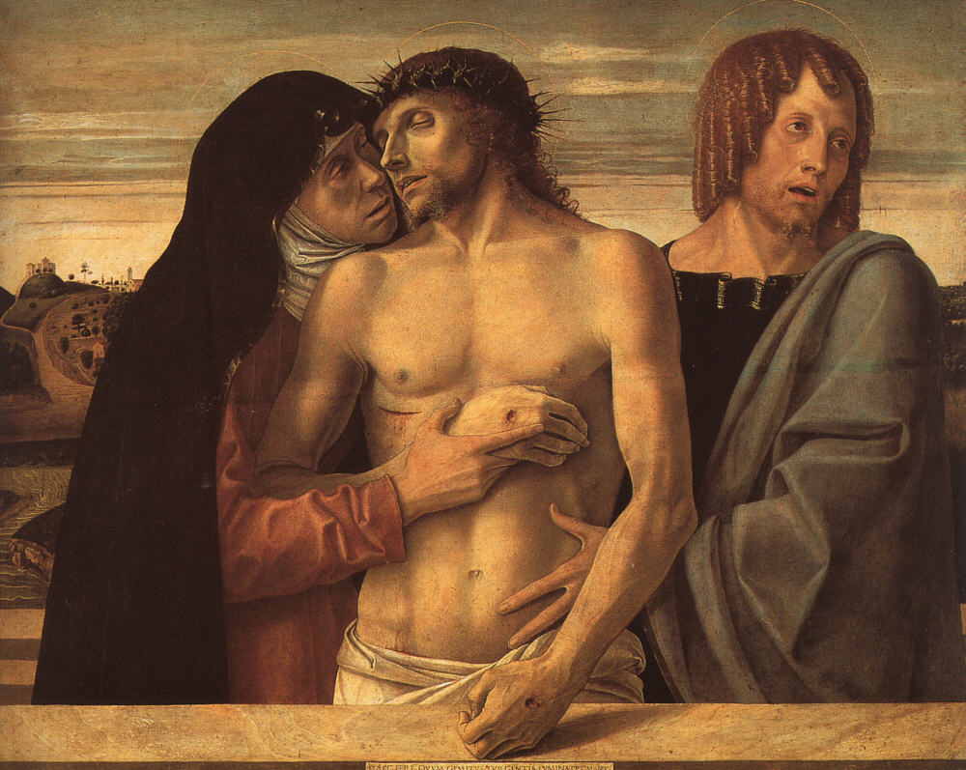
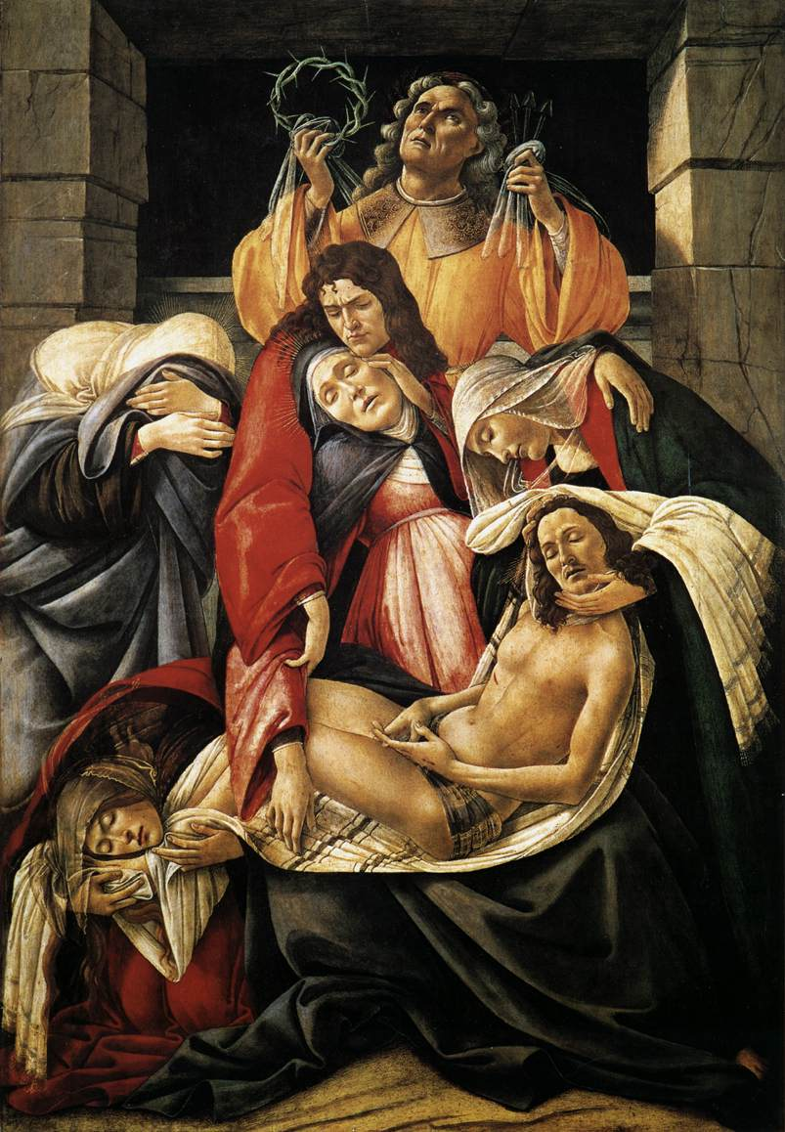
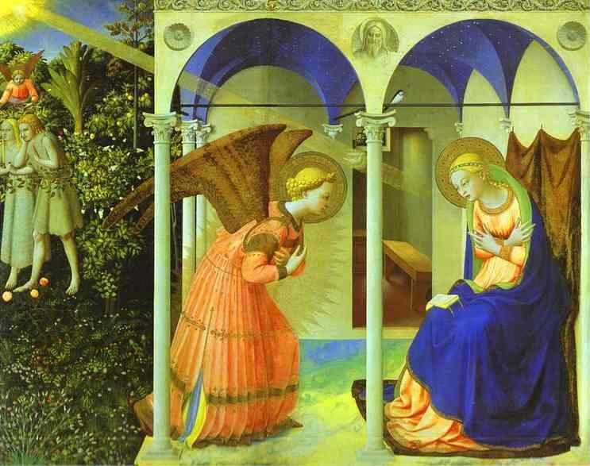

Slide 20
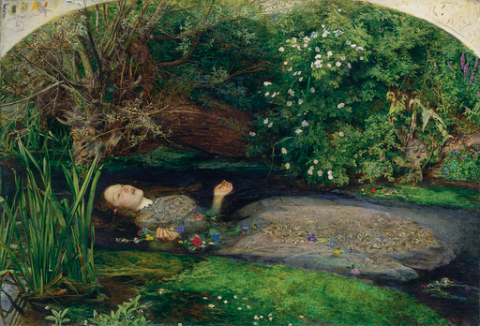

Slide 21
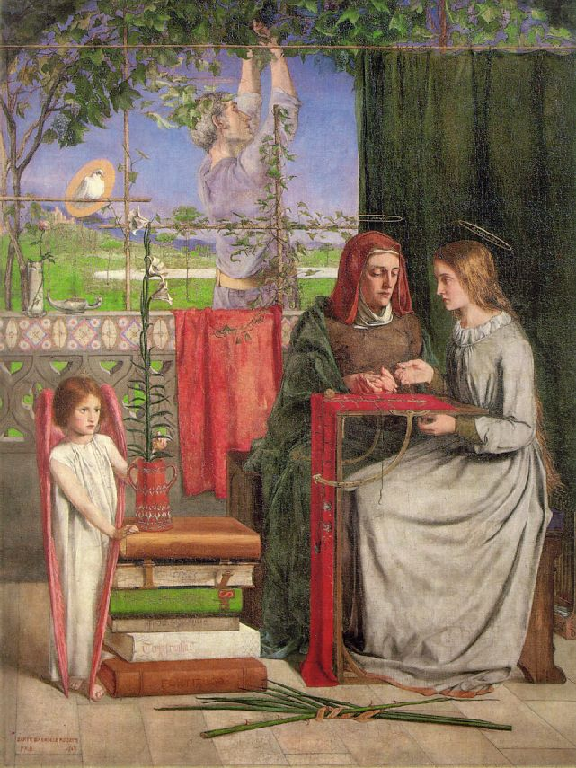
Dante Gabriel Rossetti (1828-1882)

Slide 22
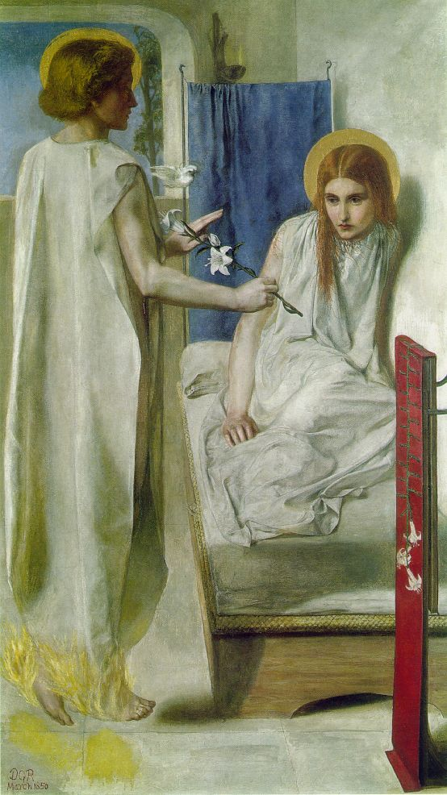

Slide 23
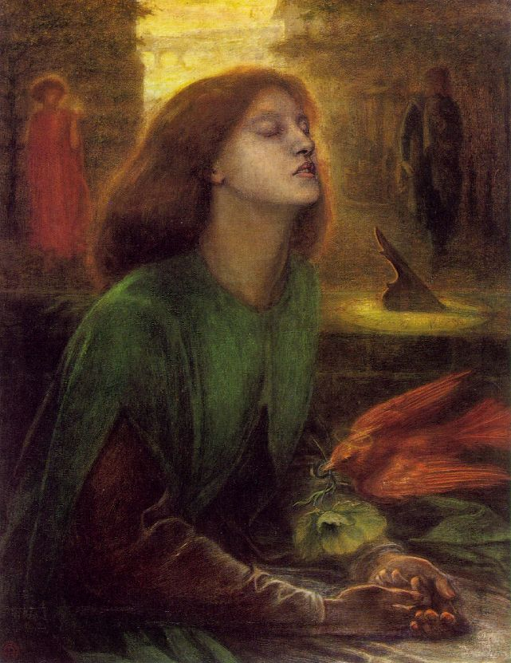

Slide 24
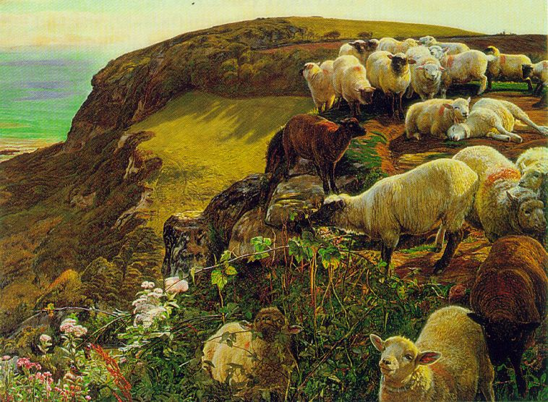

Slide 25
Characteristics of PreRaphaelite Brotherhood
Religious, literary, or moral in subject matter
Mood often somber, serious, or haunting
Highly detailed (sharp, clear focus over entire picture), and colour intense and jewel-like

