Slide 1
ART 10 ART HISTORY II
Baroque, Neoclassicism, and Romanticism

Slide 2
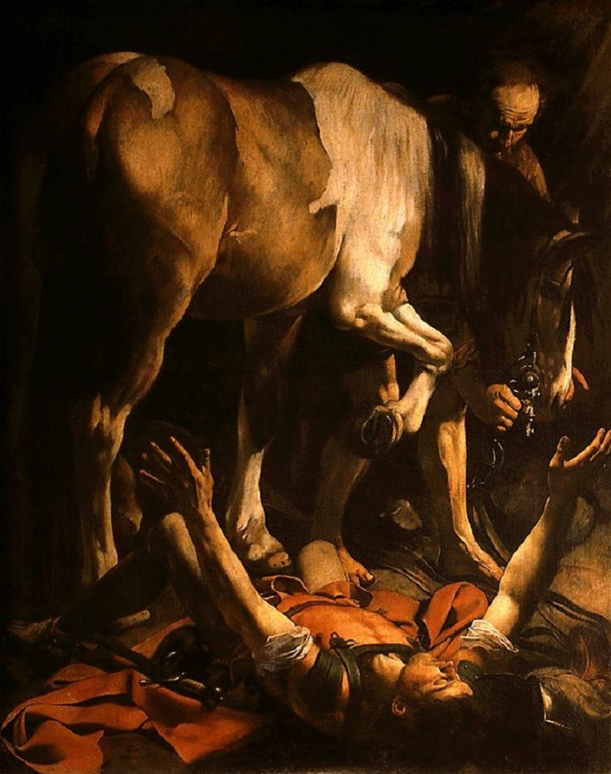
BAROQUE (C.1600 – 1750)

Slide 3
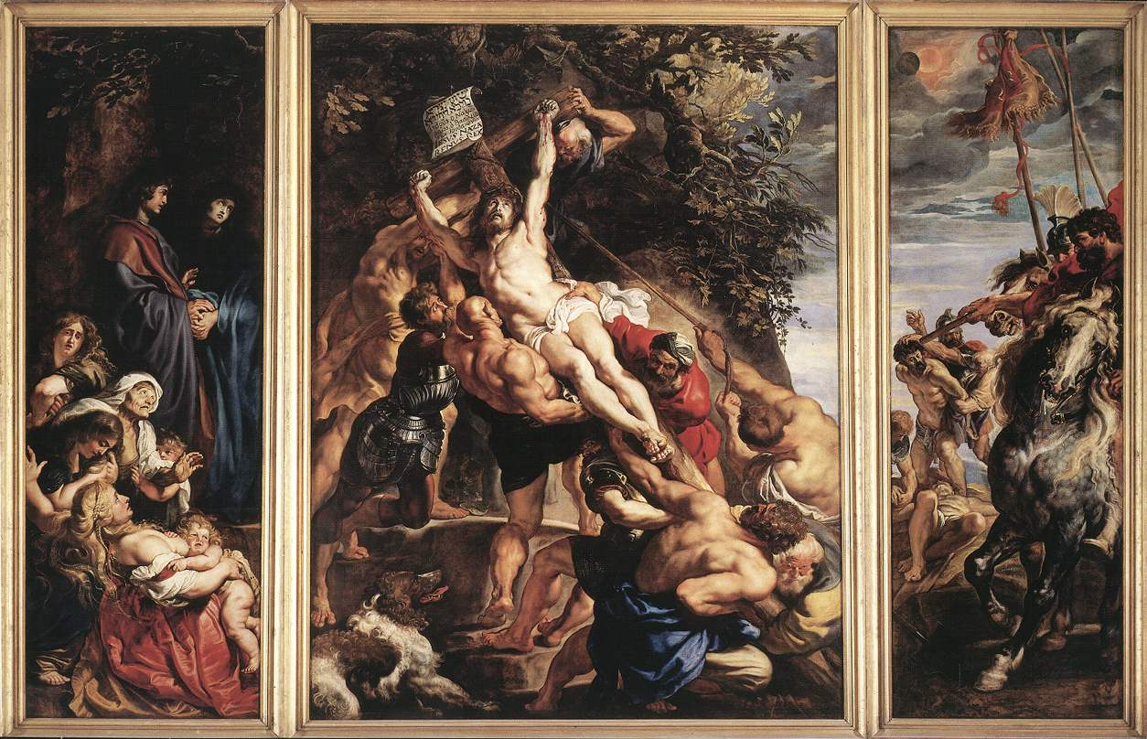

Slide 4
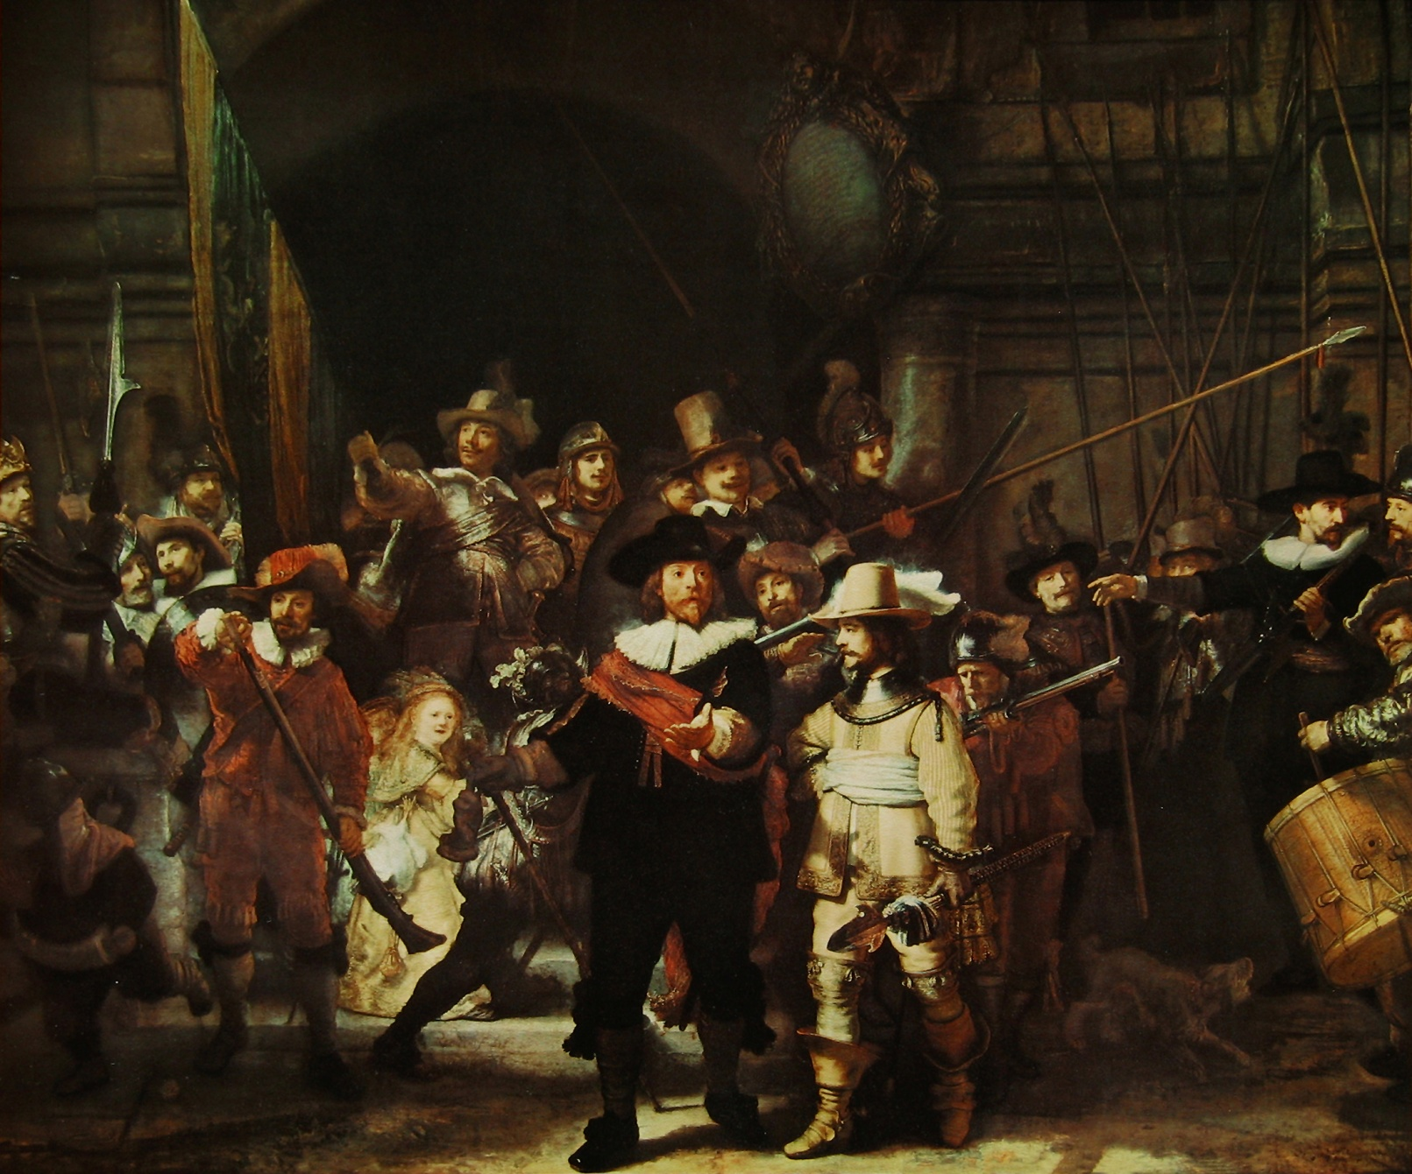

Slide 5
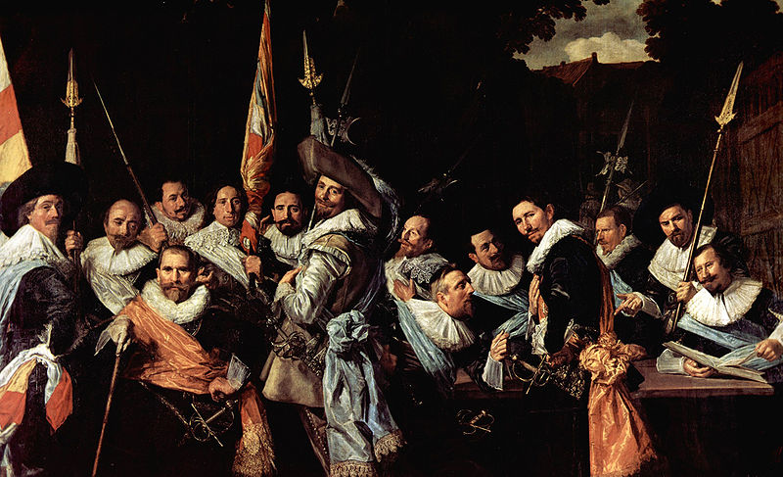

Slide 6
Notes p. 1-2
a) Caravaggio The Conversion of Saul
S. blinded by light on road to Damascus; scene realistic and dramatic. How is it so?
Accurate texture, earthy colours – “naturalism”
Takes place “at our feet” – S. close to us, abruptly foreshortened, leaning into our space and drawing us into scene.
Strong light and dark areas –
CHIAROSCURO (light-shadow)
Light picks out S’s expressive face
and arm gestures.

Slide 7
b) Rubens The Raising of the Cross
Cross is pulled up by Roman soldiers. Scene realistic, dramatic, full of energy and movement. How?
Unlike stable Ren. Pyramid (remember Raphael’s ptg.), here the cross forms an unstable diagonal into space (“orthogonal”) so that movement increased and soldier seem to lean into “our” space.
Strong CHIAROSCURO – light falls on Christ, directing us continually back to him.
Rich colours and textures – naturalism
Huge, muscular, “Michelangelesque”
figs, straining – typical of
Rubens.

Slide 8
c) Rembrandt The Night Watch
Militia co. (similar to police force); each member wd pay to have portrait included. Rem’s ptg different from earlier such portraits in its feeling of movement (as opposed to static line of men) and drama (as if something is happening).
Orthogonal movement – comp. seems to surge from back to front.
Lots of diagonals formed by spears – adds movement.
CHIAROSCURO – dark shadows contrast with Rem’s characteristic golden light.
Some figs cut off – extends space into ours.
Rich, earthy tones - naturalism

Slide 9
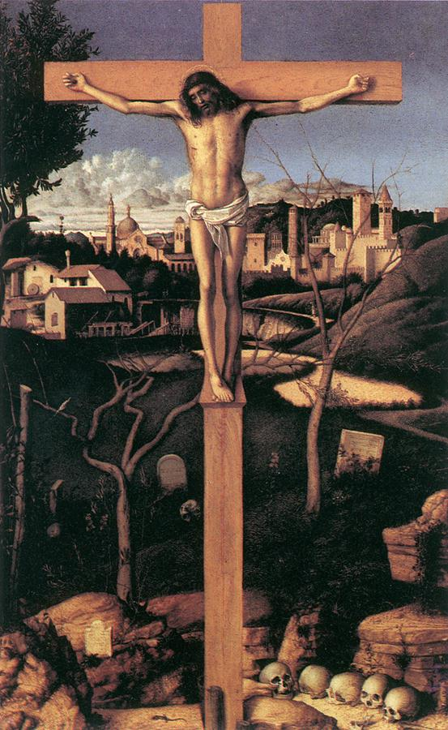
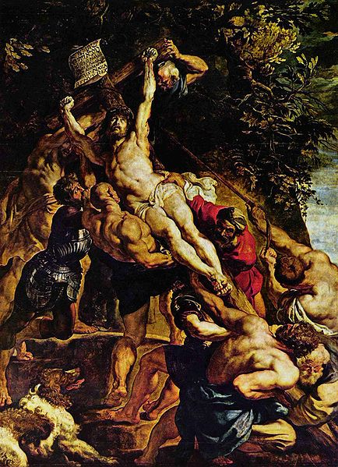
High Renaissance Baroque

Slide 10
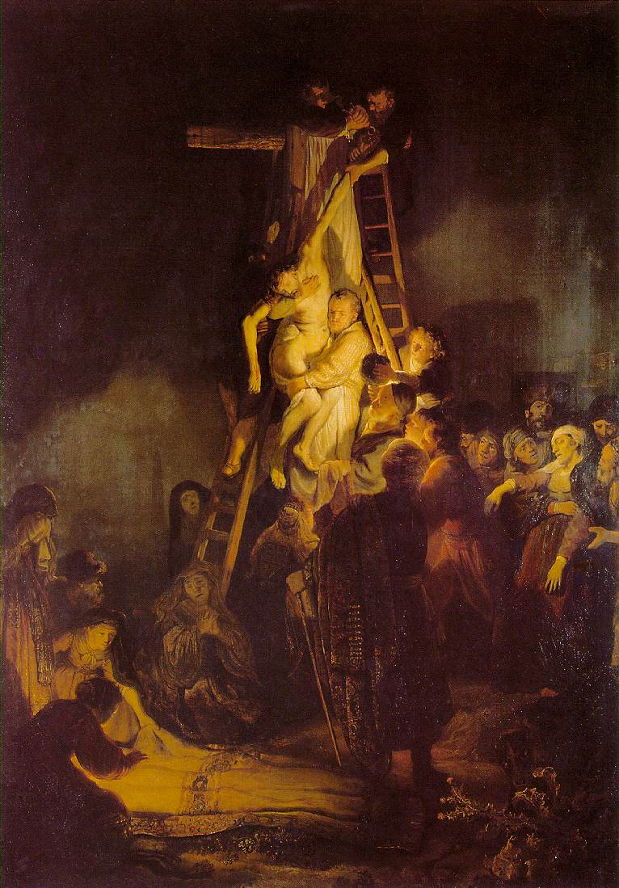
The Descent from the Cross
Compare this
version of the
Crucifixion with
Ruben’s painting.

Slide 11
High Renaissance | Baroque
Controlled emotion, etc. Evenly diffused light (same all over) Stillness – calm, subdued poses | Strong emotion, etc. Strong Chiaroscuro – strong light/dark contrasts Movement, exaggerated gestures, poses, facial expressions
2. Space Tho’ there is deep space, shallow space is emphasized by figs placed on front plane Pyramid structure confines image within frame. | 2. Space Deep space emphasized by strongly foreshortened figs and objects; action on orthogonal. Figs and objs often seem to “break out” of frame into viewer’s space.

Slide 12
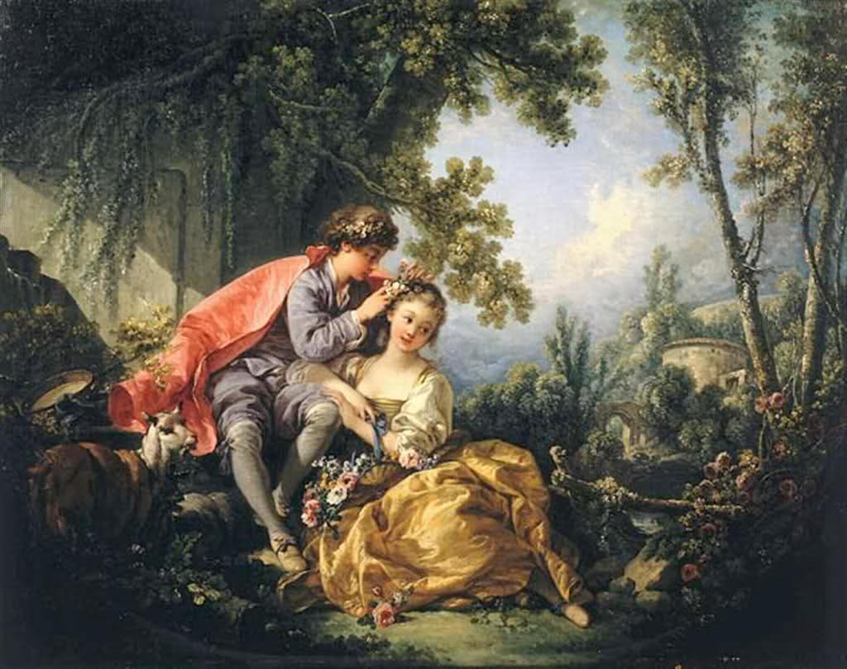
ROCOCO (late Baroque watered down to mere frivolity!)
Francois
Boucher

Slide 13
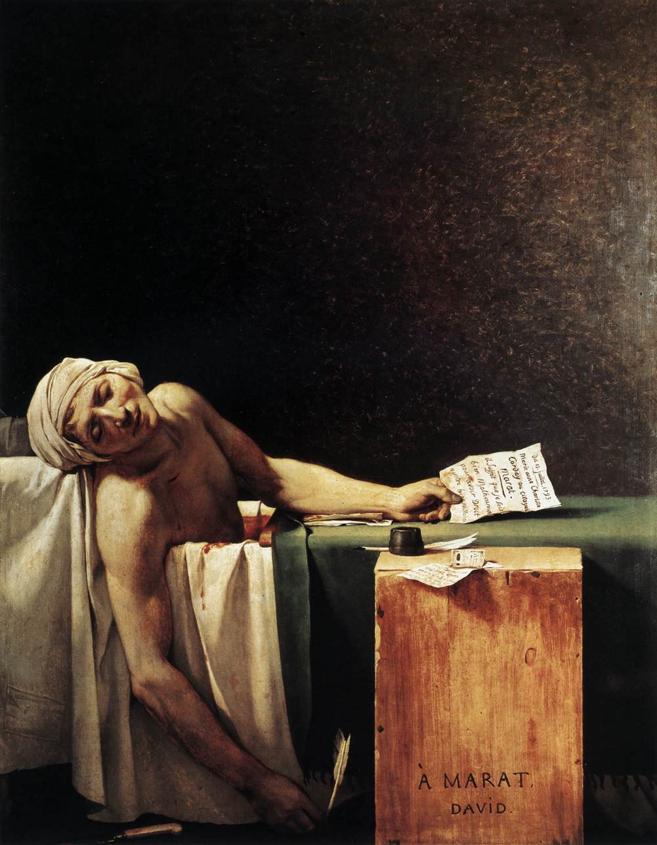
NEOCLASSICISM (C.1750 – 1800)

Slide 14
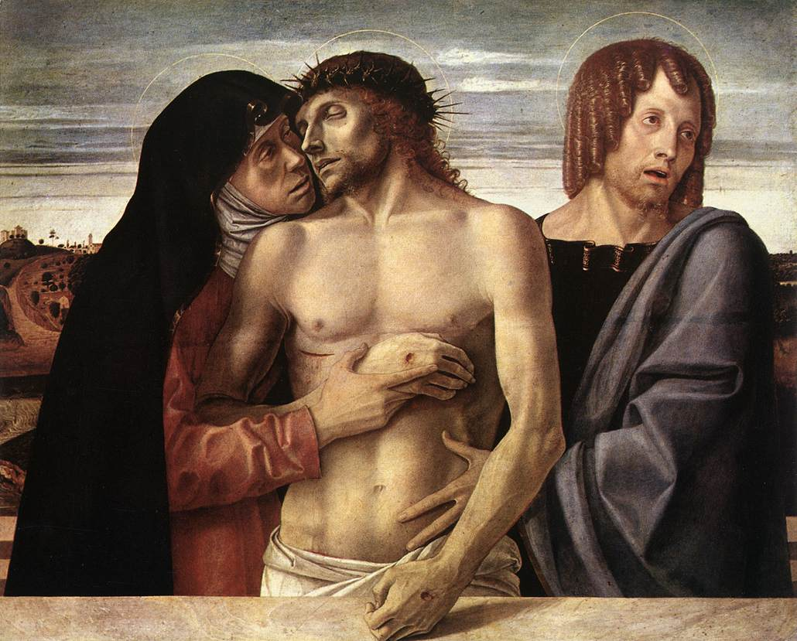

Slide 15
P.3 Notes Neoclassicism Neo: New Classical Era: Greek and Roman Era
b) Similarities to the High Renaissance
-was a rebirth of ideals of classical era (in art, literature, philosophy), therefore there are similarities betw Neocl. And High Ren ptgs (tho subj matter differs).

Slide 16
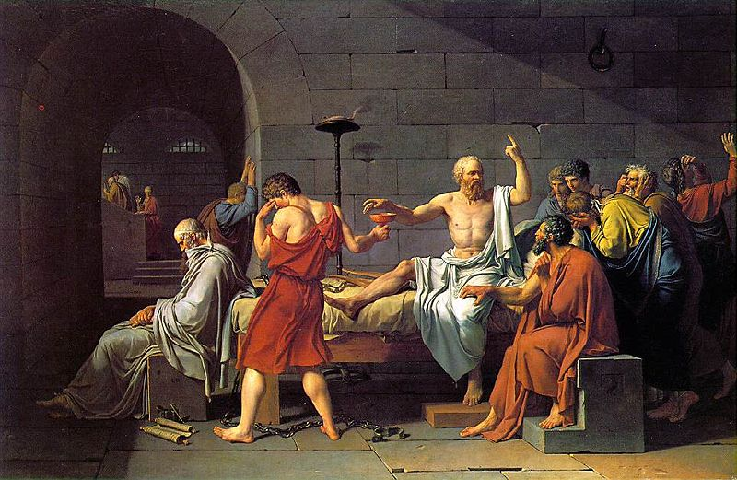

Slide 17
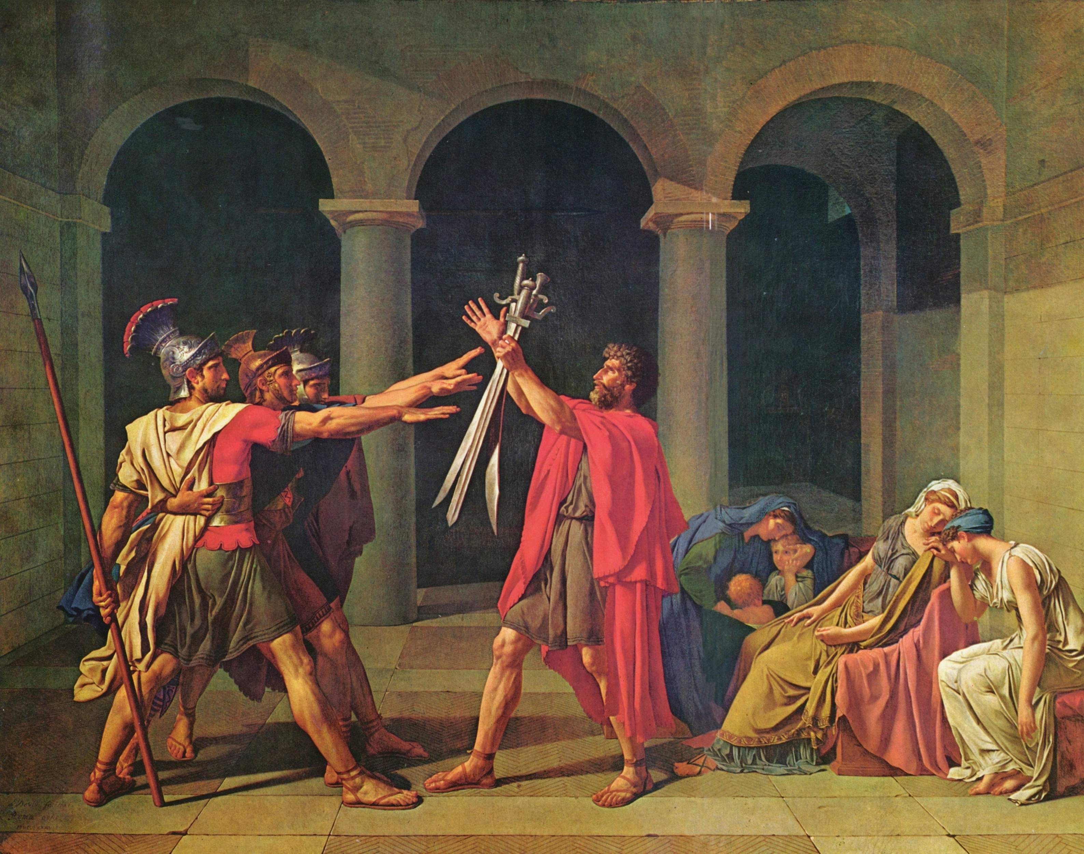

Slide 18
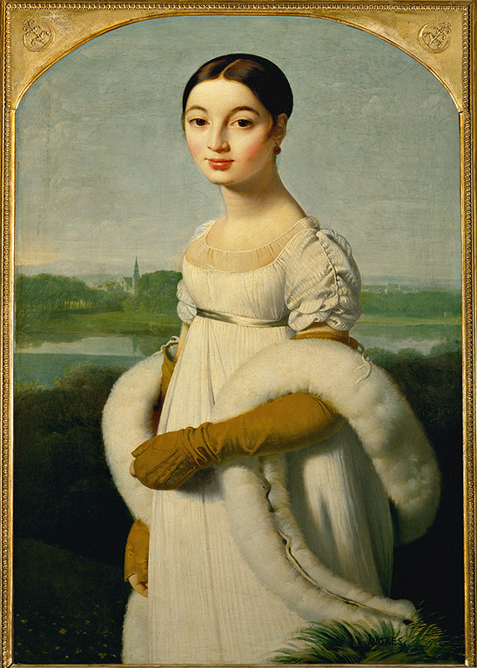
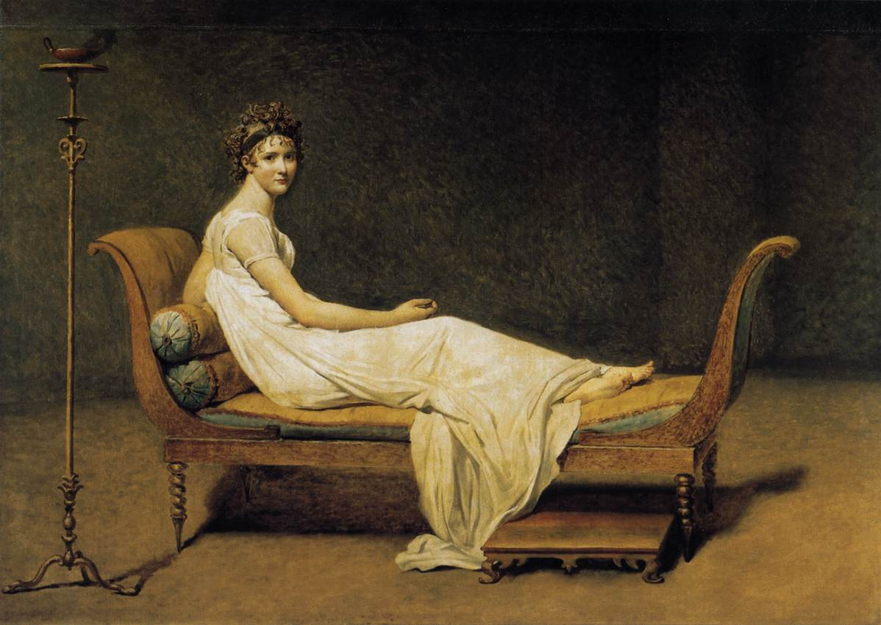

Slide 19
Notes p. 4
a) David The Death of Marat
Marat in medicated bath (had skin disease), and
Charlotte Corday has just stabbed him. What
makes this Neocl?
Emphasis on clear image in immediate forgr;
clean edges (termed LINEAR).
2. Comp. parallel to picture plane; horiz/vert. – very stable
3. Carefully organized, dramatic lighting – focus on face.
4. Empty backgr., little detail, subdued colour – SEVERE (ie. no embellishment)
5. Calm facial expression and little blood; we are to admire M. as a martyr of the Revolution. Reference to Bellini’s Pieta in hanging arm. Picture is more intellectual than descriptive of scene.

Slide 20
b) Ingres Mademoiselle Riviere
Ingres was student of David – reinterpreted
his teacher’s Neocl. vision; also inspired by
Raphaels’ precise drawing and idealization.
Shows clean, carefully drawn edges and
sinuous line; to Ingres, drawing (ie. Line as opposed to colour) was EVERYTHING.
2. Idealized portrait of calm, noblewoman; emphasis on blues makes her look cold
and aristocratic.
3. Horiz/vert. comp. – calm, severe.

Slide 21
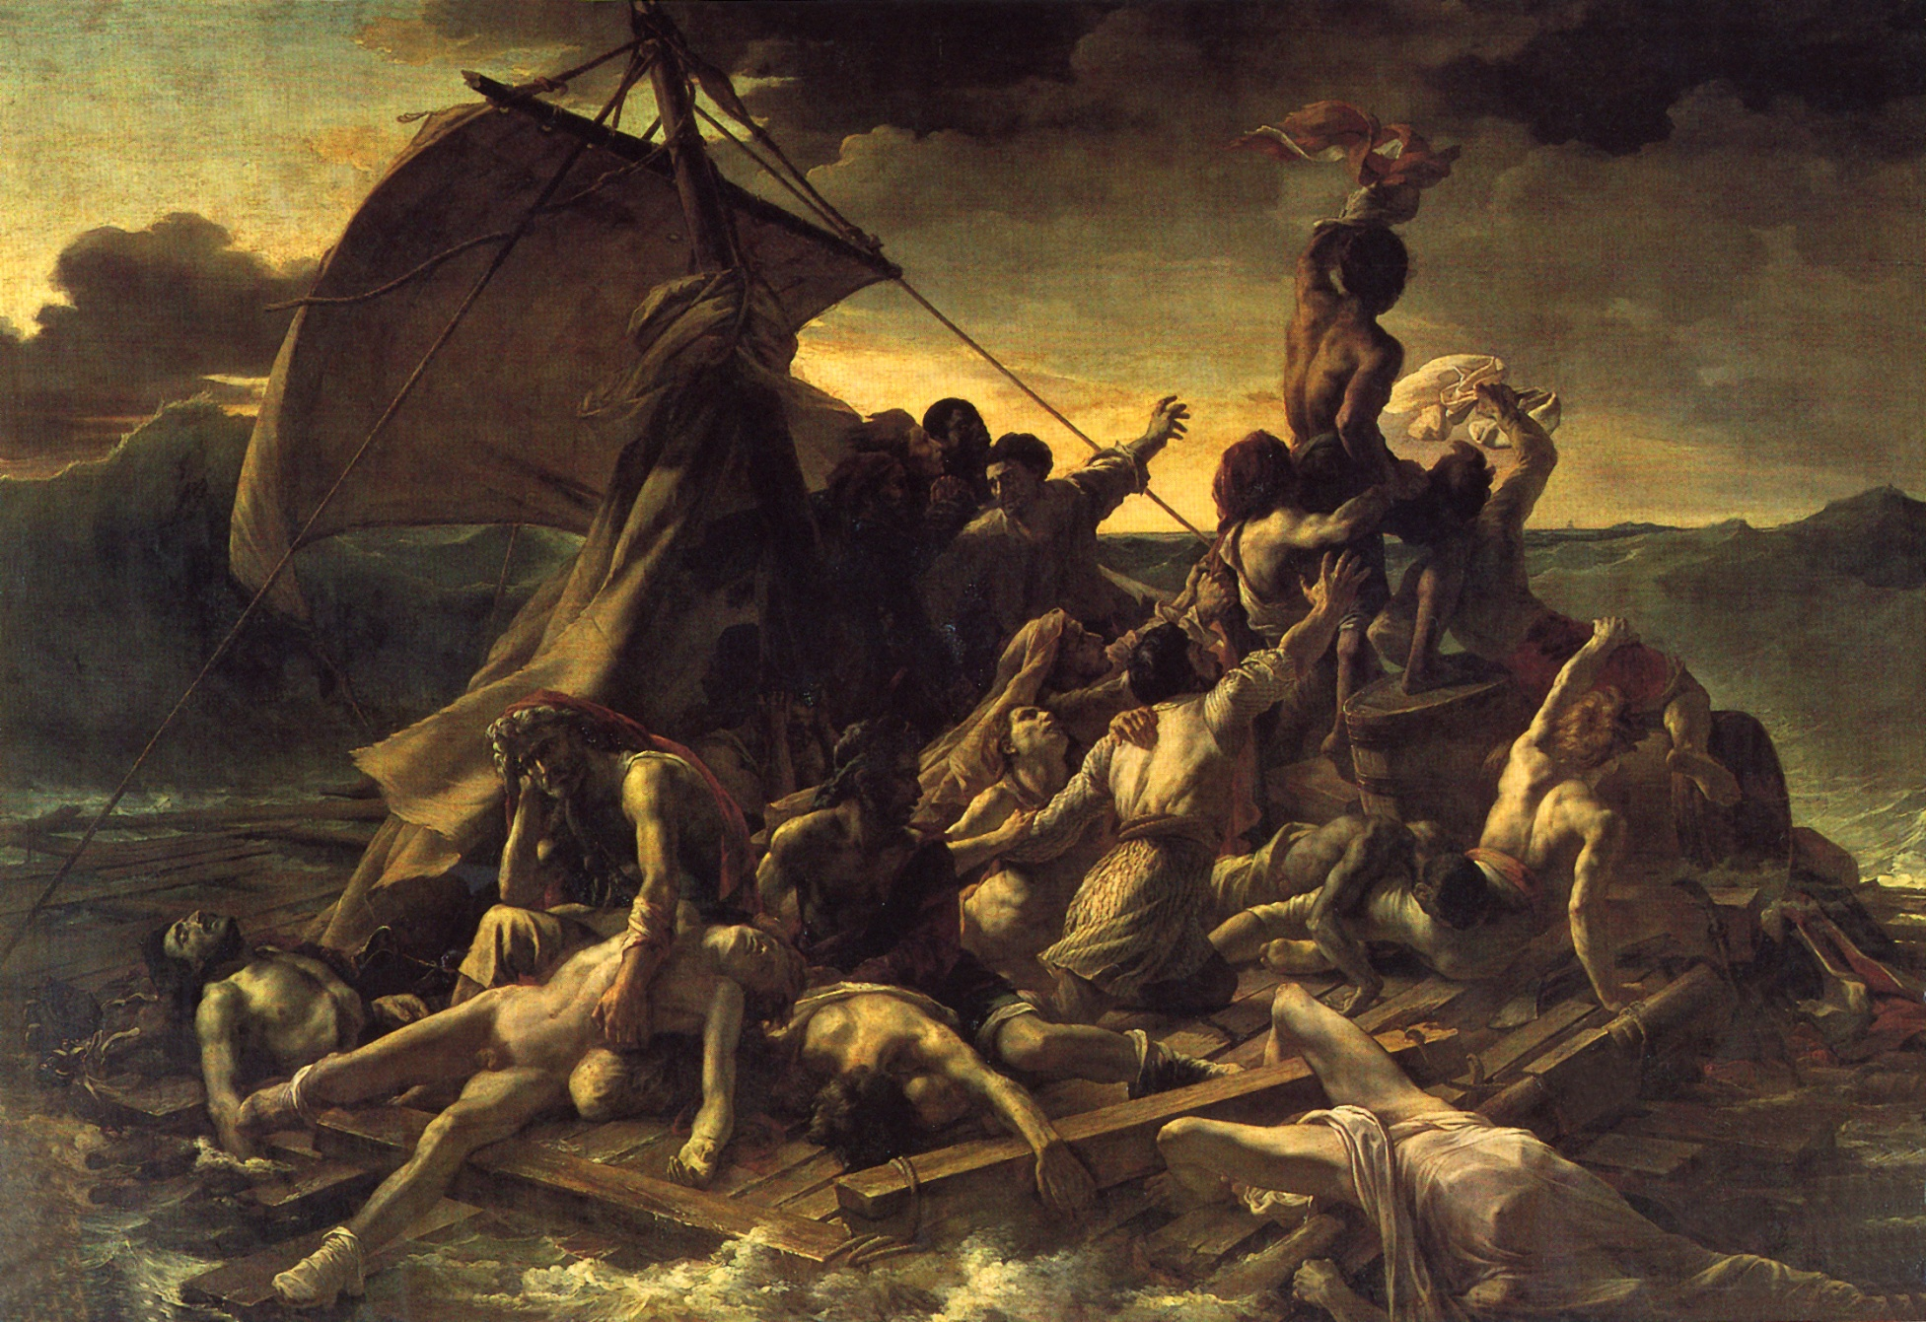
ROMANTICISM (c. 1800 – 1850)

Slide 22
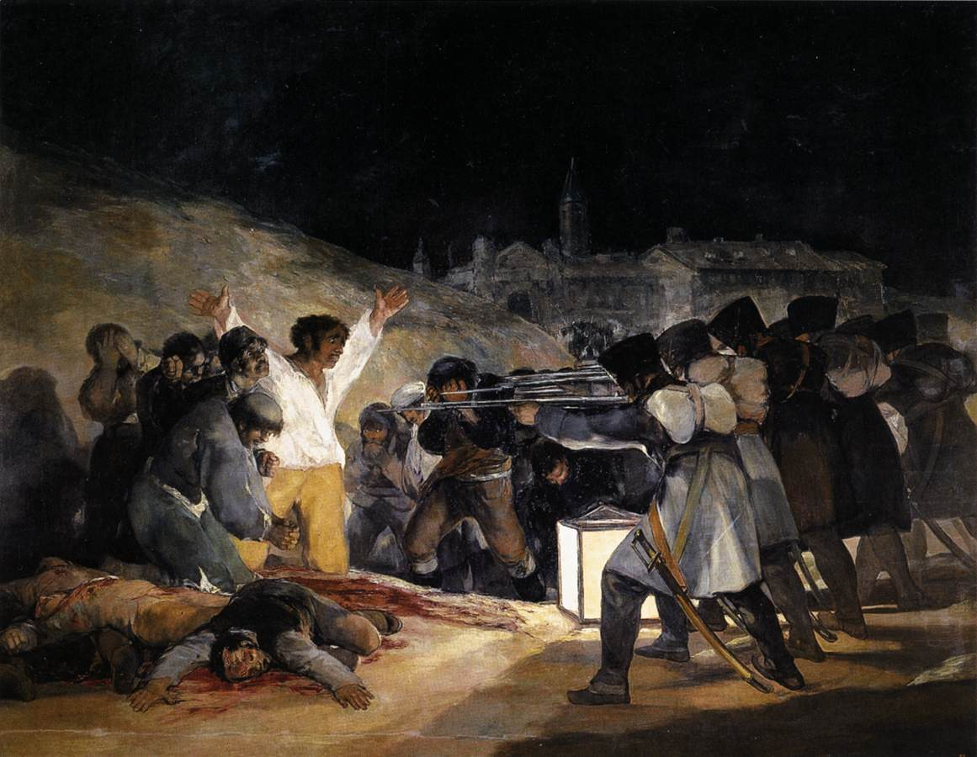

Slide 23
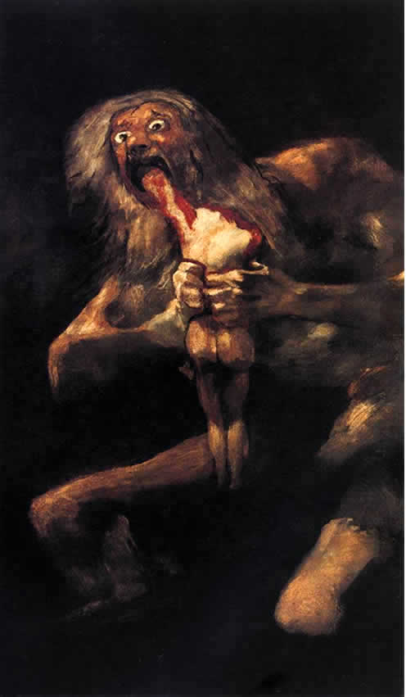
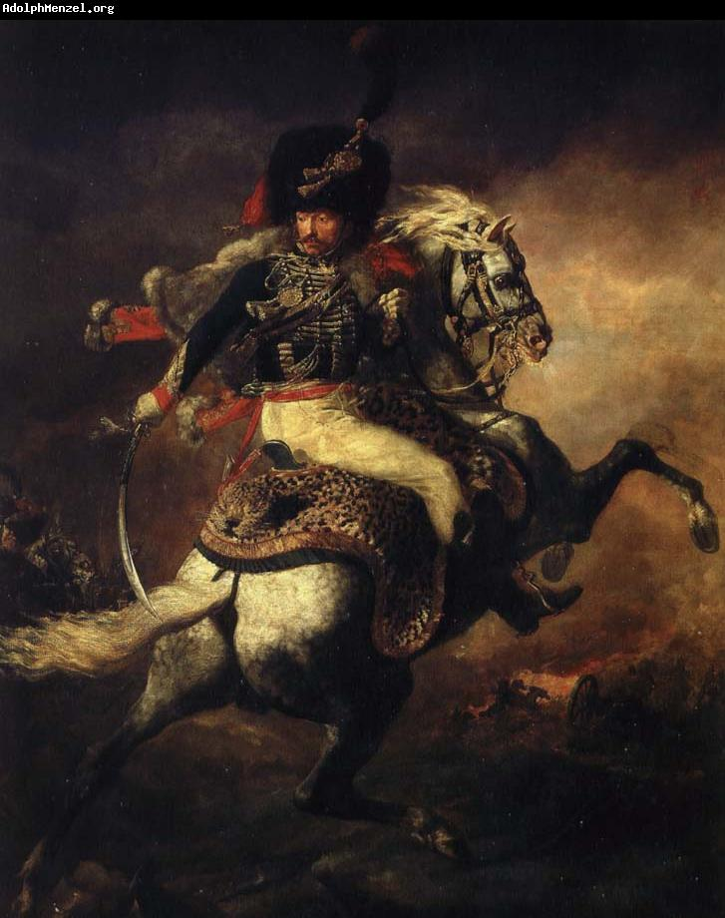

Slide 24
Notes bottom p.4
Romanticism
b) Rom. – drama, emotion, love of the horrific (Neocl. = order, severity, virtue)
c) Similar to Baroque in style (movement, colour,
Chiaroscuro); but Rom. subj. more human-oriented, esp. concerned with the darker side of life.
a) Géricault The Raft of the Medusa
15 of 149 survivors of shipwreck off African
Coast, due to incompetent commander. What
makes this Rom., besides tragic subj.?
Strong chiaroscuro – dramatic back lighting in stormy sky.
Series of orthogonals; strong thrust from front to back right where African frantically tries to hail ship in distance.
Exaggerated gestures and features of dying and struggling victims (influence of Michelangelo in figs).
High emotional intensity – humans in desperation and/or despair.

Slide 25
b) Goya The Third of May
In 1808 Napoleon occupied Spain, setting his brother on throne. Citizens of Madrid rebelled against French reforms continually and this shows resulting executions.
Horror of scene heightened by:
1. Blood splashed on ground (remember how little blood in Marat).
2. Wild faces and gestures.
3. Strong, eerie lantern light focusing attention on “Christ-fig. in white.
4. Robot-like soldiers and their proximity to victims.

