Slide 1
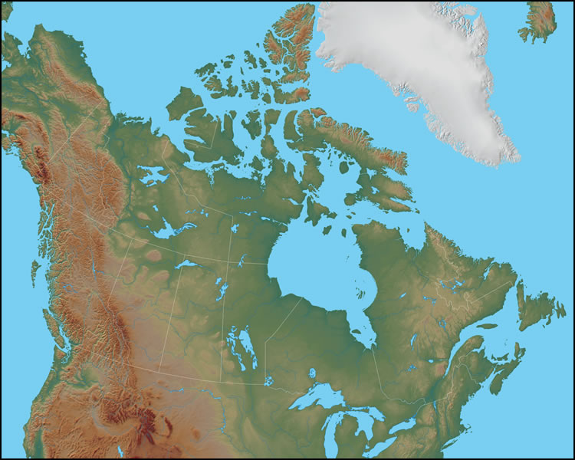
CANADA
The
Early ExplorerS

Slide 2
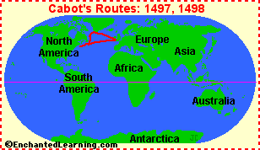
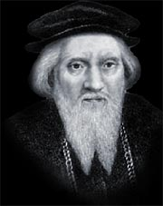
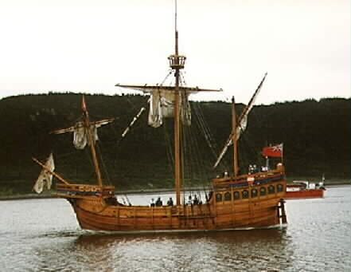
Giovanni Caboto (John Cabot) 1450-c.1500
Replica of Caboto’s ship,
the Matthew

Slide 3
What did Giovanni Caboto accomplish?
Although Caboto did not discover a route to Asia, he was the first European since the Vikings to land in North America and bring back news of a land teeming with fish and birds.

Slide 4
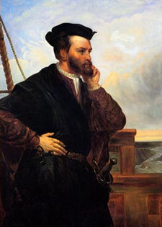
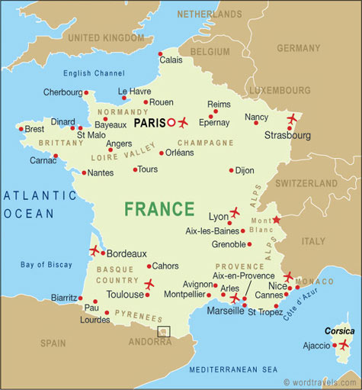
Jacques Cartier 1491-1577

Slide 5
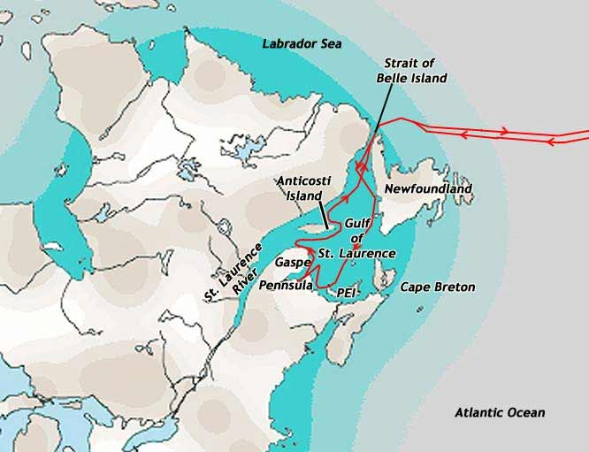
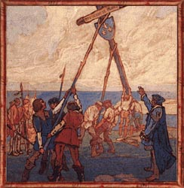
Cartier’s First Voyage 1534
Cartier raising a 30’ cross on the Gaspé Peninsula, watched by Donnacona and his people.

Slide 6
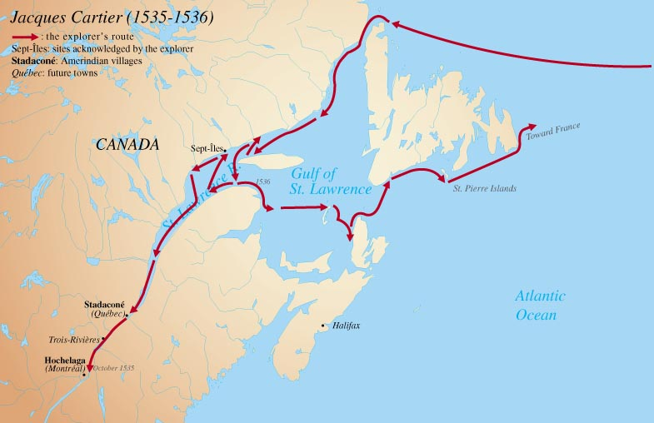
Cartier’s Second Voyage 1535

Slide 7
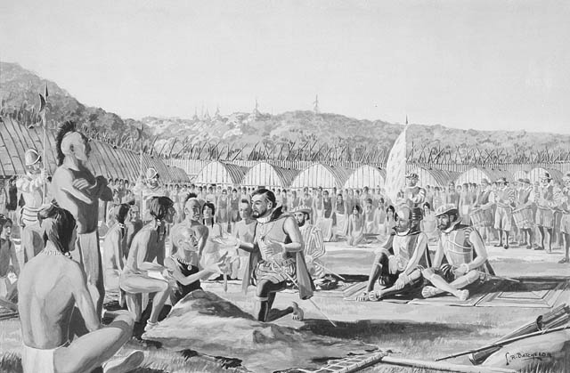
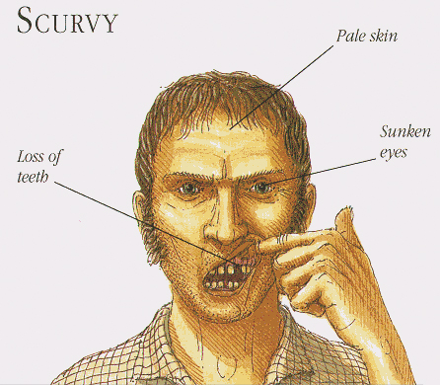
Cartier spent a miserable winter at Hochelaga (present-day Montreal)
About half the men died of scurvy,
caused by the lack of Vitamin C

Slide 8
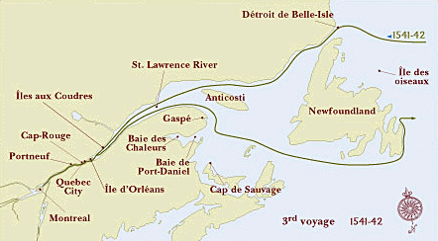
In 1541, Cartier came again from France and spent the winter at Stadacona (present-day Quebec City), waiting for his partner, Roberval, who only arrived after Cartier left.

Slide 9
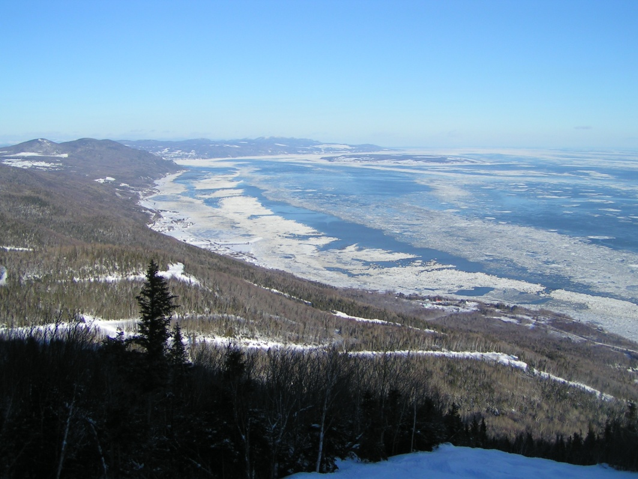
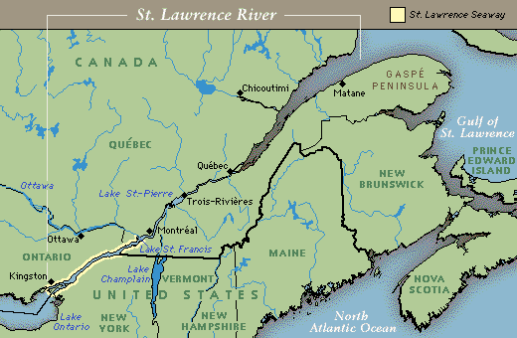
What did Jacques Cartier accomplish?
Cartier was the first to use the name, “Kanata” to refer to the new land.
Cartier was the first European to sail down the St. Lawrence River, and to discover it was in fact a very large river and not just a big bay.

Slide 10
THE END

