Slide 1
ART 10 ART HISTORY I
Early and High Renaissance

Slide 2
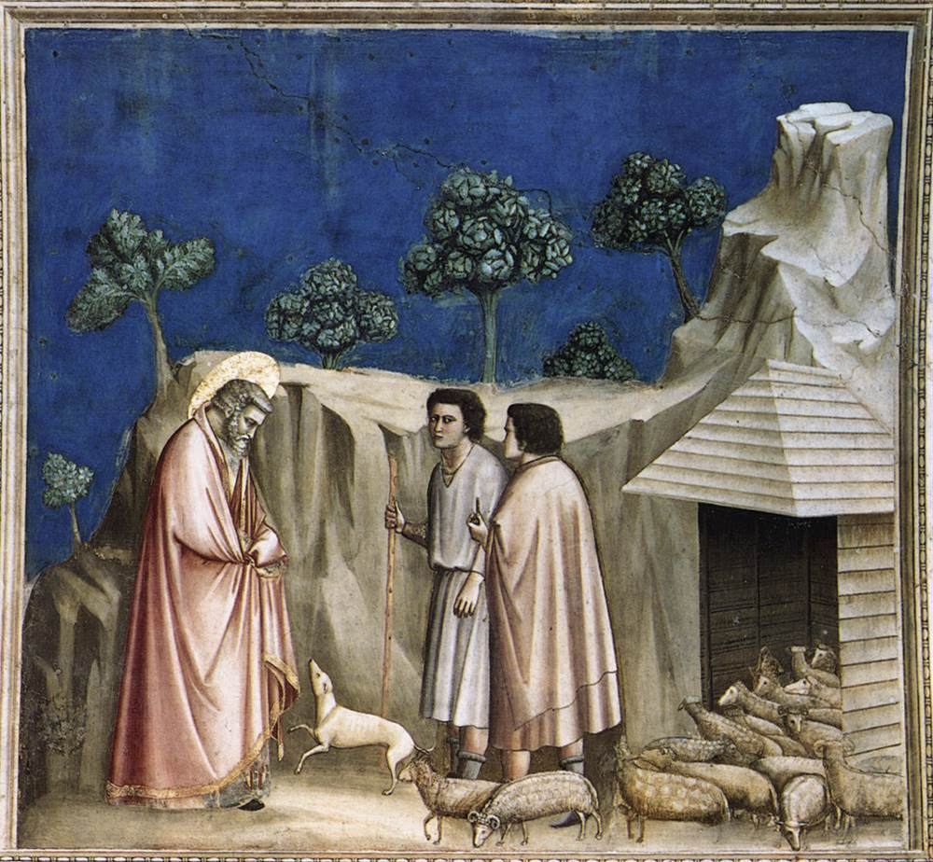
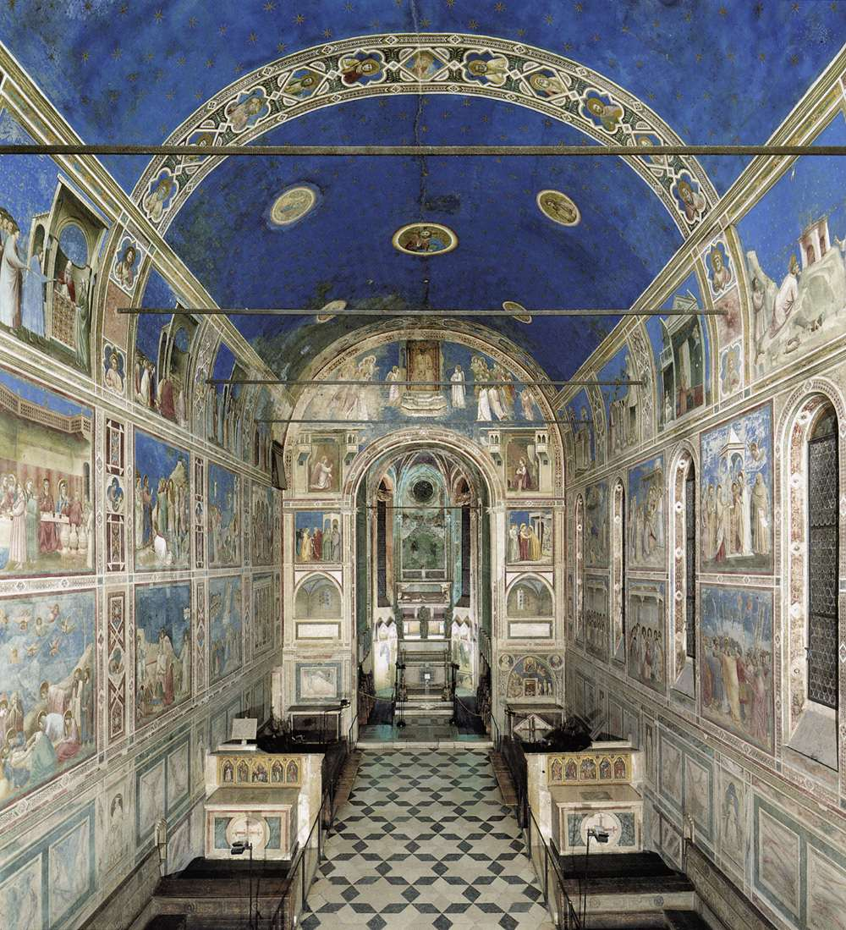
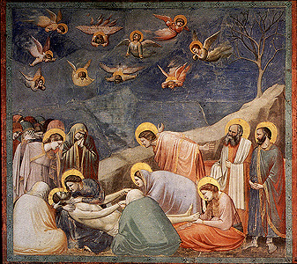
EARLY RENAISSANCE (C.1300 – 1400S)

Slide 3
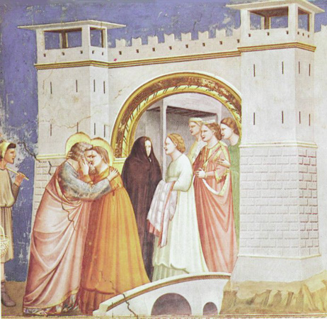

Slide 4
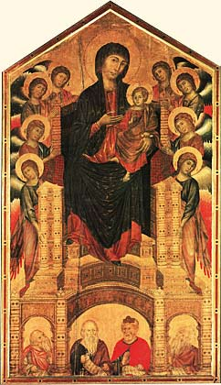
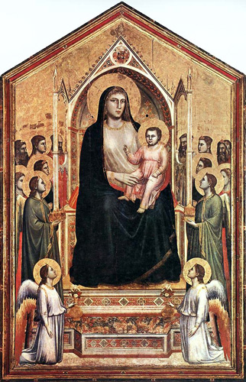
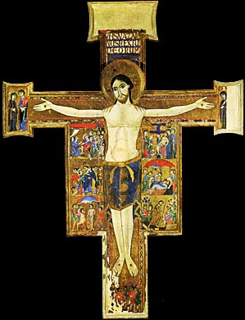
Compare Early Renaissance to Medieval Painting
Medieval Early Renaissance

Slide 5
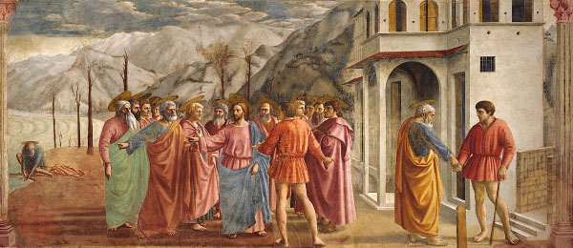
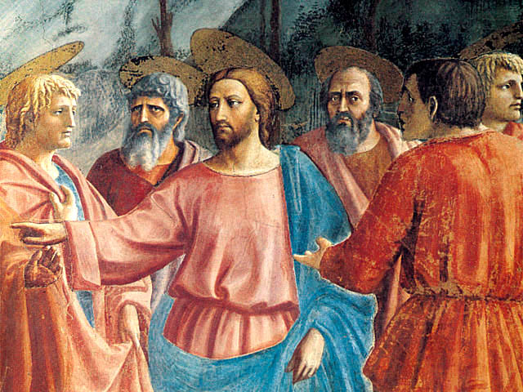

Slide 6
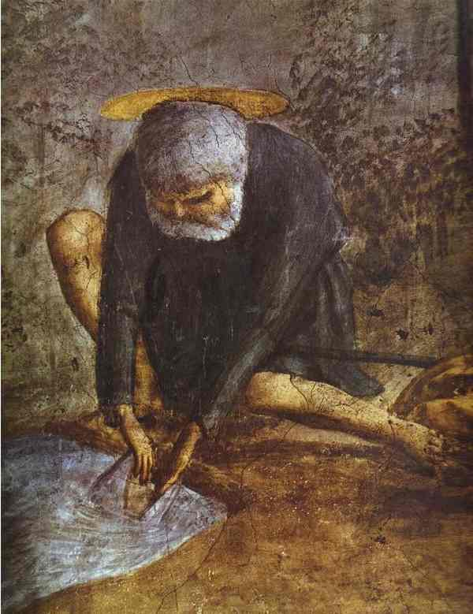
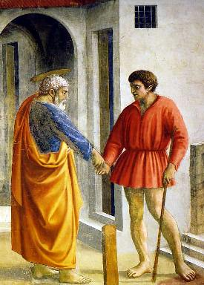

Slide 7
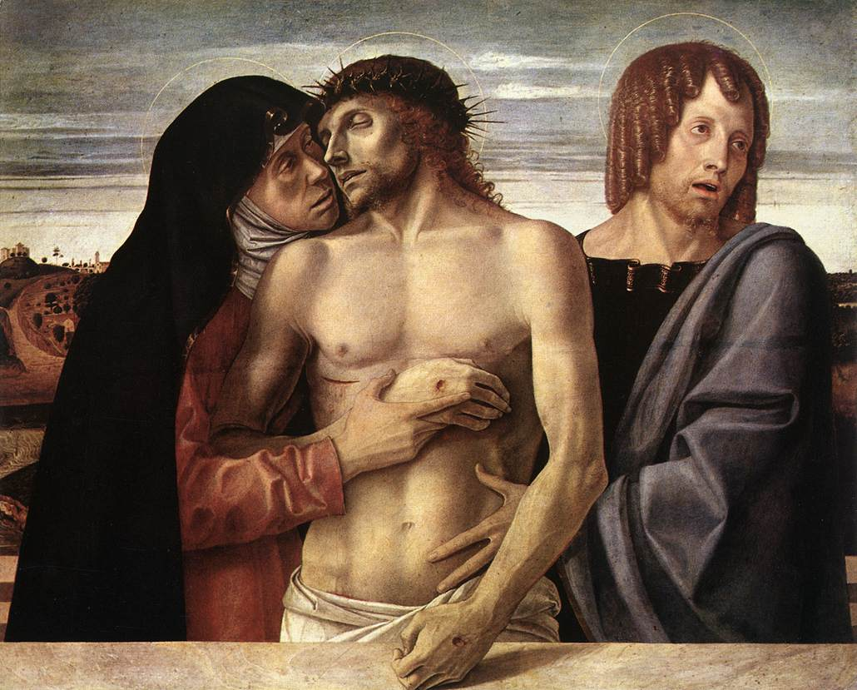

Slide 8
Notes p.11
Giotto Arena Chapel
Based on Golden Legend (13th c. Life of Mary)
More “realistic” than medieval: how?
Softer colours
Figs. modelled, drapery falls naturally, heavy bulky figs.
Figs. relate to each other; human warmth in facial expressions & gestures.
Perspective gives sense of depth in bldgs & landsc, tho not quite accurate, & still fairly shallow
Haloes are like flat discs, & not in persp.
Masaccio The Tribute Money
Masaccio picked up where Giotto left off, altho 100 yrs. Later. Art “regresses” to older styles after BLACK DEATH of 1348-49
Ptg. Is story of Christ telling Peter to get tax $ from fish’s mouth (Matt.17:27)

Slide 9
Deeper space, persp. more accurate.
Bulky, solid, well-modelled figs. in soft drapery
Light from one source outside ptg., so things are illuminated consistently
Haloes – discs still, but seen in persp.
Bellini Pieta
Dead Christ with Mary and disciple John
Accurate anatomy, fairly softly modelled skin
Colour naturalistic
Emotion important – facial expressions give strong impact of pathos
DEEP SPACE – landsc in distance (but still in sharp focus)
Halo reduced to thin gold line – more emphasis on earthly than spiritual

Slide 10
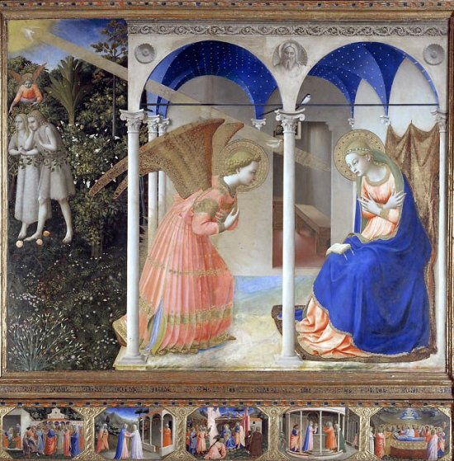

Slide 11
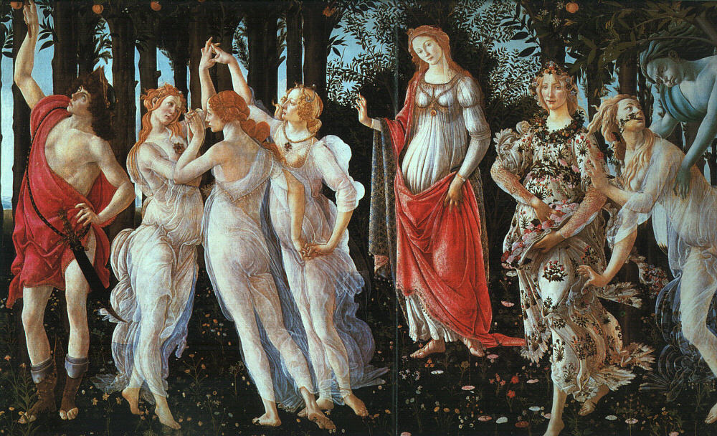

Slide 12
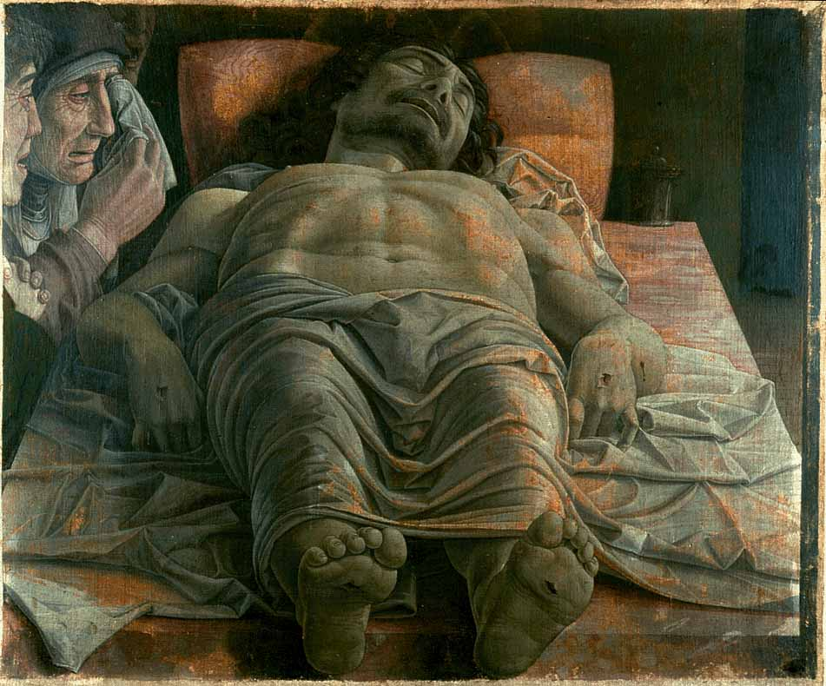

Slide 13
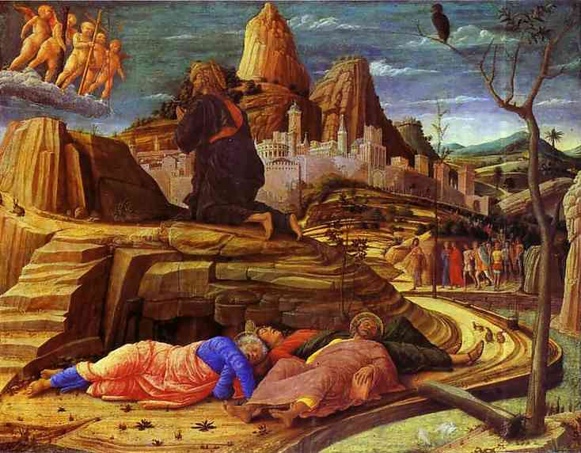

Slide 14
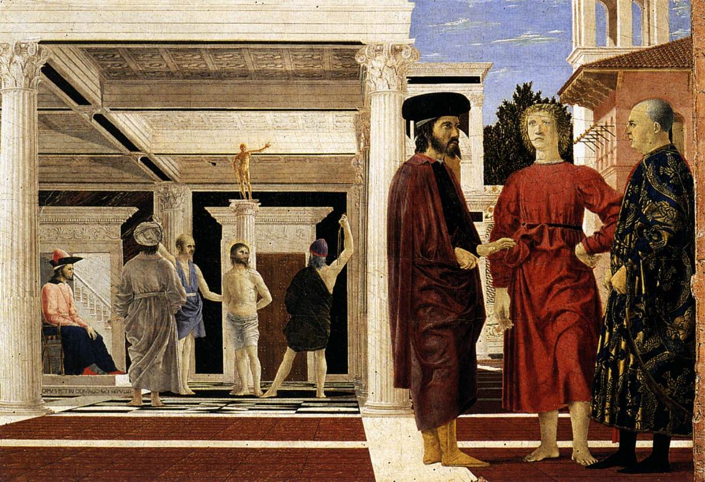

Slide 15
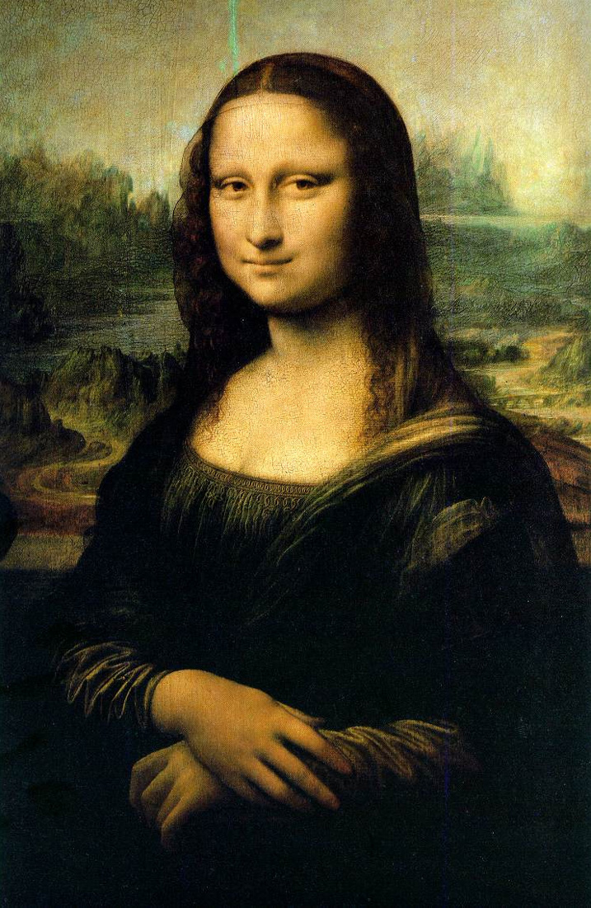
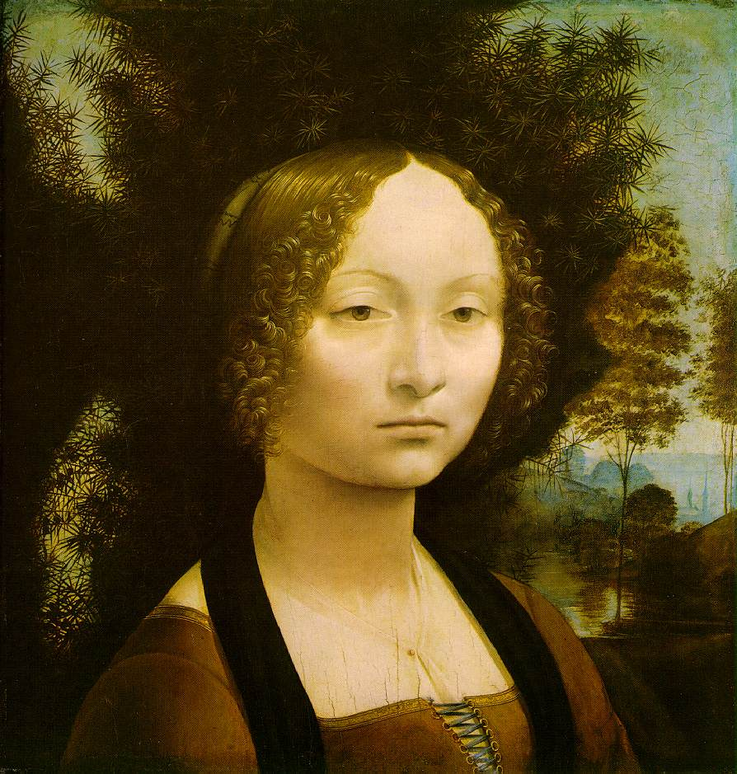
HIGH RENAISSANCE (c.1500 – 1550)

Slide 16
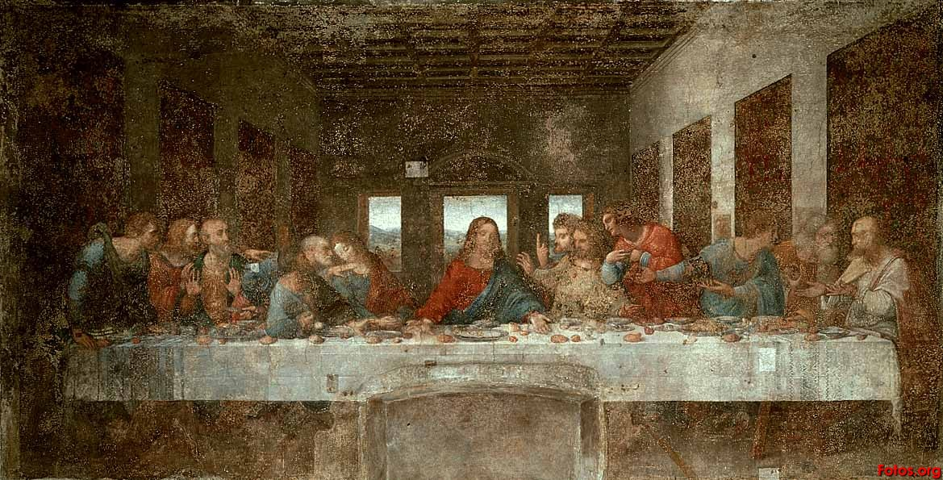

Slide 17
Notes p.13
Da Vinci – mysterious, aloof; great intellectual, left 1000s of pgs. of notebooks.
How is the Mona Lisa so innovative?
Sfumato (from Italian “fuma’, smoke) – a soft focus or smoky look around form, as if in mist. Unlike hard, clean edges & sharp detail of E. Ren.
Aerial, or Atmospheric, persp. – things in distance get fuzzy, like in real life
Pose is new, at ¾ angle (instead of profile or en face)
Skin very softly modelled; eyes & smile give mysterious, psychological impact (this latter pt., together with fact ptg. Stolen in 1911 from Louvre by an Italian who thought it shd come back to Italy, has made ptg. the cultural icon it is today.

Slide 18
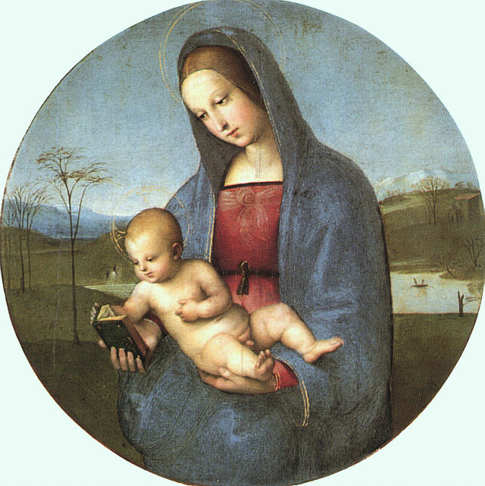
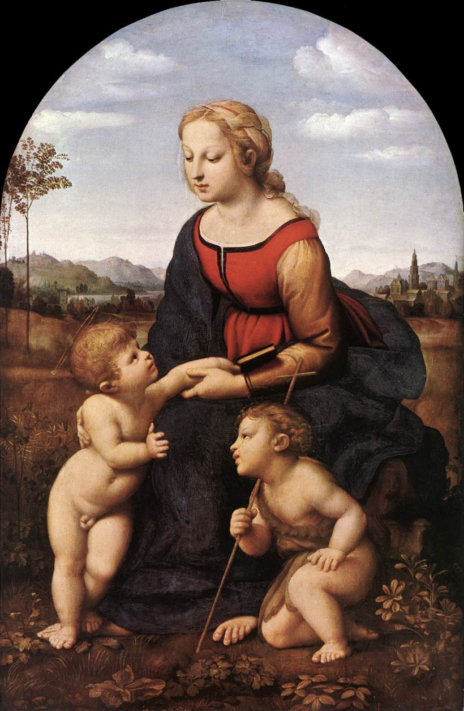
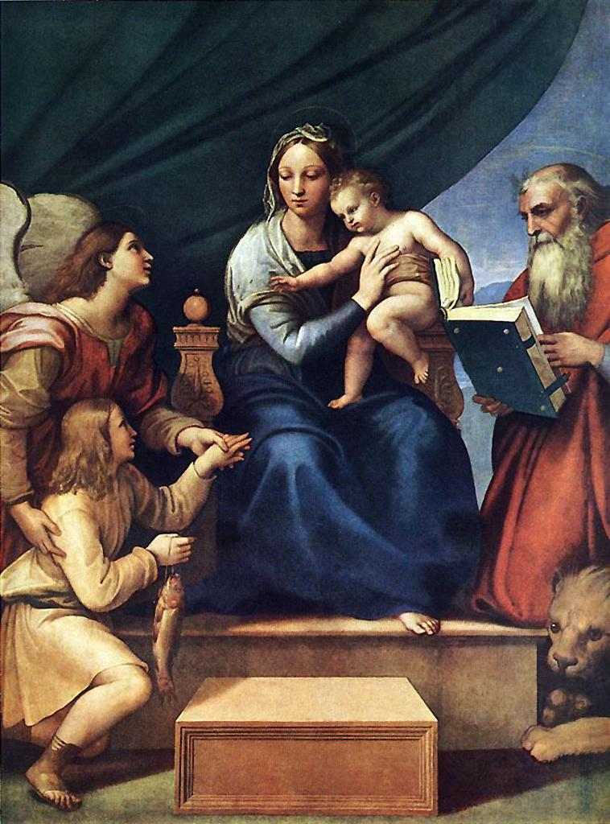

Slide 19
Raphael – Charming, handsome, gentle-mannered, well-liked
Ptg. Shows pyramid structure of composition typical of Raphael’s love of balance & order (High Ren. characteristic too); Mary at apex (top) & children from base. Gives stability, contributes to peace, repose.
Virgin’s face typical of Raphel – very sweet & gentle-looking: round, with large eyes, long straight nose, small mouth. Looks very maternal, unlike many earlier Madonnas.
Primary colours (red, blue, yellow) are simplest & purest, reflecting character of scene.

Slide 20
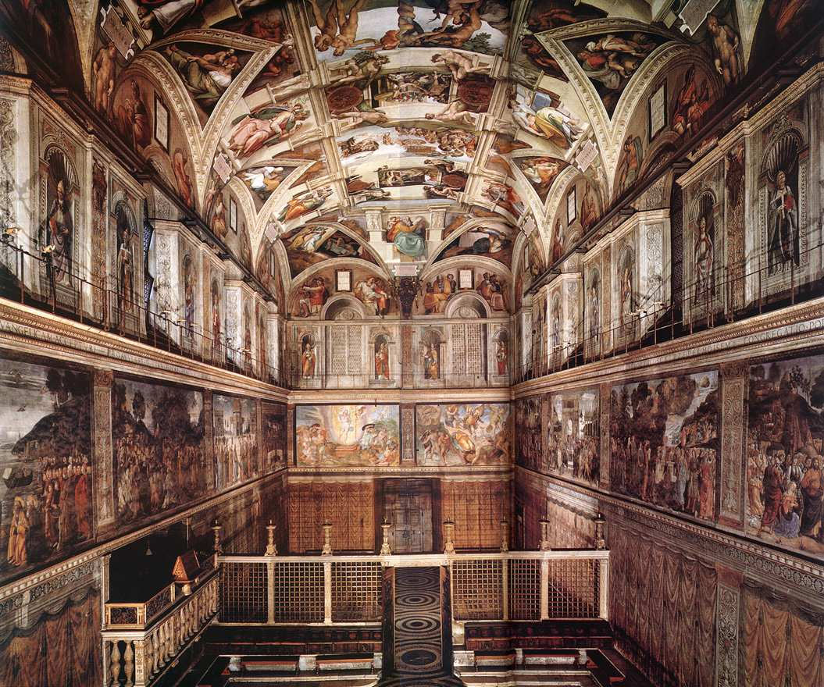

Slide 21
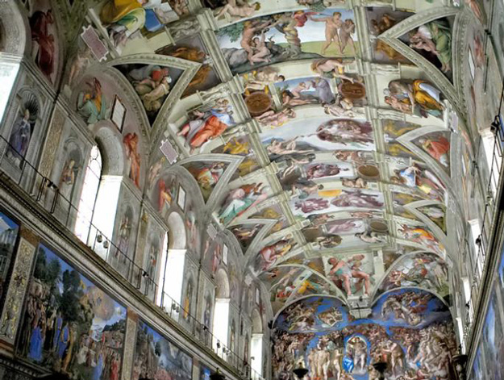
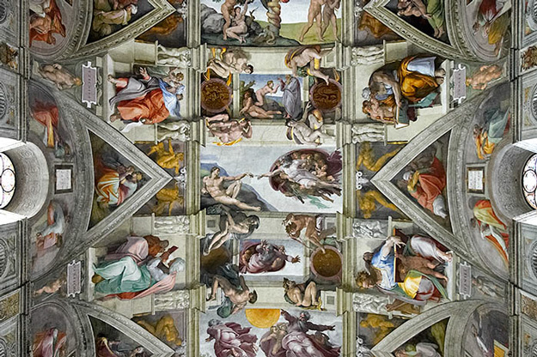

Slide 22
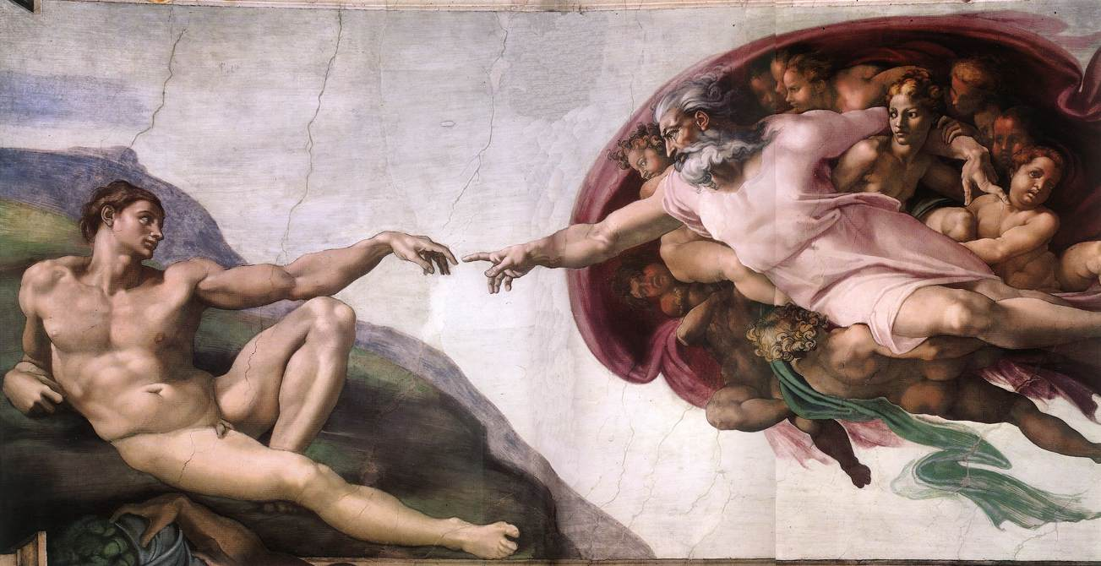

Slide 23
Michelangelo – Quarrelsome, even violent at times, therefore had to work alone most of the time; obsessively committed to his work
Studied classical sc. & drew from it regularly; also studied dead bodies; for him, the nude became a symbol of the spirit of man.
Here both Adam & God are huge, muscular figs. which emphasize man’s strength, his god-like qualities.
Scene is dramatic & full of energy in the almost electric near-touch of Father & Adam, & in strong feeling of movement of figs and drapery.

Slide 24
