Slide 1
ART 10 ART HISTORY I
Early Christian
Romanesque and Gothic

Slide 2
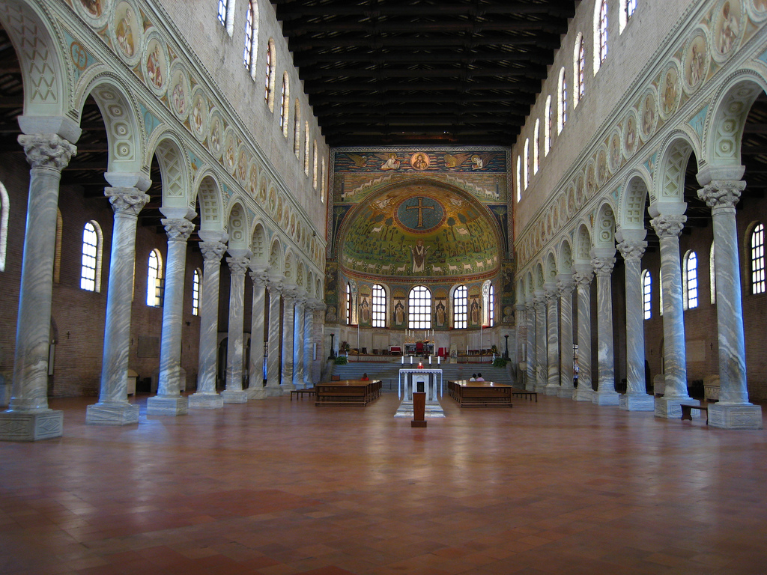
EARLY CHRISTIAN (c.100 – 500s CE)

Slide 3
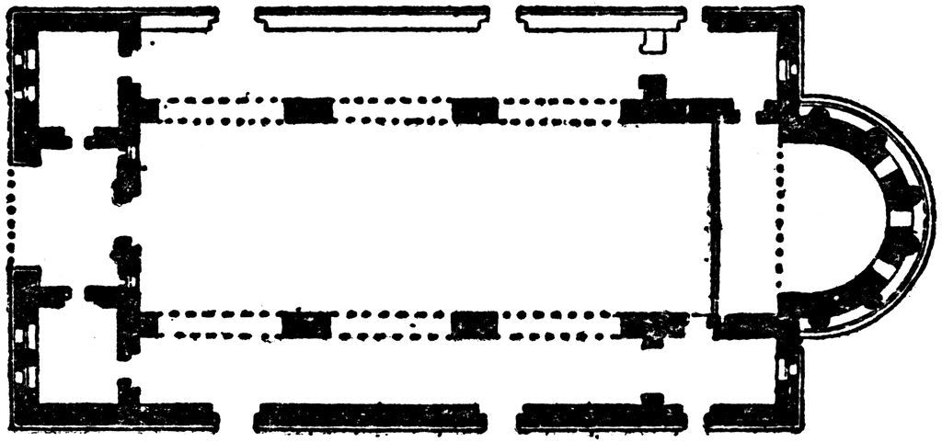
Narthex
West End Nave Aisles Apse

Slide 4
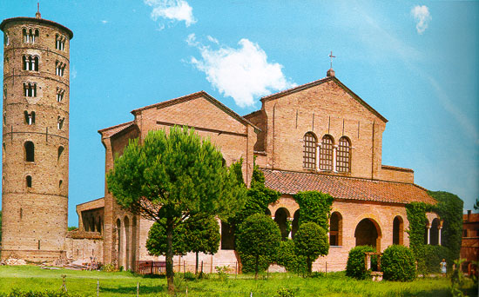

Slide 5
San Apollinare in Classe
Typical of the period; follows above pattern
1. rounded apse
2. 2 outside aisles; 2 storeys (aisle & clerestory)
3. colonnades separate nave & aisles
4. interior decorated with MOSAIC, FRESCO and COLOURED MARBLES: reflects Christian principle of the IMPORTANCE OF INNER OVER OUTER BEAUTY.
5. exterior is plain red brick.

Slide 6
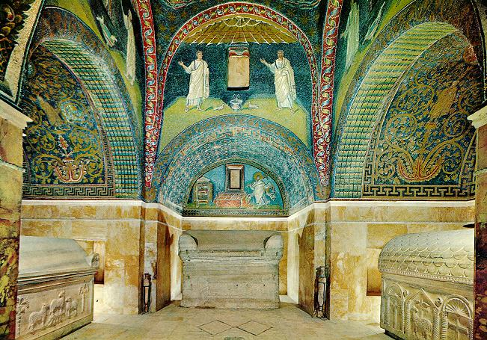
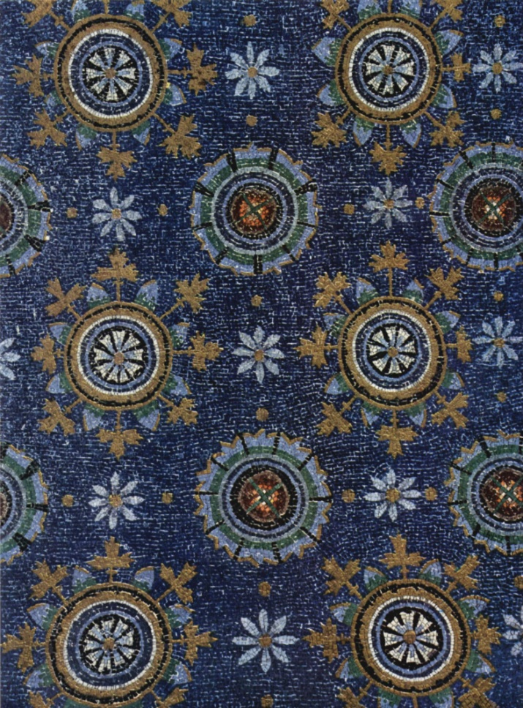
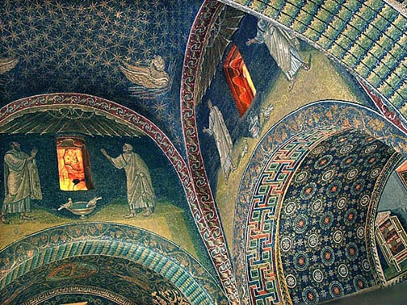

Slide 7
Notes p.8 What is Mosaic?
An image made up of small pieces of manufactured coloured glass called “tessarae”, from the Latin for “cubes”.

Slide 8
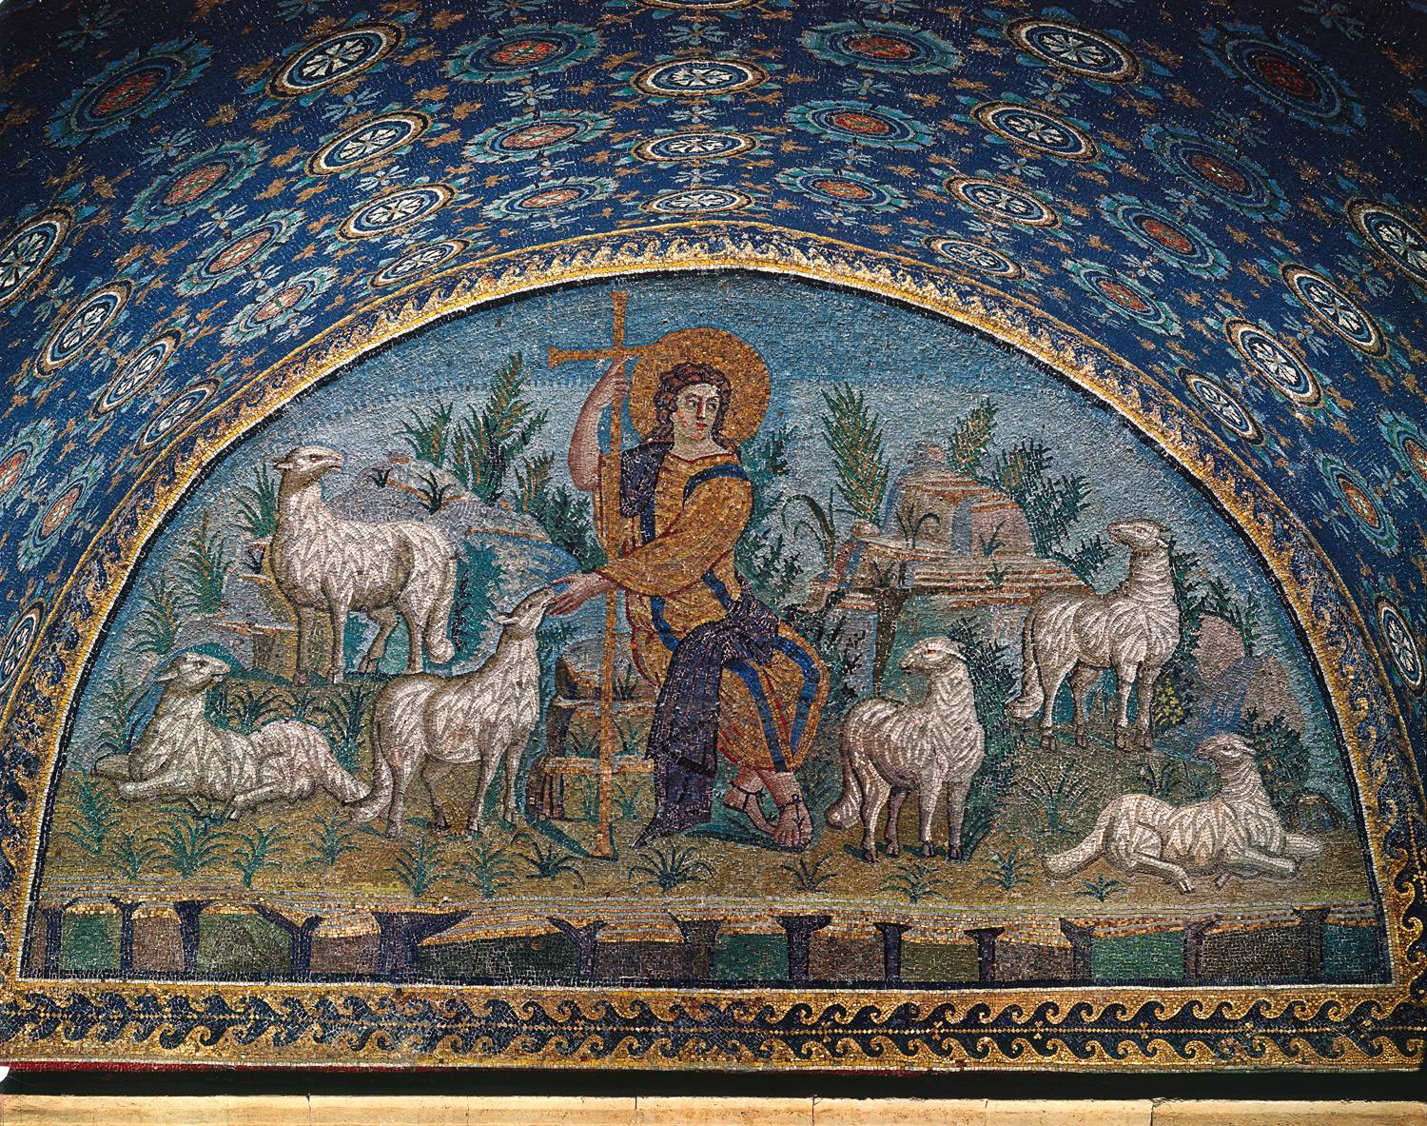

Slide 9
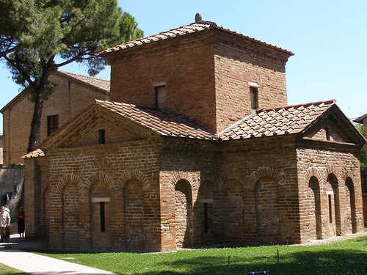

Slide 10
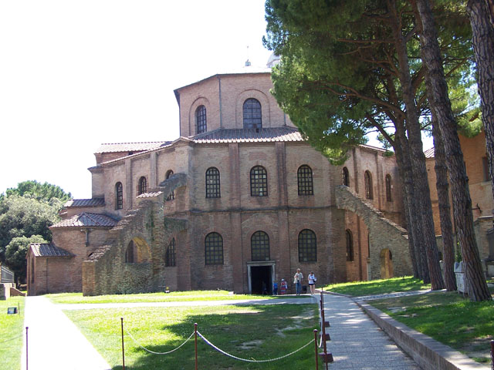

Slide 11
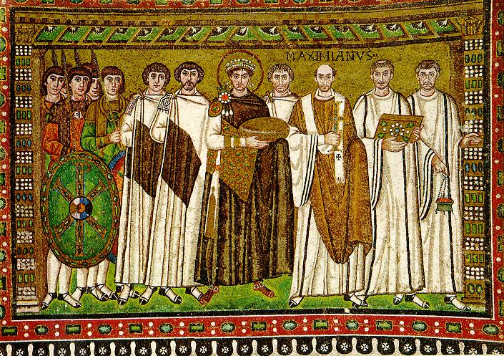
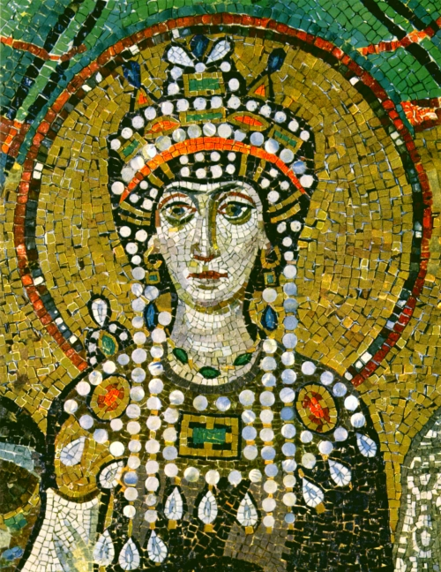
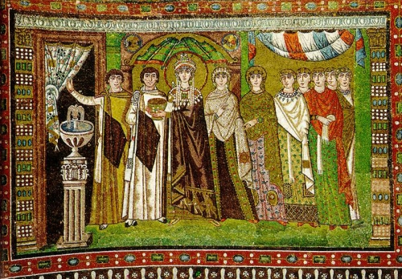

Slide 12
Notes p.8
Good Shepherd Mosaic
Christ as Good Shepherd: shows lingering influence of Roman ptg. in soft, natural colours, carefully modelled forms, natural landscape, & sense of perspective.
Theodora and Court
100 yrs later, shows move away from Roman Realism to eastern BYZANTINE style in the brighter and more decorative colours, outlines, less modelling, all which contribute to an overall FLATNESS.
Also, figures stiff and formal (like Archaic Greek sc.), staring straight ahead as if into another world.

Slide 13
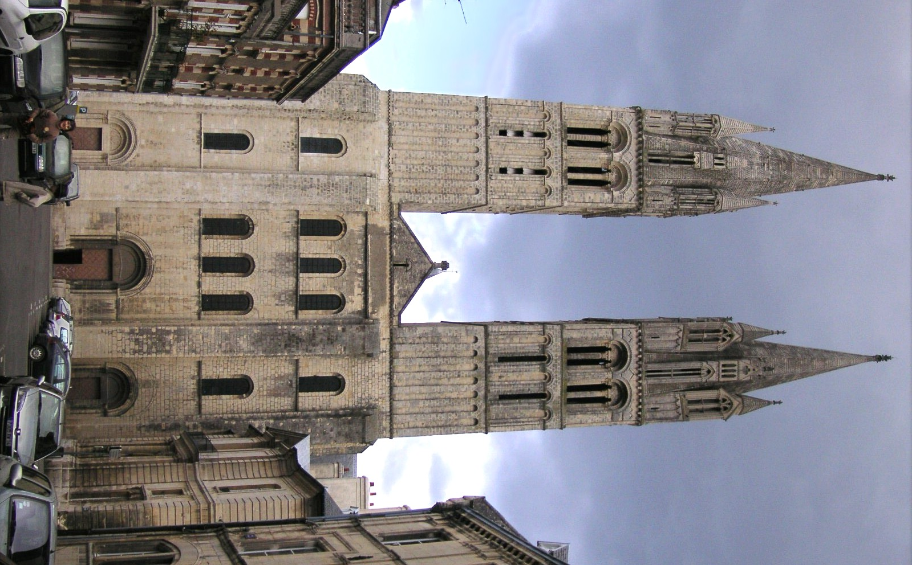
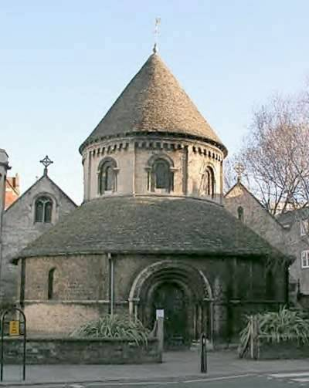
ROMANESQUE ARCHITECTURE c.1050-1125

Slide 14
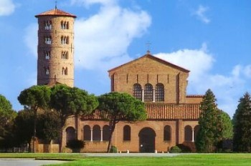
Romanesque
Early Christian

Slide 15
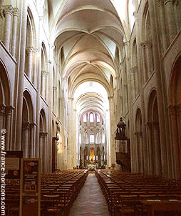
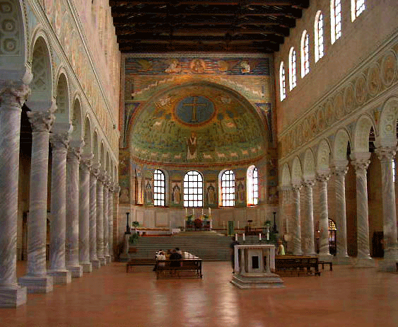
Early Christian Romanesque

Slide 16
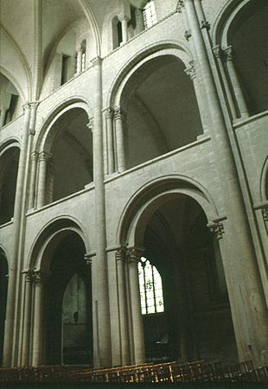
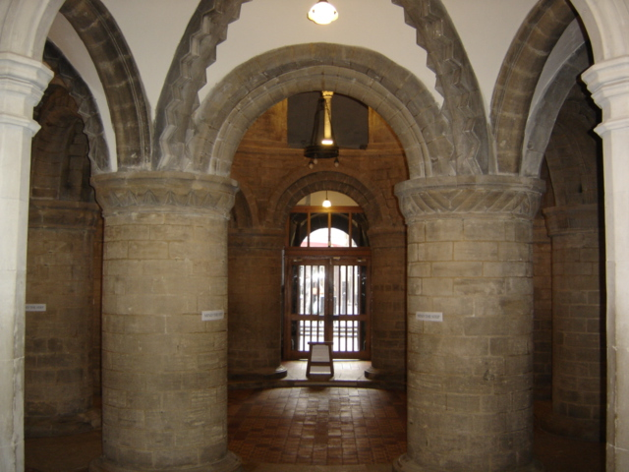

Slide 17
Early Christian Romanesque

Slide 18
Notes. P.10 St.-Etienne (Exterior)
Ext. now important visually – now includes details.
How?
2 towers on façade.
Organized into 3 sections vertically & horizontally, & in towers (reflects TRINITY).
Buttresses included to support heavy walls. ROUND ARCH allowed for greater height than E. Chr. Churches.
St.-Etienne (Interior)
3 storeys of approximately equal height
Storeys joined by “engaged” columns to try eye upwards
Church higher than E. chr., with heavy walls & somewhat larger windows.
Instead of flat, panelled E. Chr. Ceiling, groin vault with ROUND arch allows for larger interior.

Slide 19
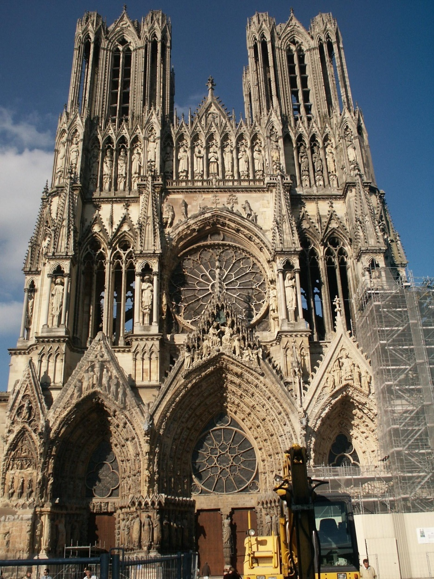
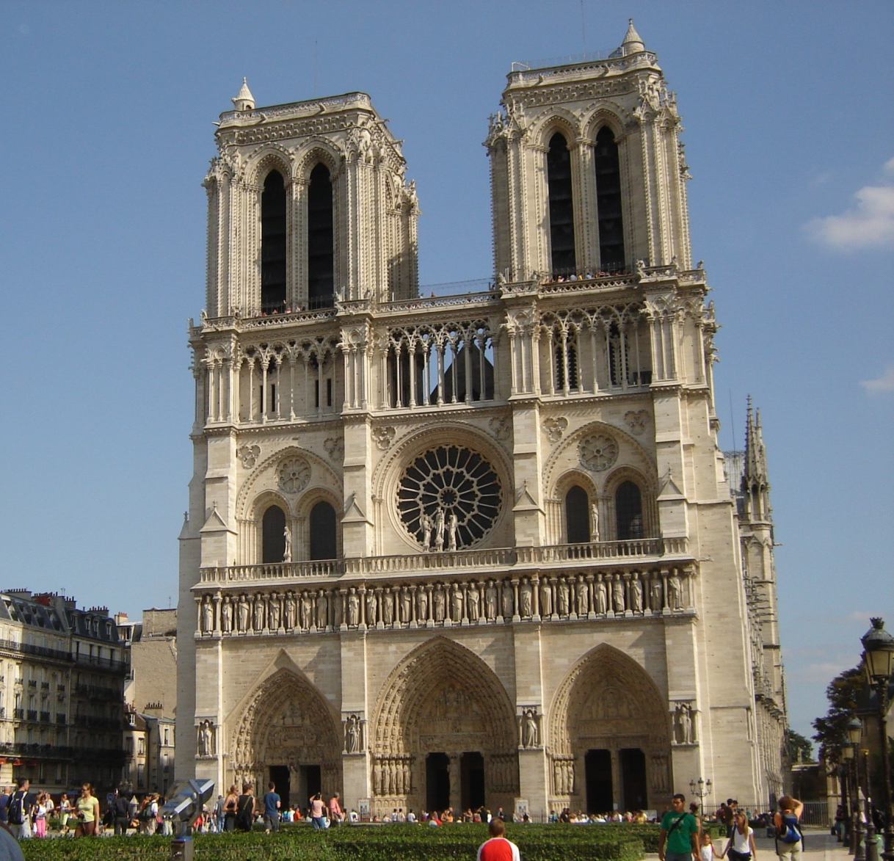
GOTHIC ARCHITECTURE (c.1125 – 1400)

Slide 20
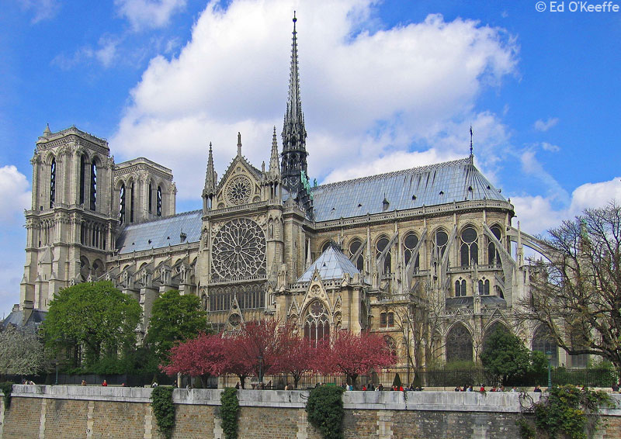

Slide 21
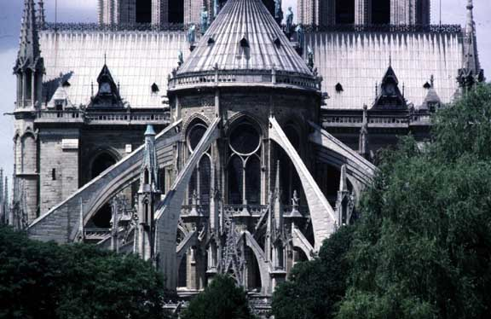

Slide 22
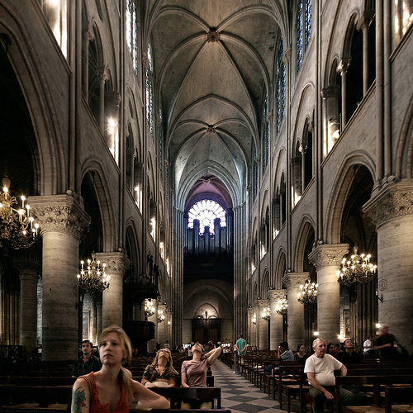
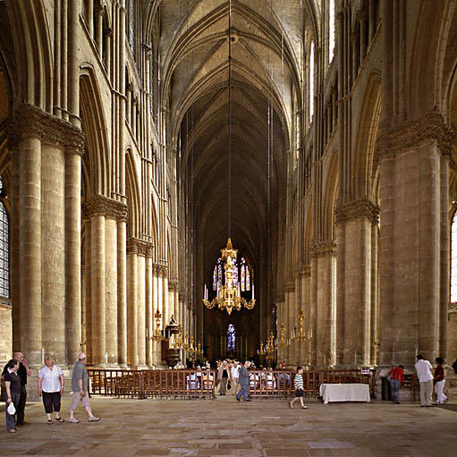

Slide 23
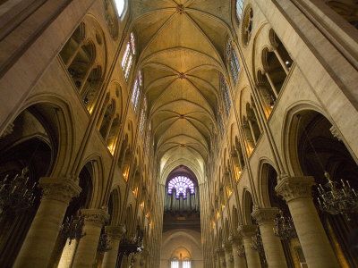
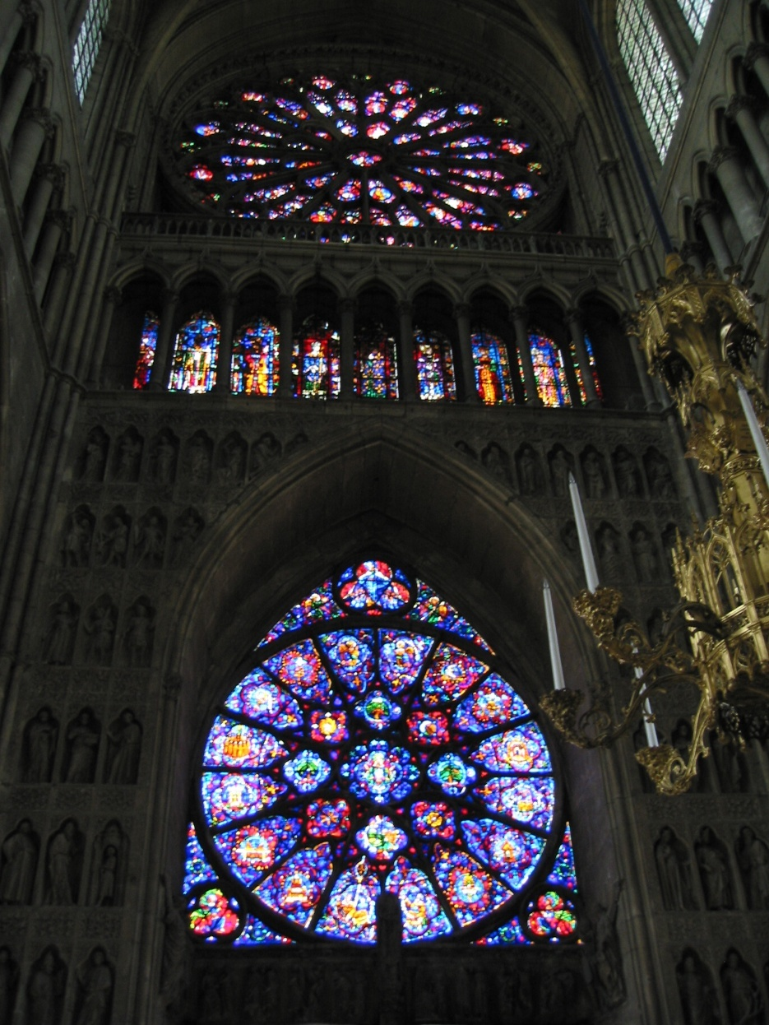
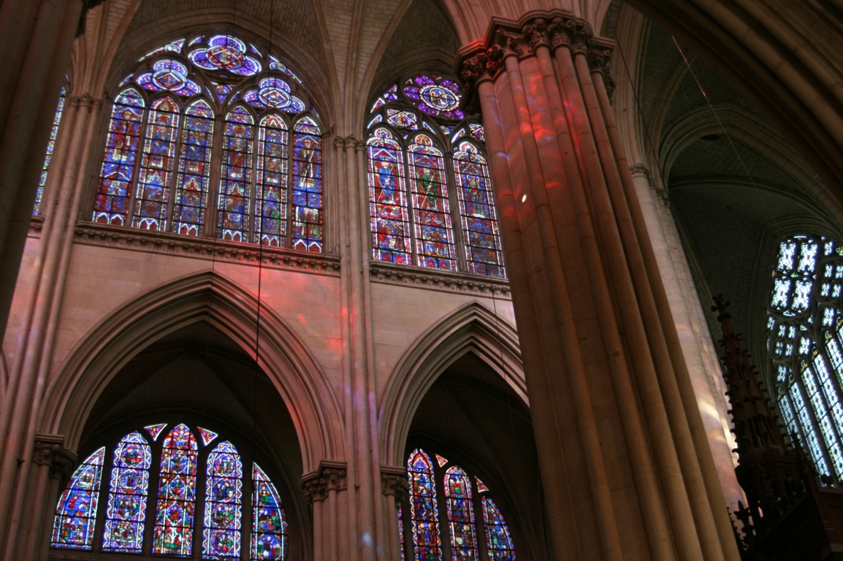

Slide 24
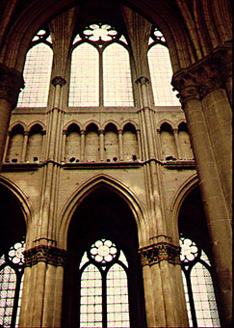
Romanesque Gothic

Slide 25
Notes p. 10 Notre Dame, Paris (exterior)
3 sections, 2 towers
HIGHLY articulated façade, with sc. in all doorways & frieze above doors.
“Rose” window above central doorway
Higher; more windows, lighter walls, supported by FLYING BUTTRESSES. POINTED ARCH allowed for greater heights than Romanesque.
Notre Dame (interior)
Taller than Romanesque, “closer” to God. Vault at highest pt. is 125’
Large stained glass windows, more “heavenly” light
Clusters of engaged columns like tree trunks

Slide 26
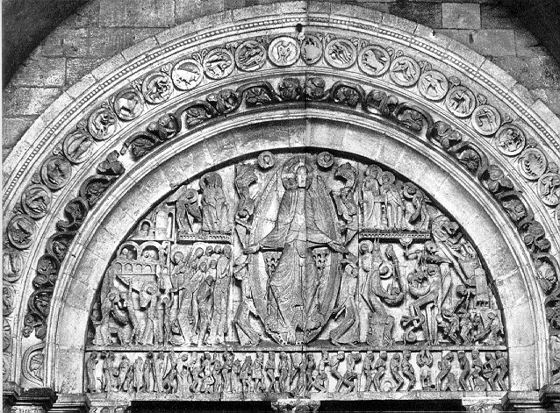
Romanesque Sculpture

Slide 27
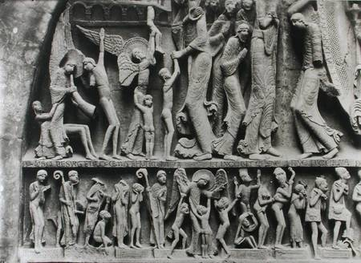
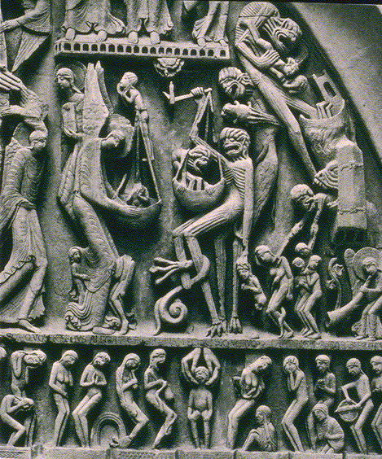
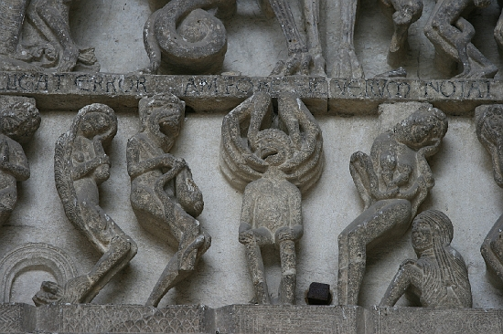

Slide 28
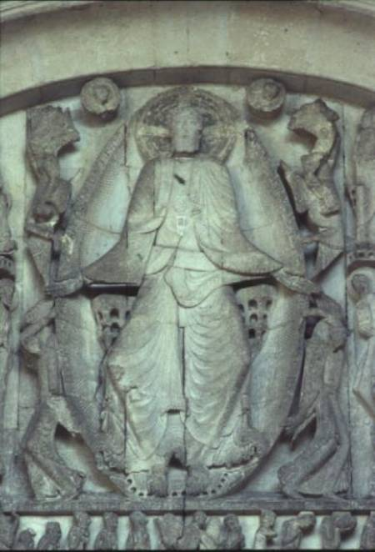

Slide 29
Notes p.10 Tympanum of Autun
Relief sc., ie. attached to wall; therefore an integral part of architecture
“Last Judgment” a common subj. aimed at teaching gospel to illiterate peasants (warning!)
elongated, flat, “stylized” figures
Christ stares straight ahead, as if in ecstasy.
Grotesque, spidery demons suggest superstitious ideas.
Scene is “hierarchical”, ie. size is according to importance; therefore, Christ is the largest (influence of Byzantine, shows up in Medieval ptg.)

Slide 30
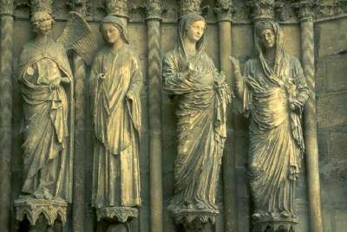
Gothic Sculpture

Slide 31
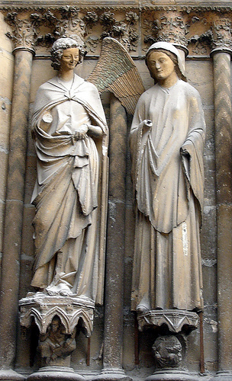
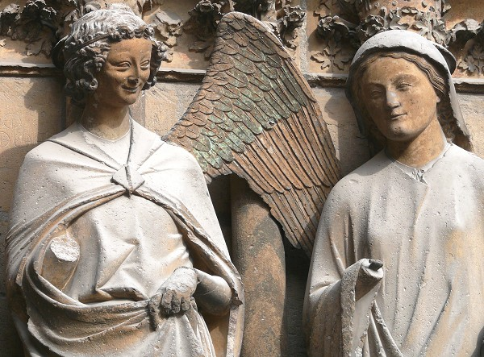

Slide 32
Annunciation Figures at Rheims
Gabriel’s visit to Mary, announcing that she will give birth to the Christ Child; on OUTSIDE of church
Figs. free-standing instead of in relief; they “move away” from the wall & have a life of their own, instead of being so much a part of architecture.
Figs. Are more natural-looking & graceful; they appear to move as humans.
Drapery folds are more realistic (like Classical Greek), facial expressions (smile!) indicate interaction between the two.

