Slide 1
ART 10 ART HISTORY I
Egyptian
Greek and Roman

Slide 2
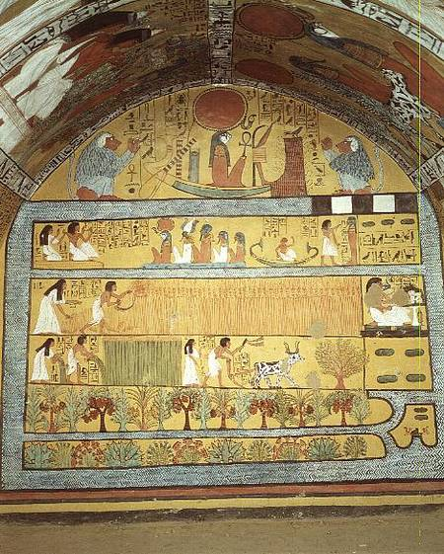
EGYPTIAN ART (c.3500 – 1000 BC)

Slide 3
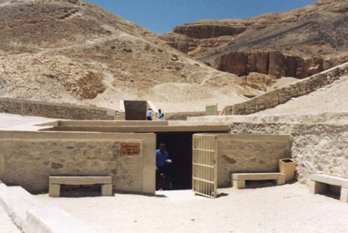
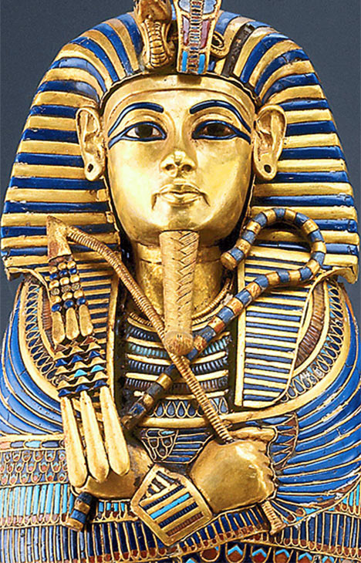
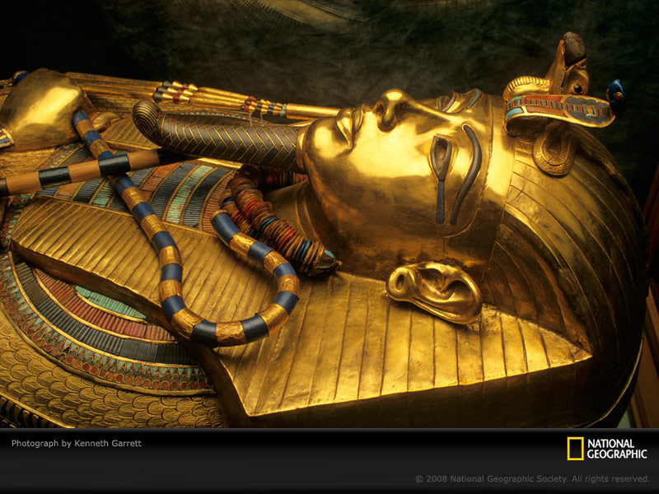

Slide 4
Egyptian Art Notes
1. People, birds, dogs, snakes, harvesting scenes, Pharaoh, hieroglyphs
2.People are flat & patternistic; no perspective; arms & legs from side, eyes from front.
3. Egg tempera (opaque watercolour bound with gum or egg white); colours from minerals and gems; turquoise, red ochre, lapis lazuli, saffron (yellow from crocus), cinnabar. Also gold, gems, & stones.
4. a) agricultural b) organized society c) wealthy
d) highly-skilled craftsmen

Slide 5
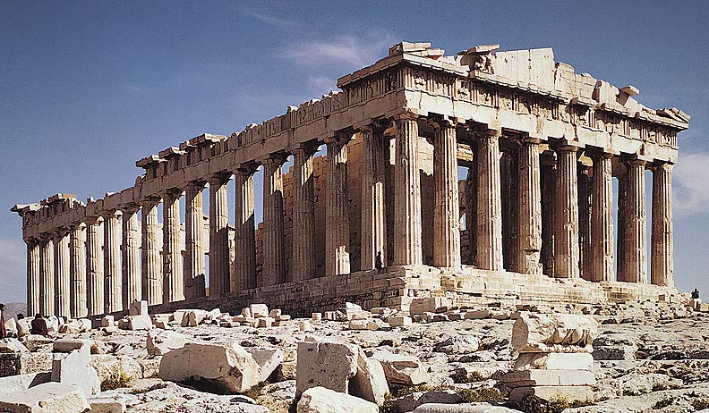
GREEK ARCHITECTURE (c.900 – 30 BC)

Slide 6
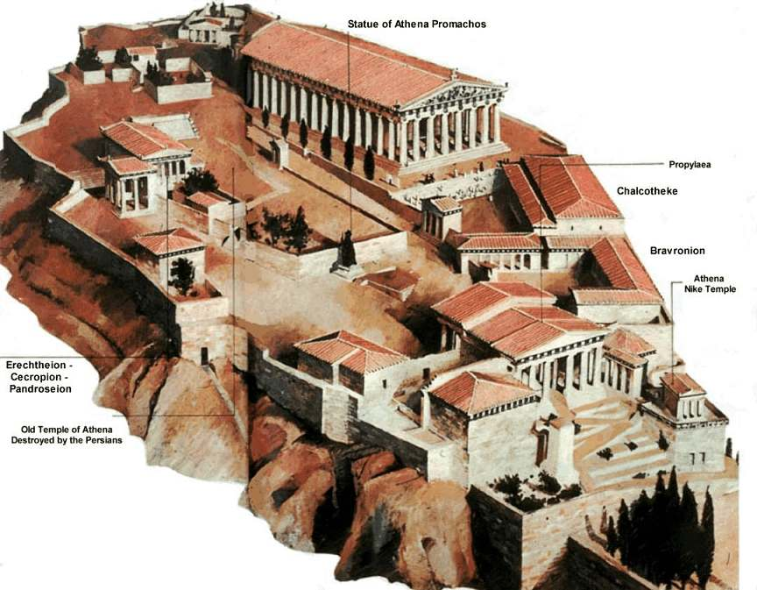

Slide 7
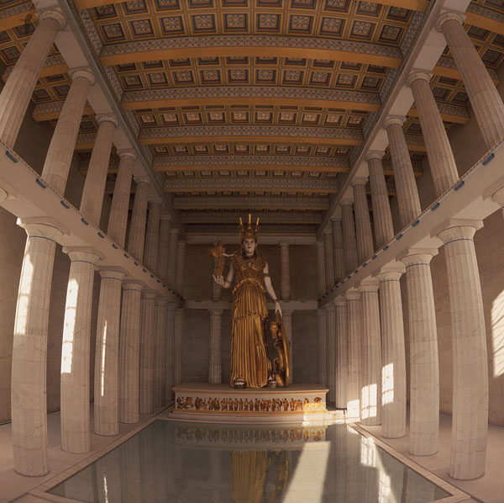

Slide 8
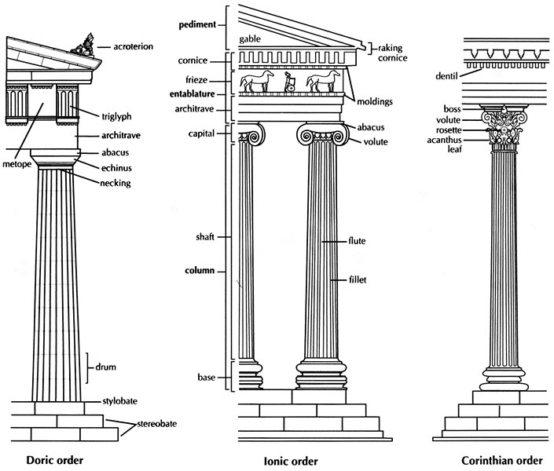

Slide 9
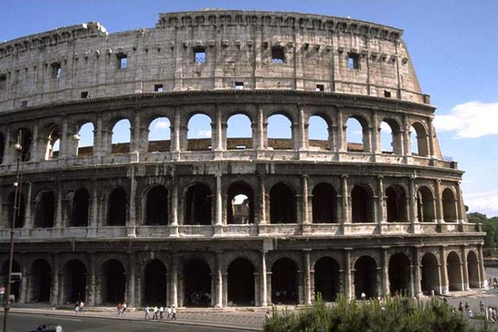
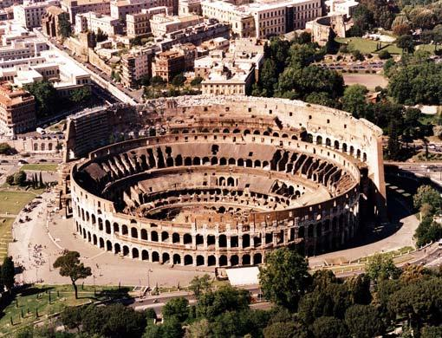
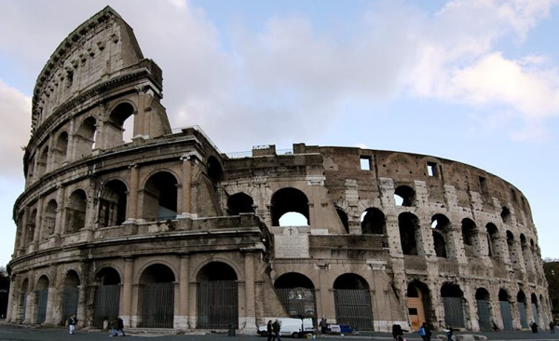
ROMAN ARCHI- TECTURE (c.509 BC – 395 AD)

Slide 10
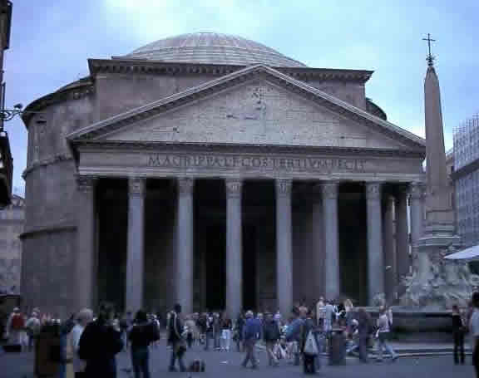
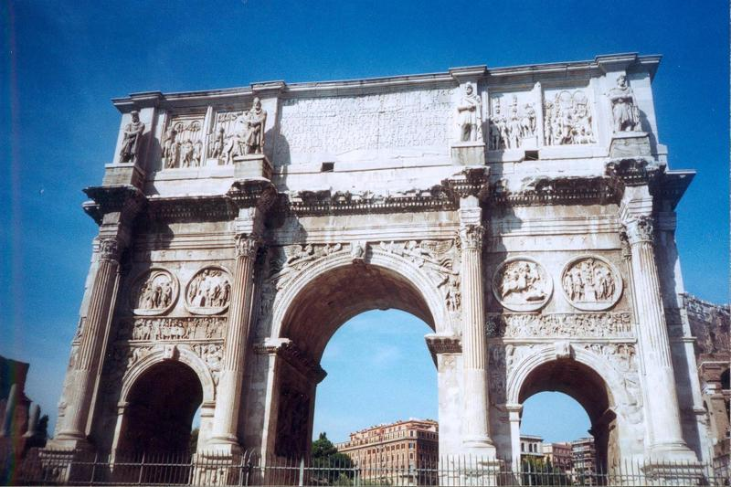
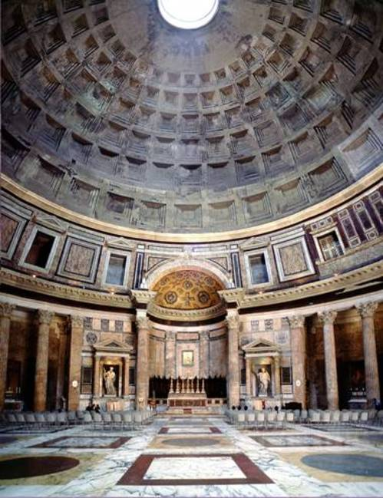
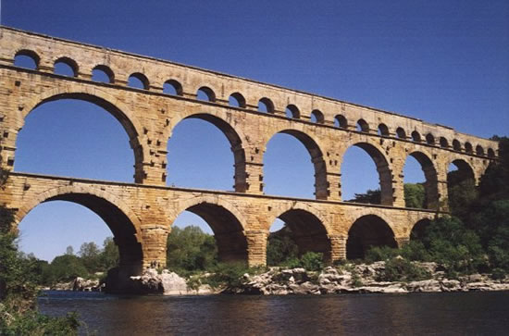

Slide 11
Architecture Chart
Greek | Roman
Greek Orders Doric – simplest: no base Ionic – scroll on capital, has a base, more slender proportions Corinthian – acanthas leaves on capital, has base. | Romans learned about archit. Engineering, town planning, and surveying from Etruscans. Rediscovered concrete; flexible, strong, cheap Arch and Vault system: Allowed for taller and wider bldgs. Created 2 kinds of ceiling: barrel and groin vaults. These vaults allowed for VAST interiors. Romans needed more indoor space than Greeks – cooler climate and larger population

Slide 12
The Parthenon Part of Acropolis (group of temples overlooking Athens) Built for goddess Athena, patron deity of Athens. Doric order, white marble; columns bulge to correct perception of narrowing at distance, closer at corners give visual reassurance of strength; porch bulges in middle. Shows Greek ideal of symmetry, balance, and grace; also “severe”, ie. little decoration. | The Colosseum Built for gladiatorial games by Emperor Vespasian. Concrete, arch & vault system allowed for great size; 50,000 spectators; still one of largest bldgs. in world. 3-tiered, with Greek orders from bottom to top; ½ columns & pilasters not structurally necessary, but they give a human scale to a vast bldg. Doric (bottom), Ionic, Corinth (top) Shows how Romans sought new and better ways of doing things; practical and commercial-minded.

Slide 13
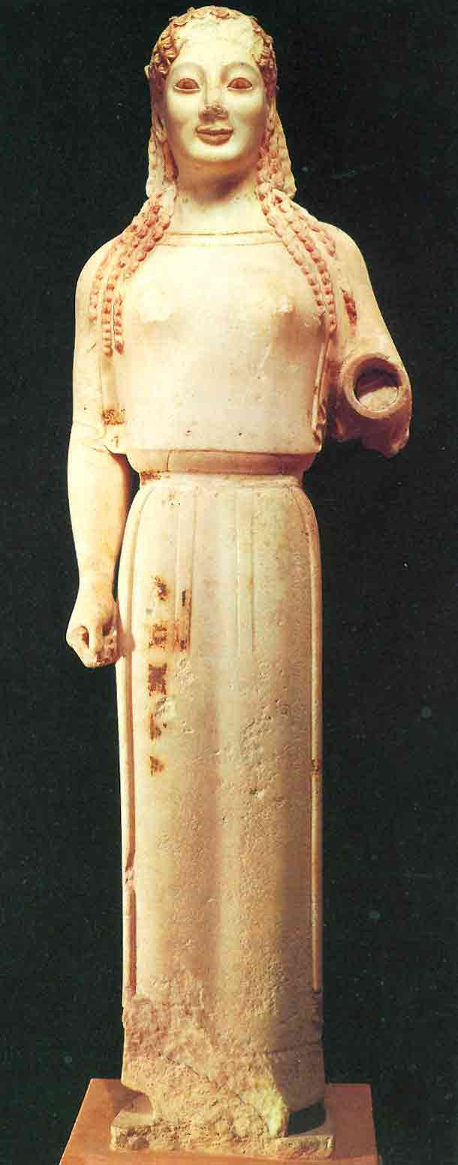
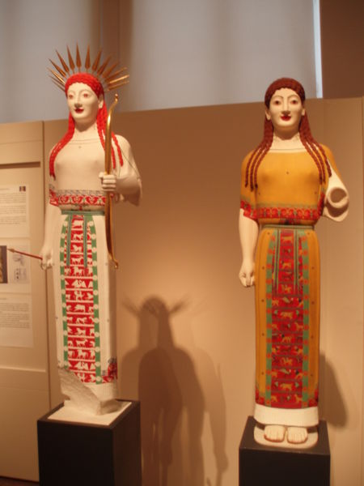
GREEK SCULTURE

Slide 14
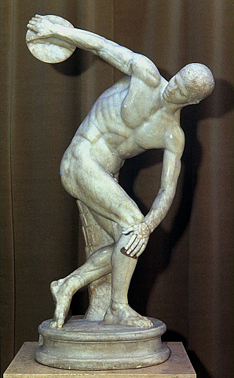
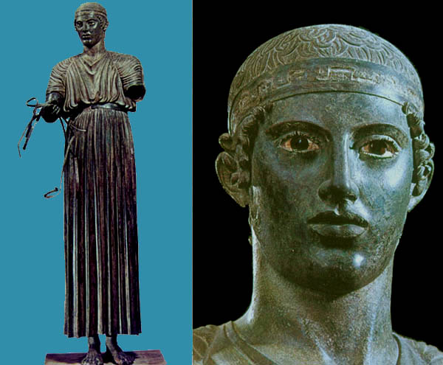

Slide 15
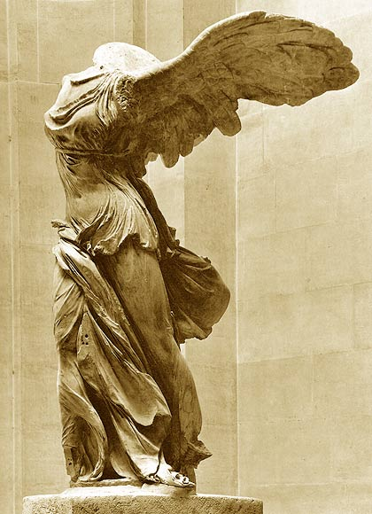
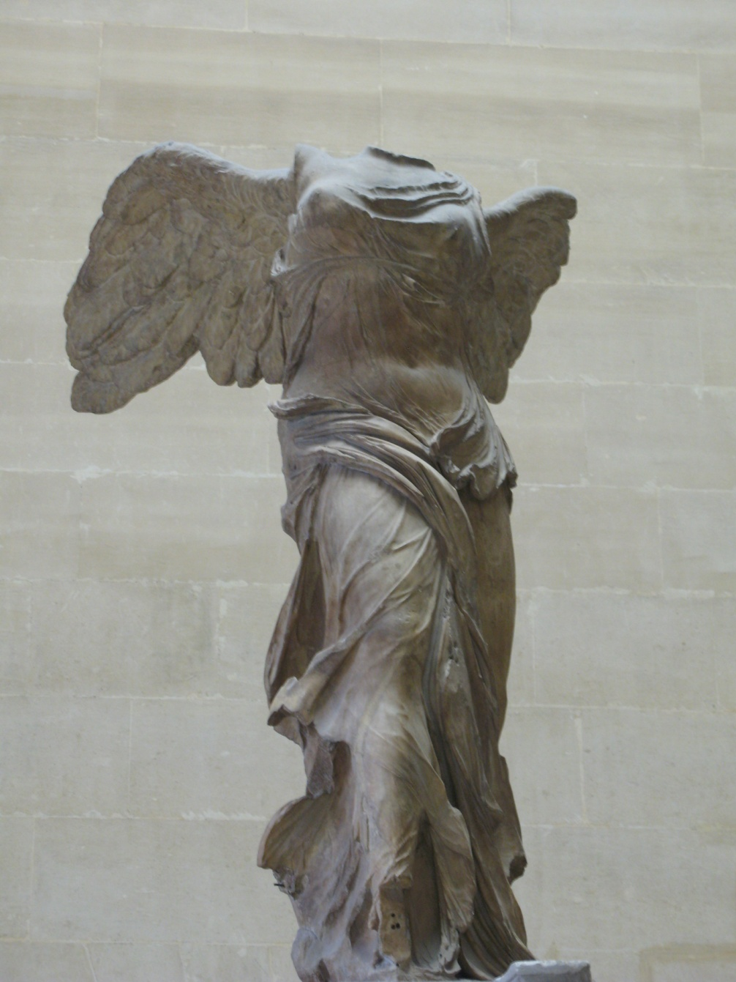

Slide 16
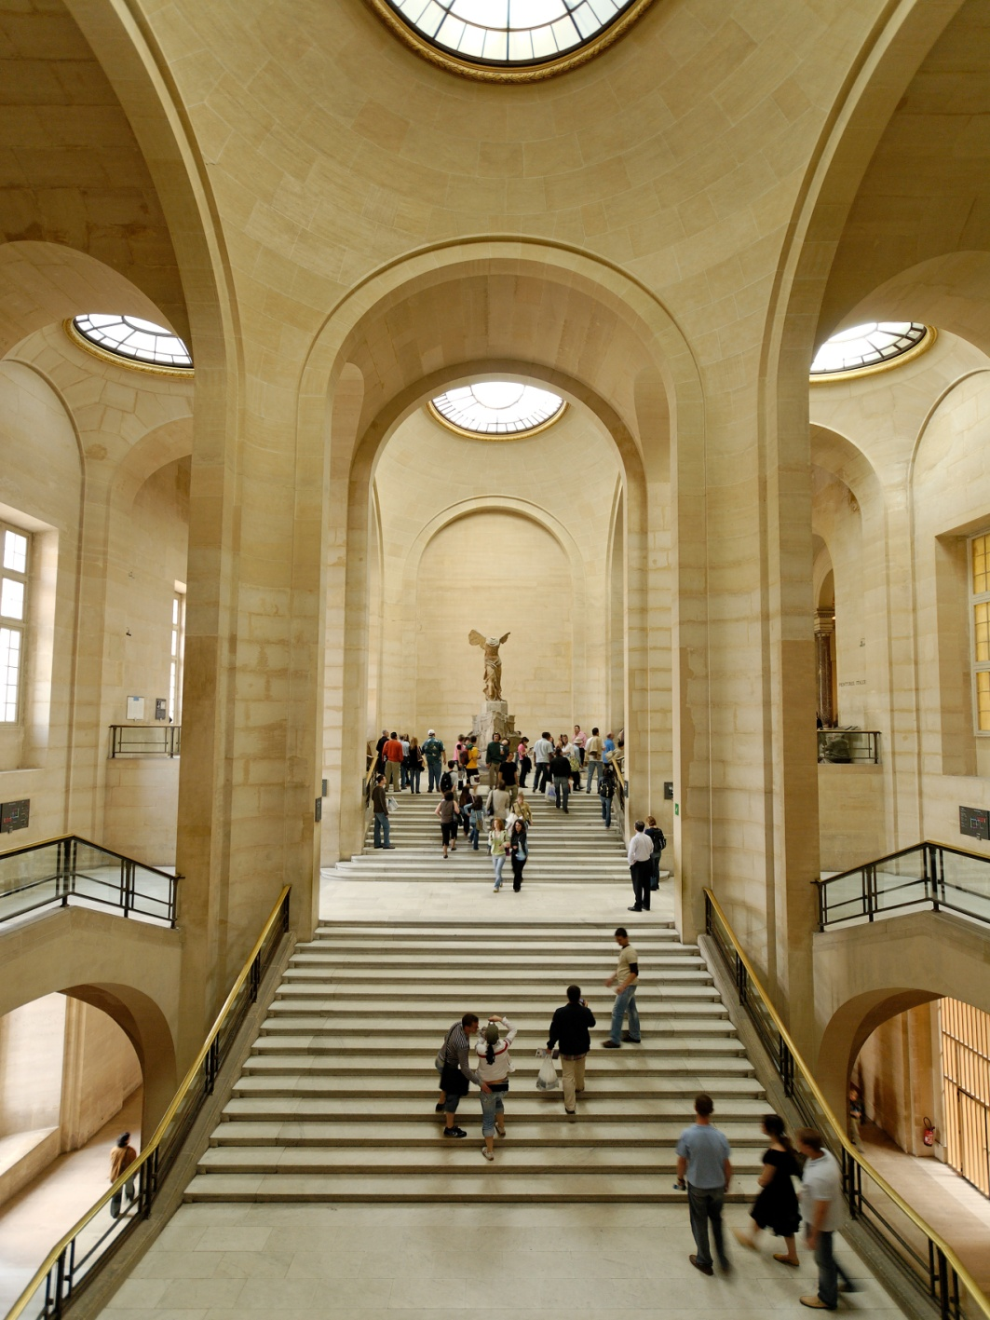

Slide 17
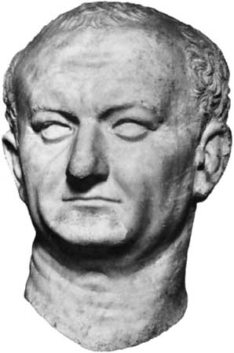
ROMAN SCULPTURE

Slide 18
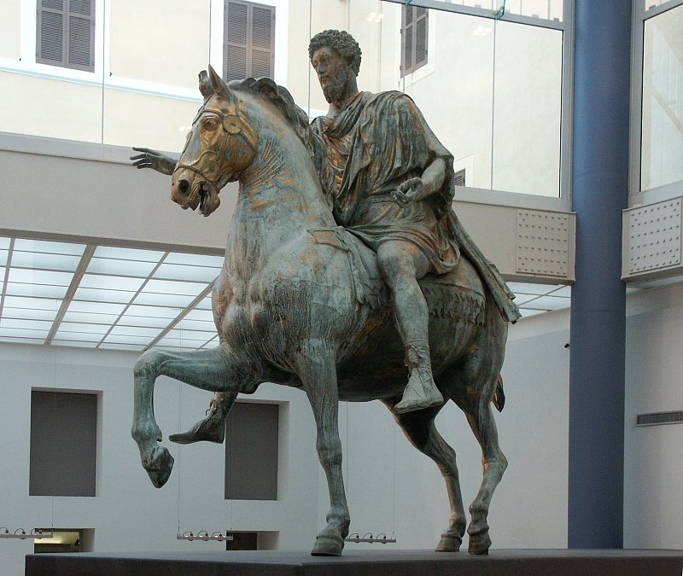

Slide 19
Sculpture Chart
Greek
Archaic – Kore
One of 1st free-standing, lifesize sc.
Eg. of oldest, most simply, roughly hewn (primitive tools – drills, chisels)
Stiff, upright, little movement, wig-like hair, stare
Smile intended to give life
Made for temple offering or grave
(some Archaic sc. Signed “So and So made me”)
Classical – Discobolus 5’1”
More advanced tools; more realistic, “softer” skin
Pose more natural: CONTRAPOSTO, ie. weight on one leg, while other acts as support. Simple, graceful
Smile not needed because so lifelike; instead expression becomes pensive

Slide 20
Hellenistic – Nike/Victory of Samothrace
More pronounced realism and expression
Drapery in thin, “diaphanous” fabric blown against highly realistic body
Increased movement in sense of blowing wind and in pose, as if she has just landed on prow of ship
GREEKS interested in the ideal; godlike men and manlike gods, the heroic, the perfect human
Roman
Vespasian
A real person (emperor)
Not idealized; he looks old!
Very fine carving, indicating very refined tools: wrinkles, skin, hair
No irises or pupils in eyes until 3rd c. AD
Vespasian viewed emperor worship with skepticism, and when dying, remarked wryly, “It seems I am about to become a god”!

Slide 21
Marcus Aurelius 11’6”
A real person; traditional sc. of emperor, on horseback, since Julius Caesar (assassinated 44BC)
Large, up high, above people’s heads, therefore carving is less fine/detailed
Exhibits theme of authority & power of emperor & therefore of Rome – emperor is shown as every victorious &, with no weapons, the bringer of peace.
ROMANS more interested in realism, business, & military.

