Slide 1
ART 10 ART HISTORY II
Expressionism, Abstraction, and Fantasy
Surrealism, Pop, and Mobile

Slide 2
EXPRESSIONISM, ABSTRACTION AND FANTASY ART (early-mid 1900s)
Expressionism – works which stress the artists’ feelings about himself and the world.
Abstraction – works in which the artists is concerned with the “order of shapes” in a picture, ie. the structure more than the content.
Fantasy/Fantastic Art – works in which the artist explores the realm of the imagination (eg. memories, dreams)

Slide 3
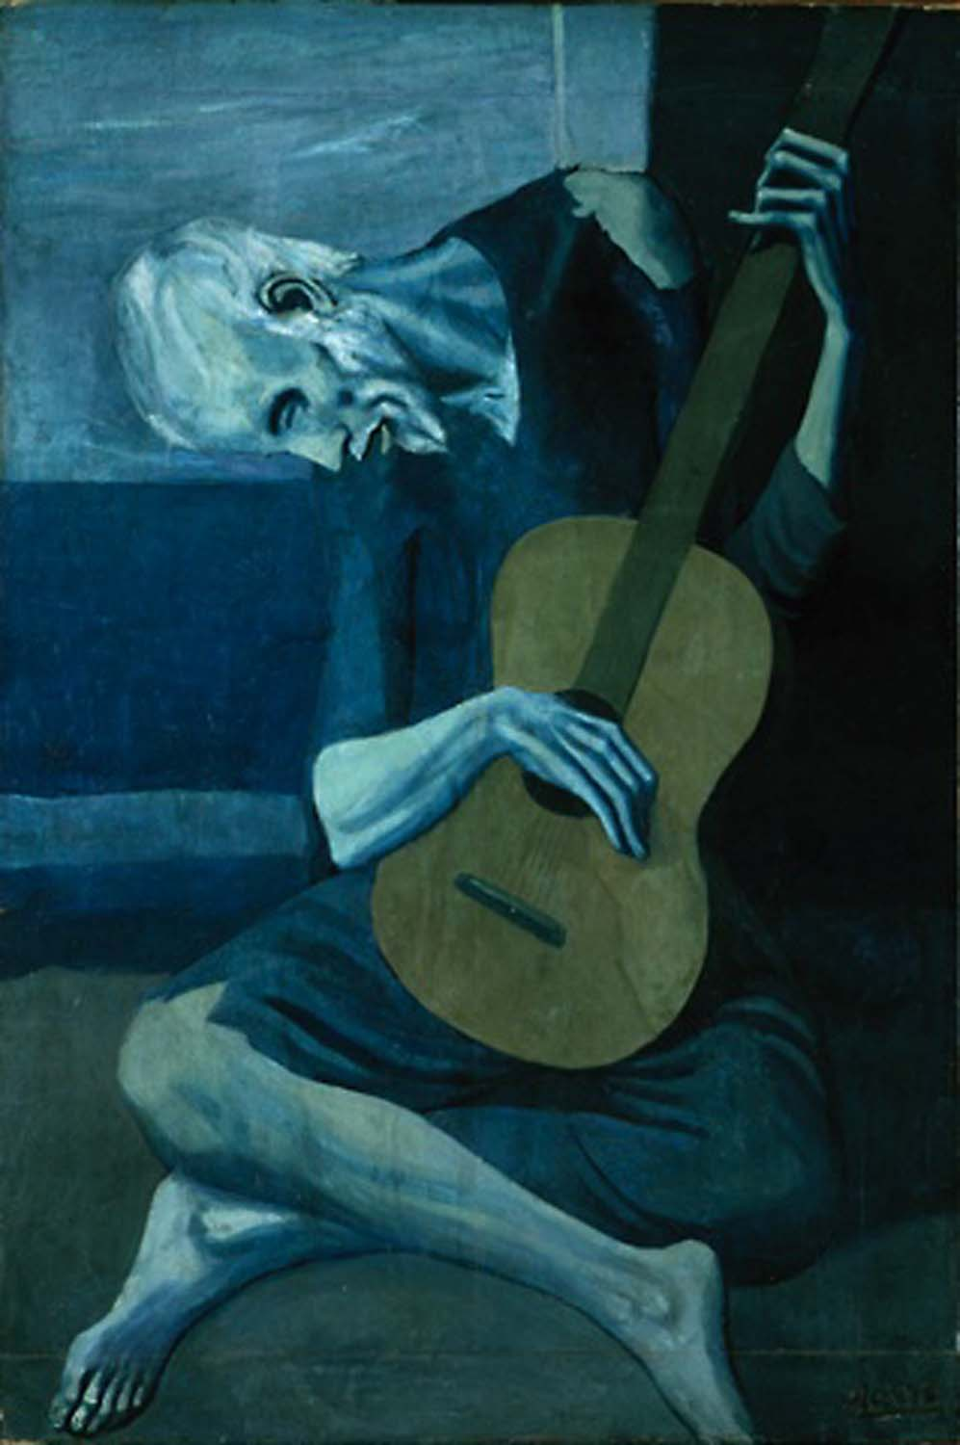
Expressionism

Slide 4
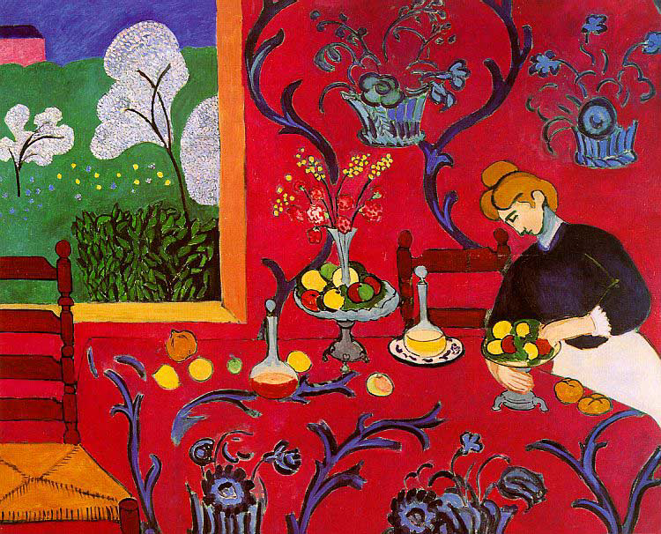

Slide 5
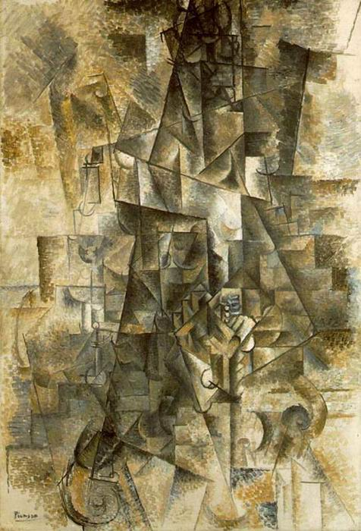
Abstraction

Slide 6
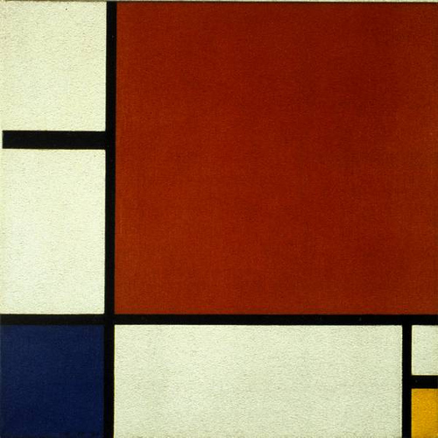

Slide 7
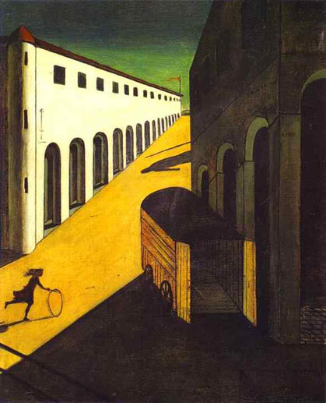
Fantasy

Slide 8
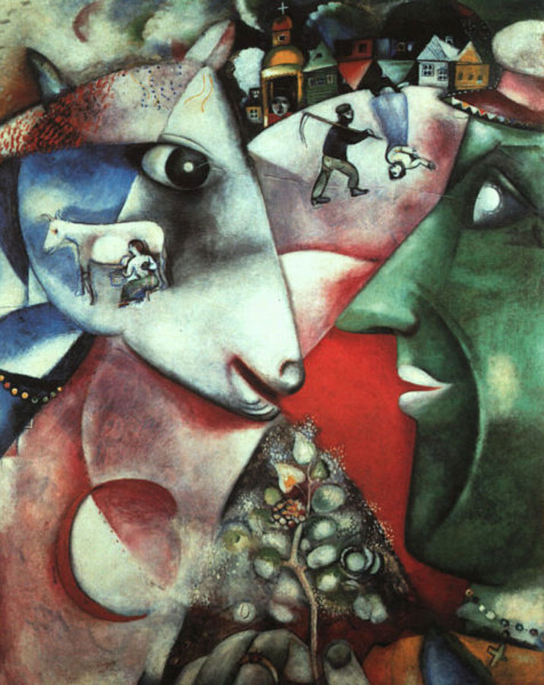

Slide 9
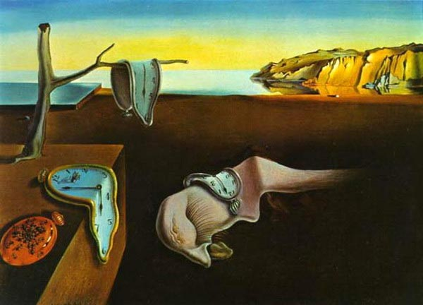
SURREALISM TO POP (1920s-1960s)
Surrealism

Slide 11
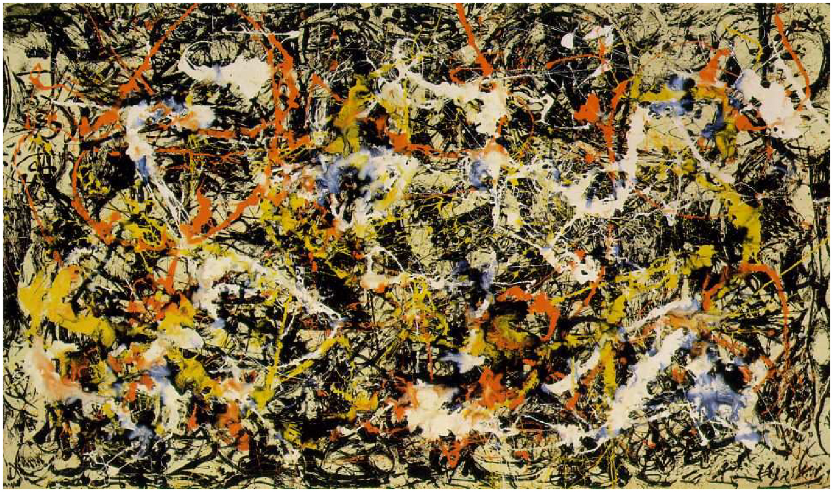

Slide 12
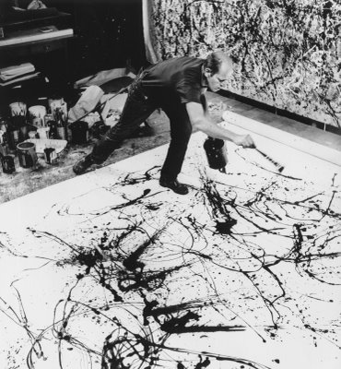
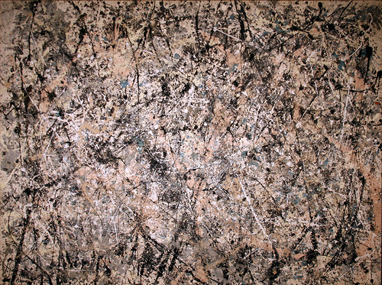

Slide 13
Notes p. 13
Salvador Dali The Persistence of Memory
Clear, mostly recognizable obj in smooth, well-modelled forms, typical of Dali’s style.
Tho’ real images, they are treated and combined in an irrational manner, creating an eerie, dream-like stillness (melting, watches, insects, barren landsc.)
Meaning not meant to be clear; Dali’s own description of it is irrational and absurd.
Surreallism attempts to focus on the “subconscious” mind.

Slide 14
Jackson Pollock Number One
Act of ptg more important than result.
Result of, in his view “internal dynamics” or pent-up forces in himself. Wd spread paint with anything except brush so he cd paint directly from subconscious mind.
Painted with great energy, then made changes after.
Result is richly-textures pattern of strands of paint, often in very attractive colours.

Slide 15
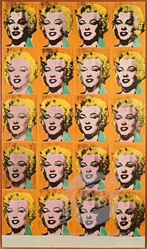
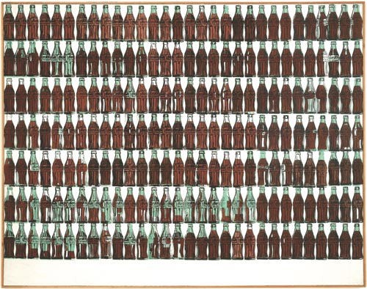
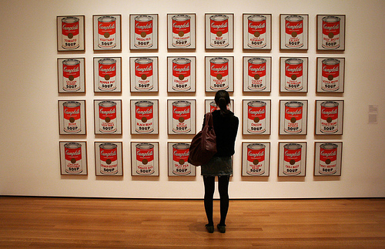

Slide 16
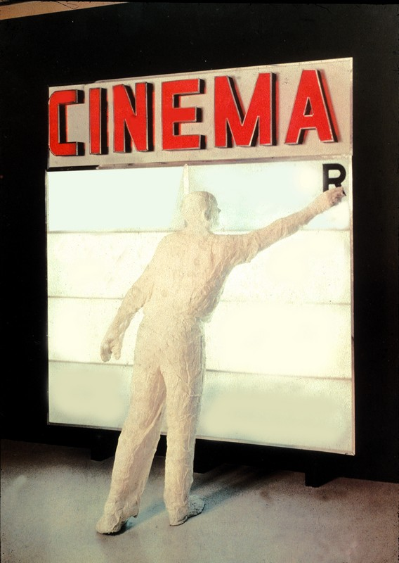

Slide 17
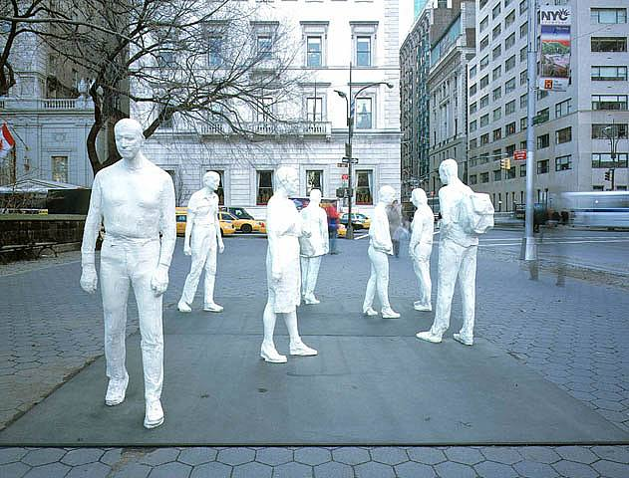
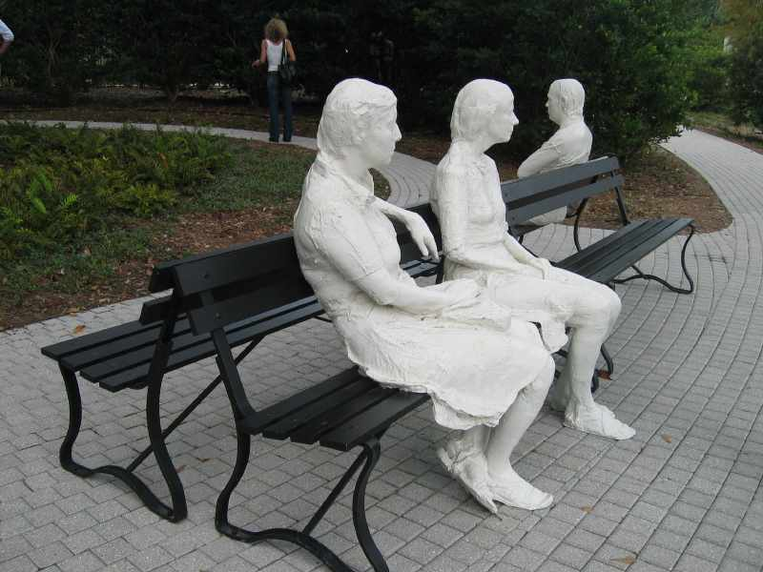

Slide 18
Notes p. 14
Andy Warhol Twenty Marilyns
Our visual experience in our commercial culture is full of repetition, and Warhol uses that concept in his art, bombarding us with the same image 20 times.
2. Marilyn Munro was movie icon in the
1950s and 60s, and even now most people
recognize her – Warhol chose images that
were easily and quickly recognizable from
our consumer culture.
3. Screen prints – slight variations among the
prints add interest.

Slide 19
George Segal Cinema 1963
Reality vs. image. Segal creates a whole environment based on pop culture.
A new 3D reality – lifesize
Instantly recognizable as a common occurrence in city.
Not quite real – sign on ground level; man a ghostly white (made from plaster-stripping a real person)

Slide 20
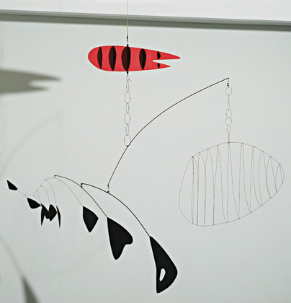

Slide 21
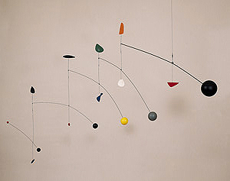
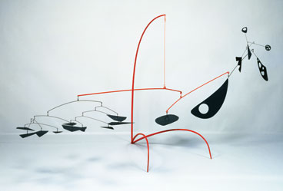

Slide 22
Alexander Calder Fish Tail and Lobster Trap
1. First form of sculpture to MOVE; hangs, air blows on it and it moves and appears to take on a life of its own.
2. Responsive to the environment, therefore unpredictable and ever-changing, making mobile an exciting art form.
3. Made of aluminum and wire – very light.

Slide 23
THE END

