Slide 1
ART 20/30 ART HISTORY I
Picasso to Pop

Slide 2
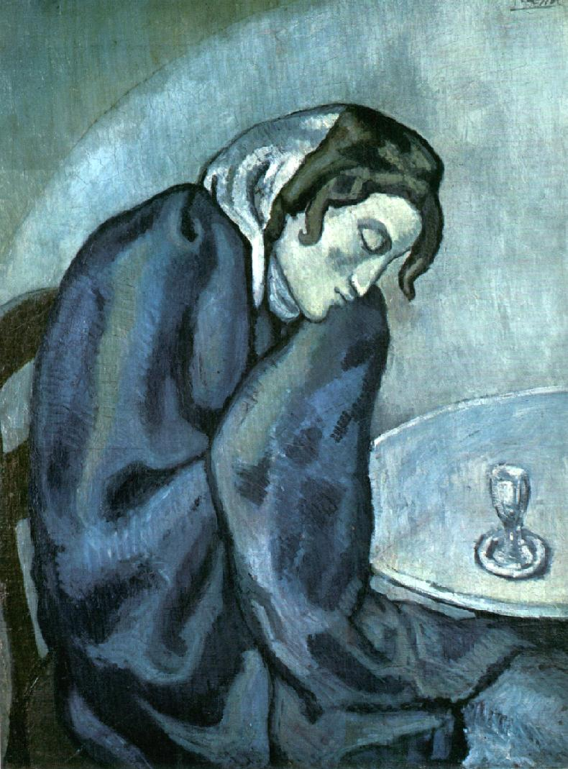
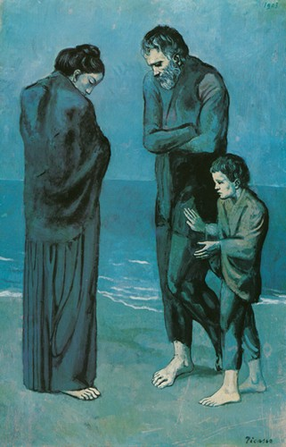
PABLO PICASSO (Spanish 1881-1973)
Blue Period
(1901-04)

Slide 3
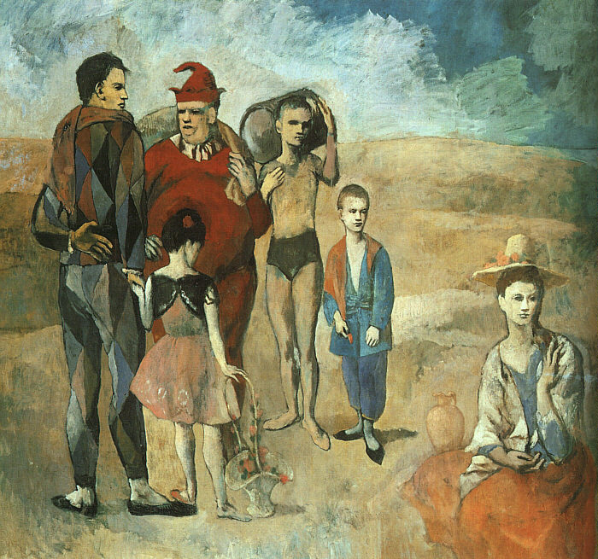
Rose Period (1905-16)

Slide 4
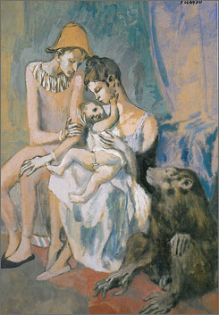
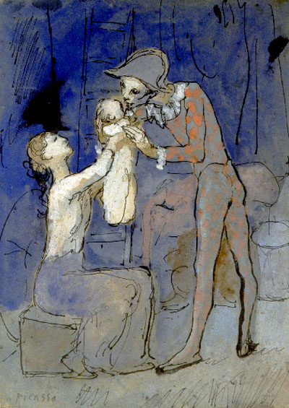
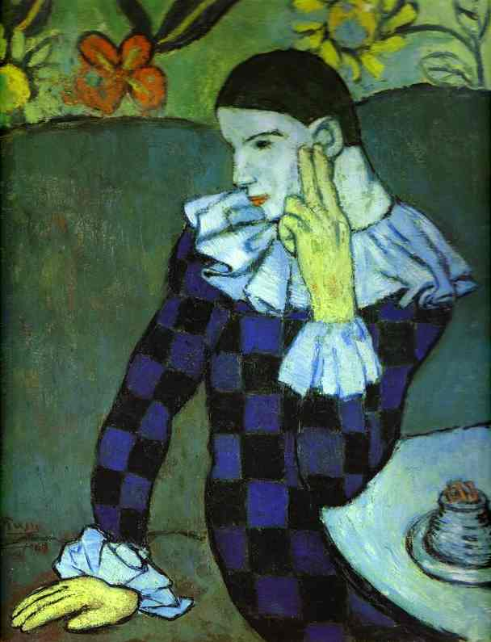

Slide 5
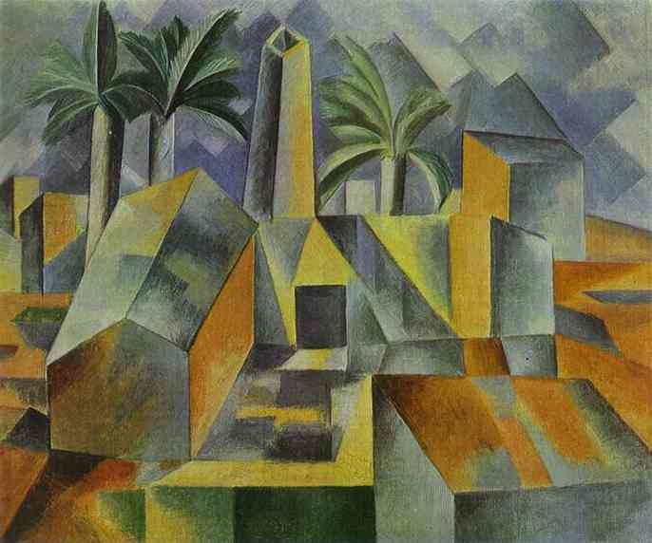

Slide 6
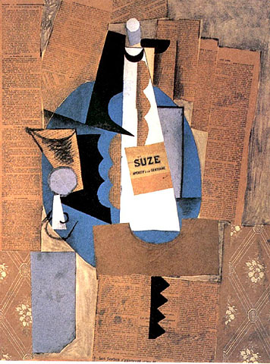
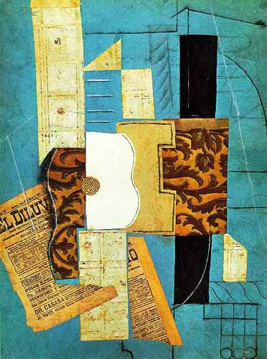

Slide 7
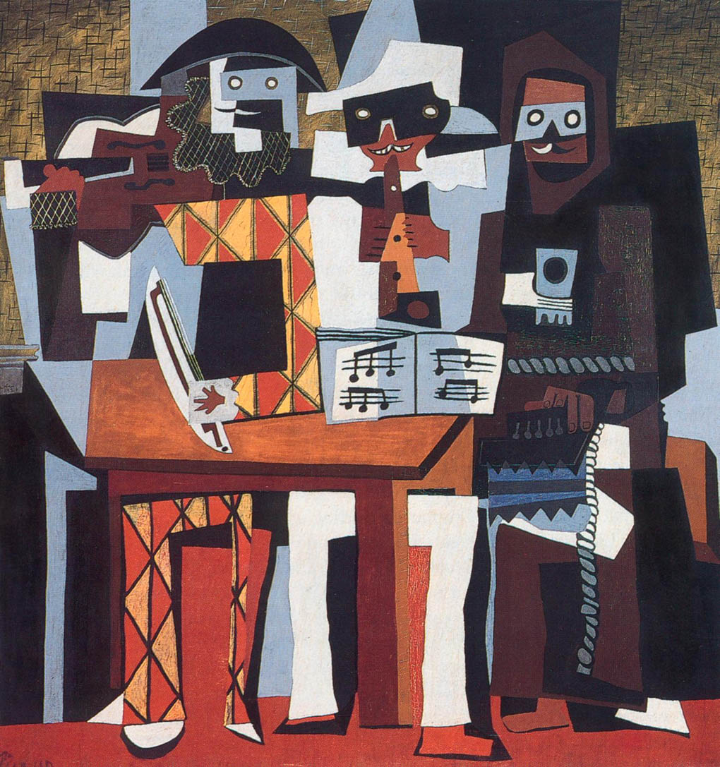

Slide 8
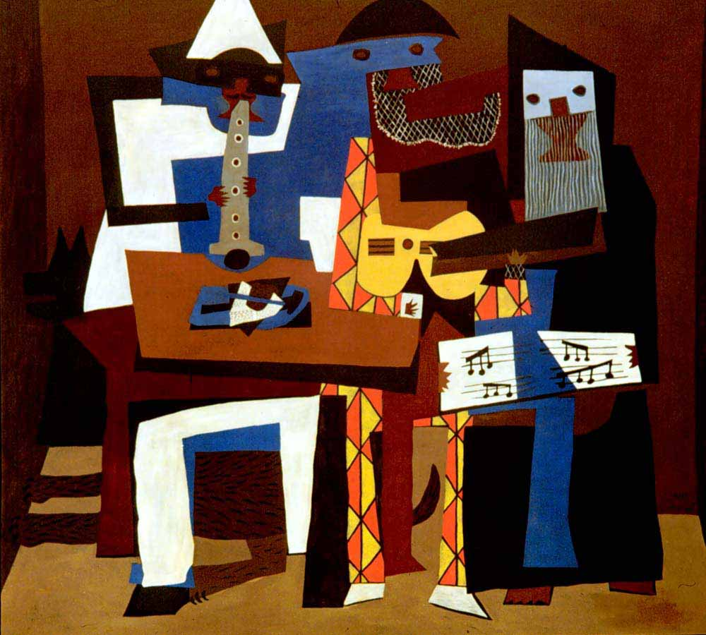

Slide 9
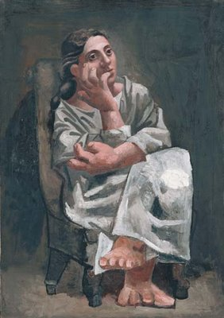
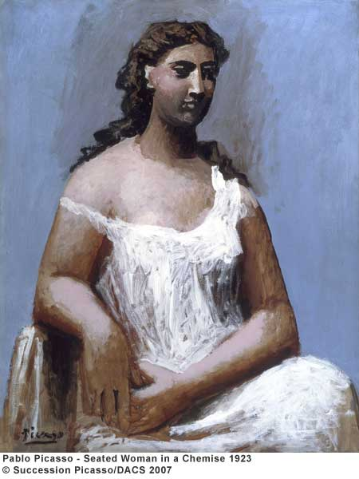

Slide 10
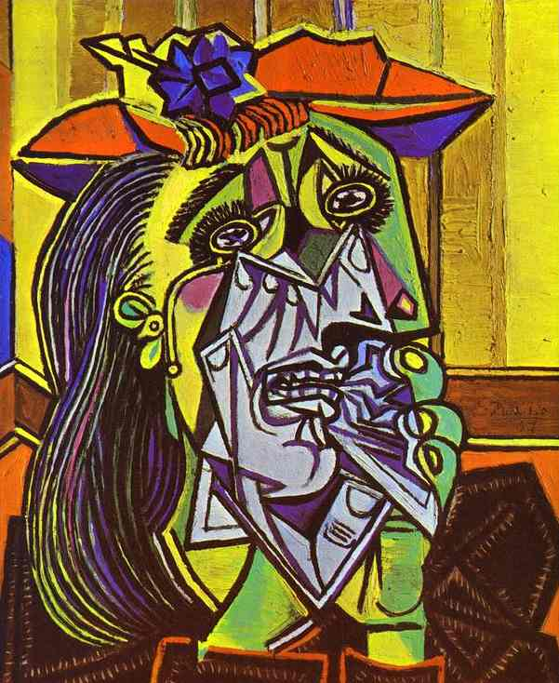
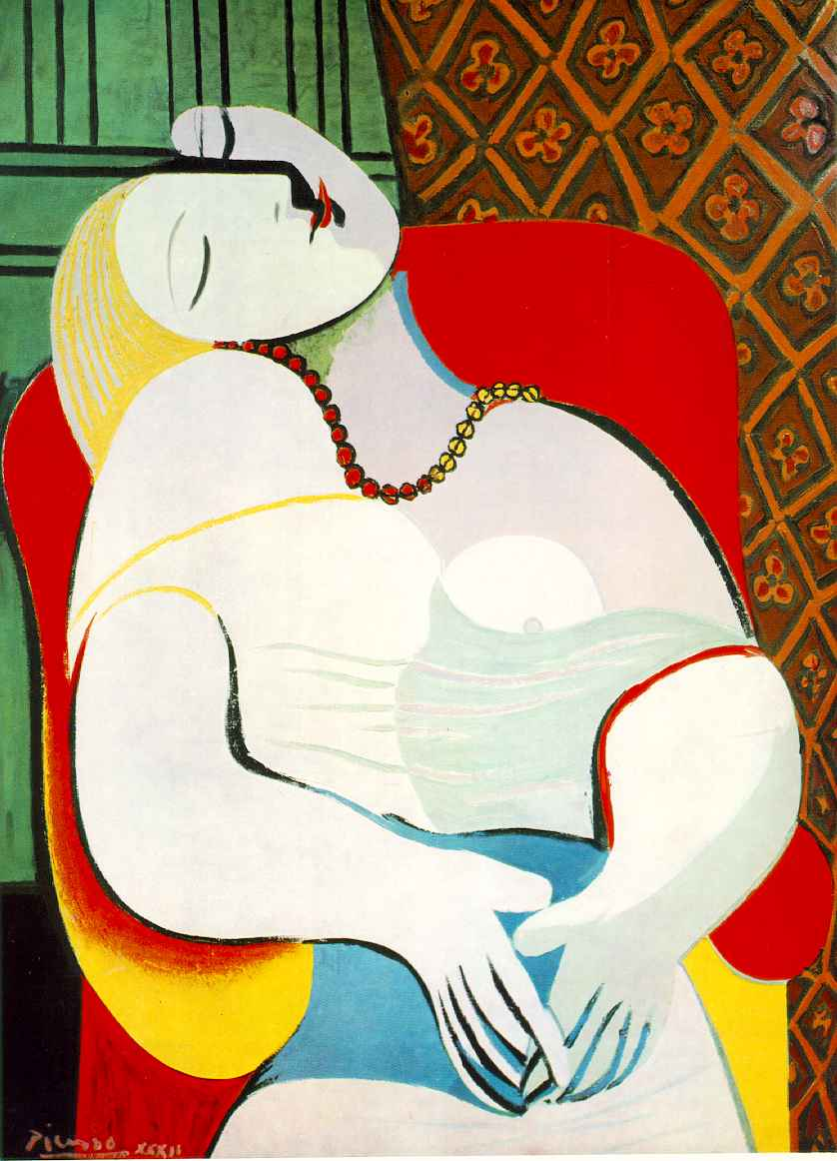

Slide 11
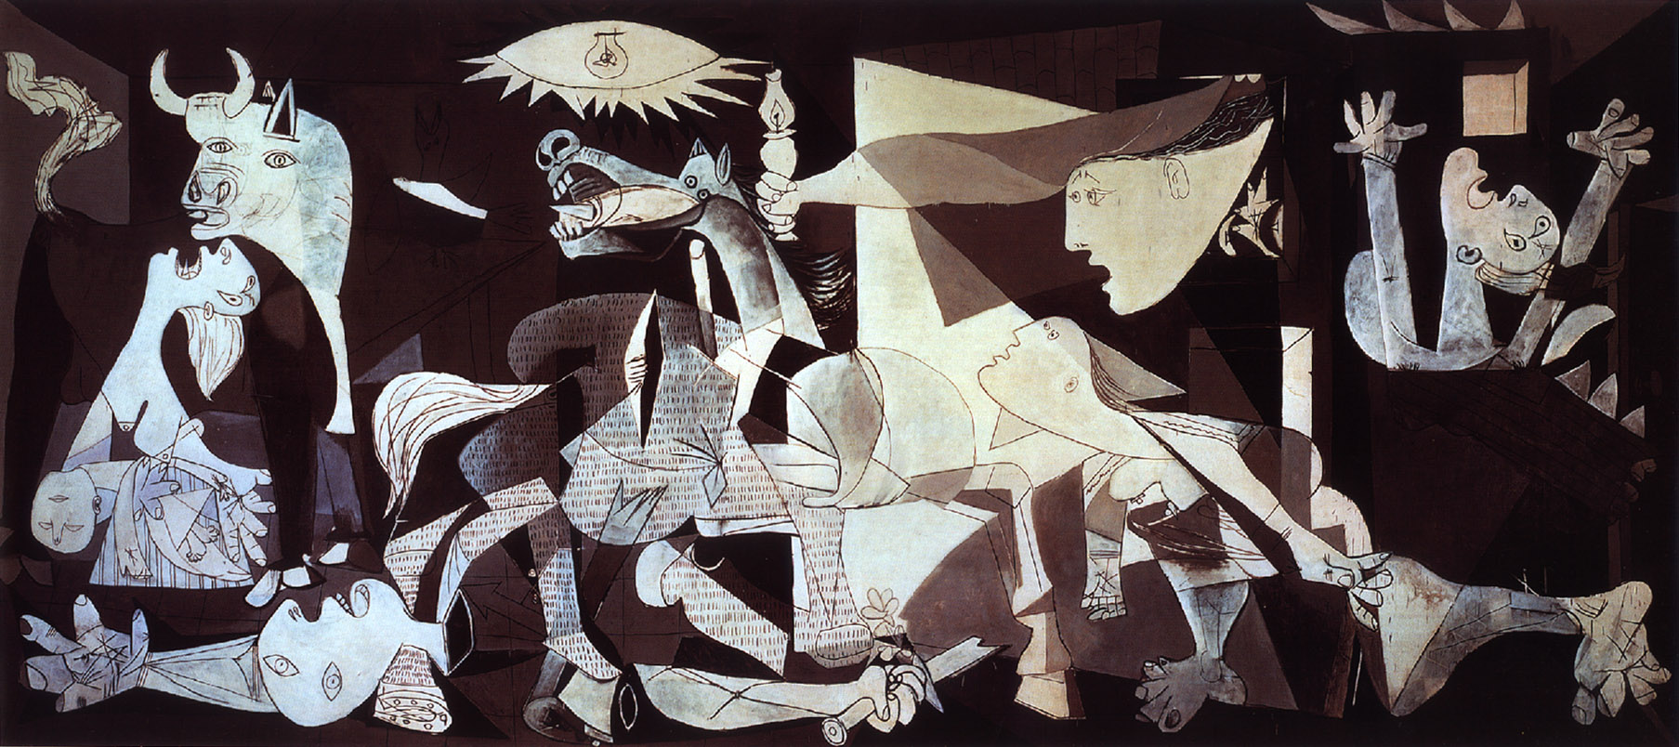

Slide 12
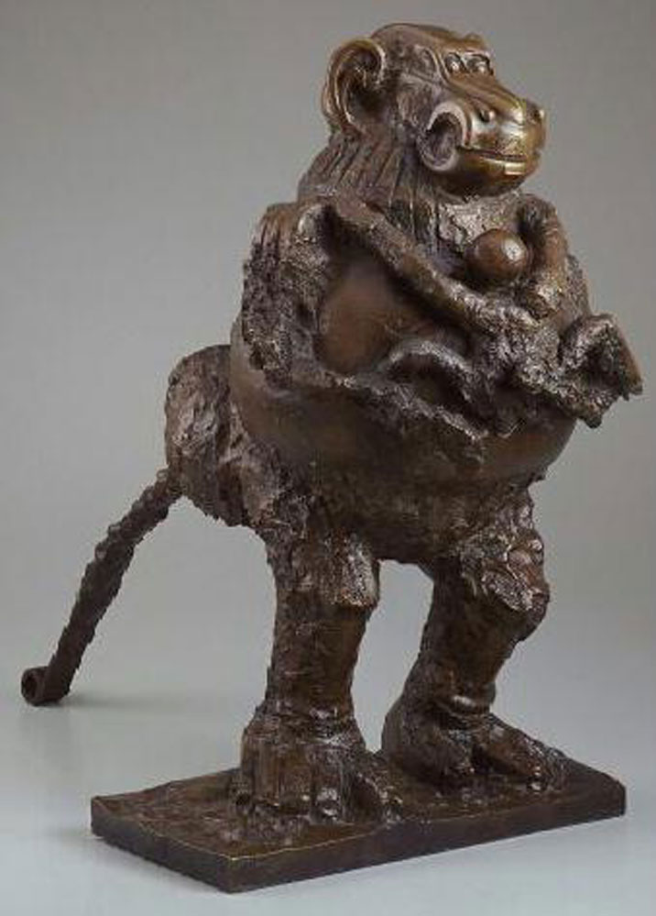
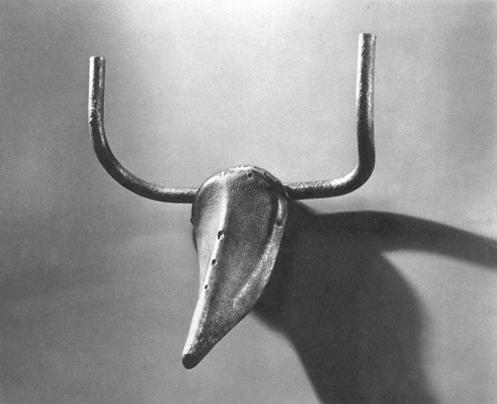

Slide 13
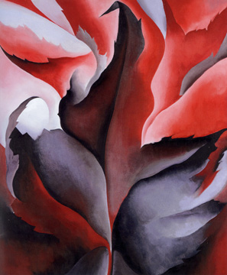
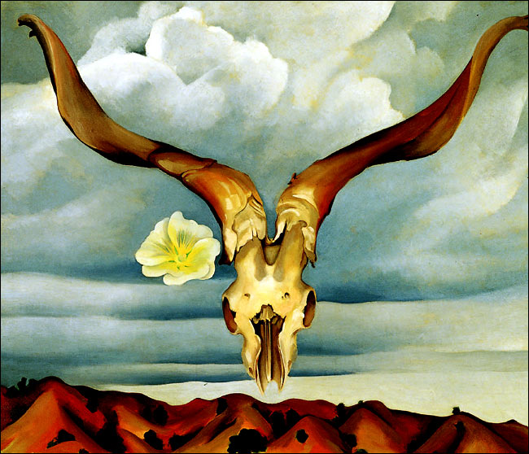
GEORGIA O’KEEFE (American 1887-1986)

Slide 14
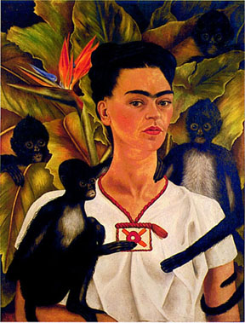
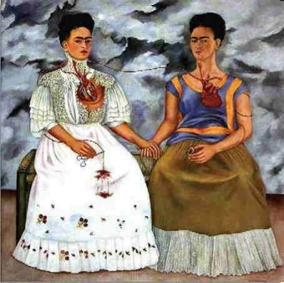
FRIDA KAHLO (Mexican 1907-1954)

Slide 15
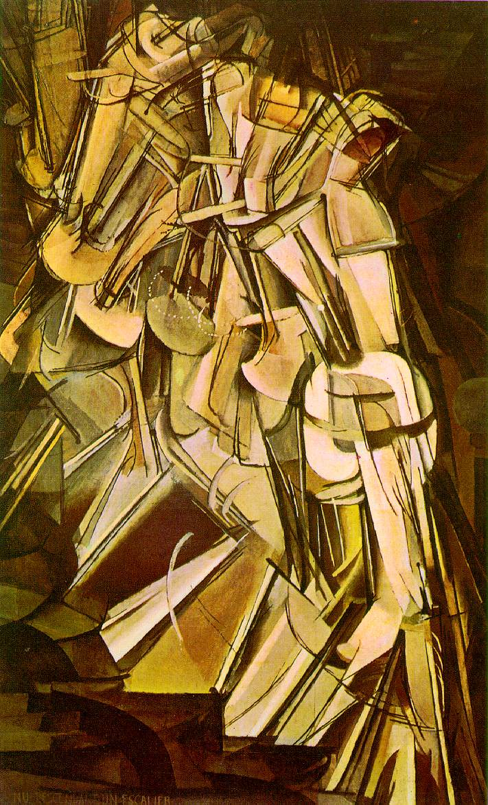
DADA
MARCEL DUCHAMP
(French 1887-1968)

Slide 16
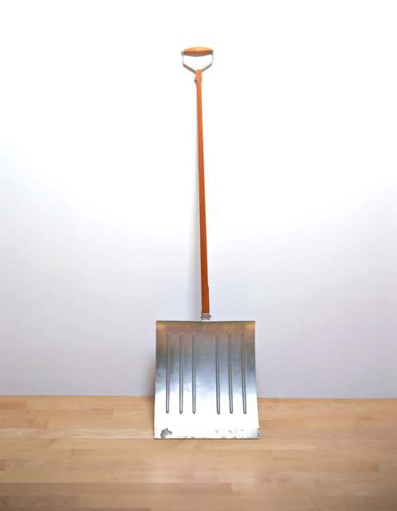

Slide 17
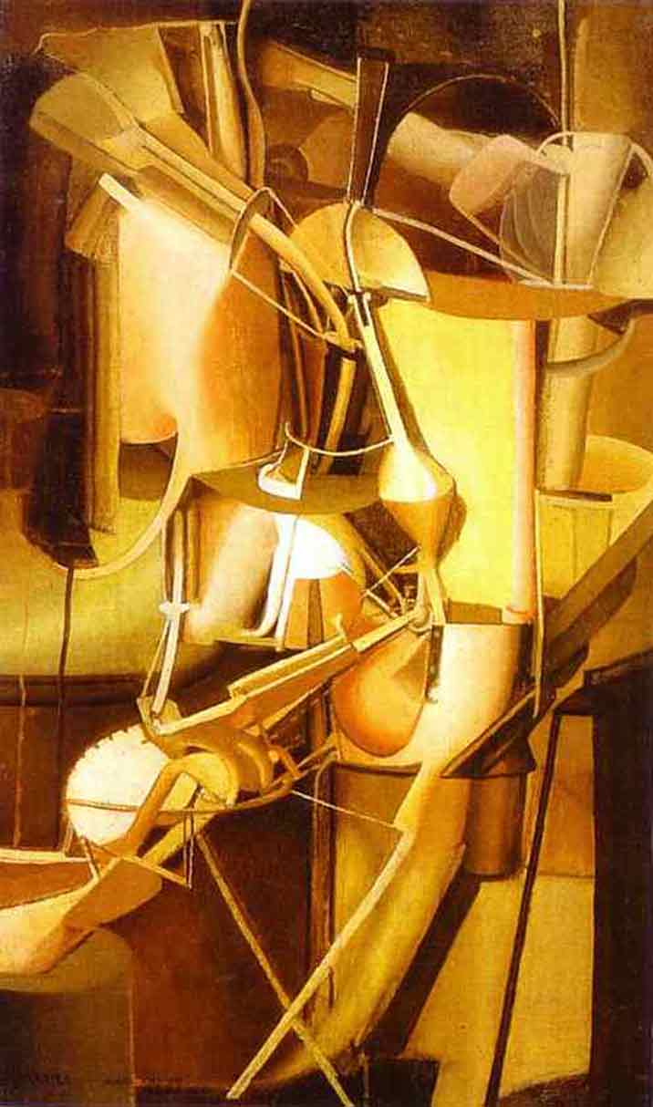
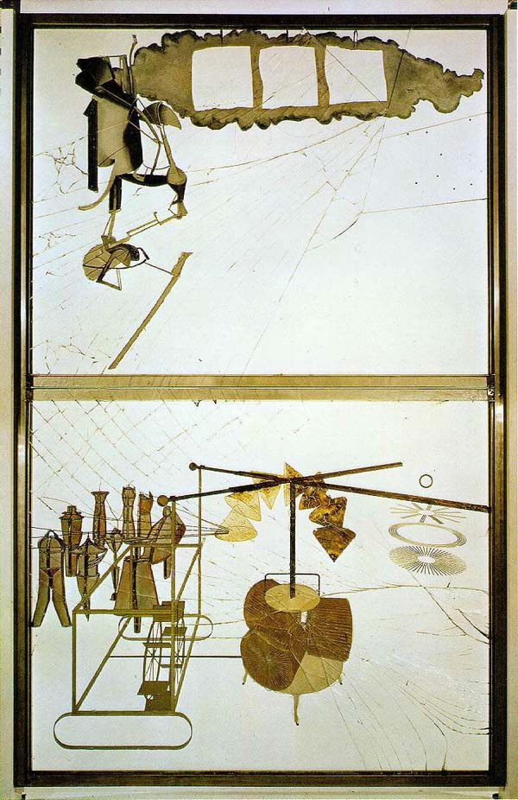

Slide 18
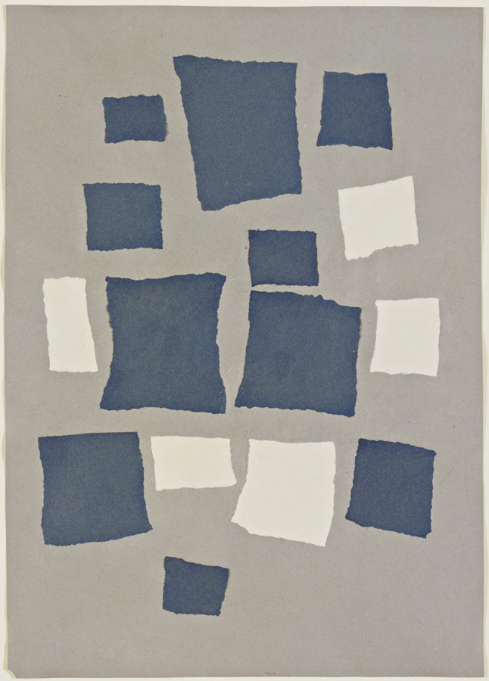
JEAN ARP (German 1887-1966)

Slide 19
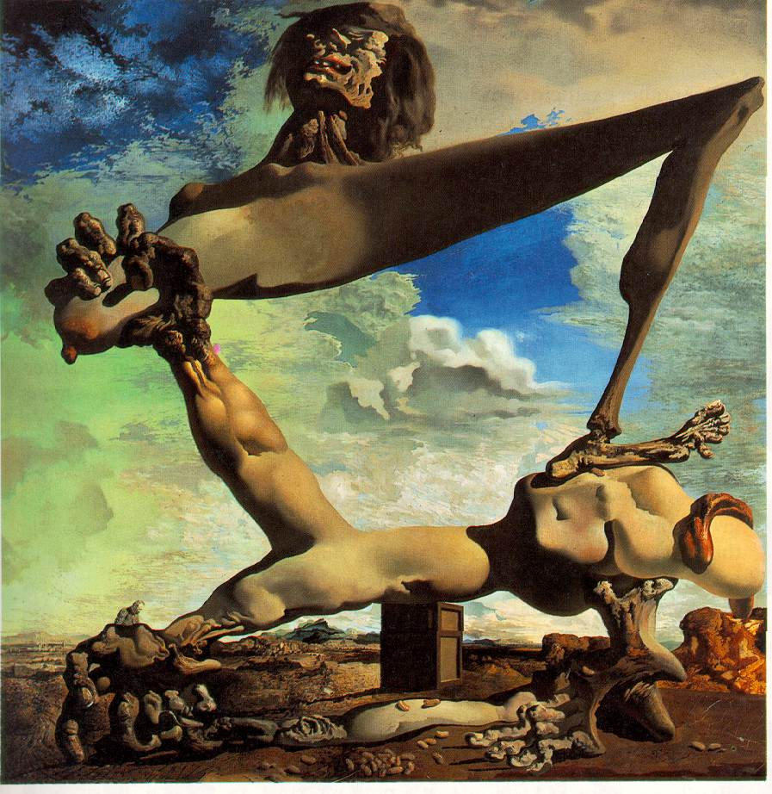
SURREALISM
SALVADOR DALI
(Spanish1904-1989)

Slide 20
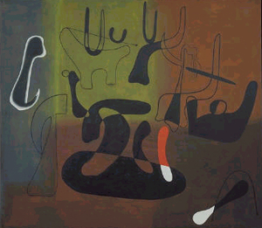
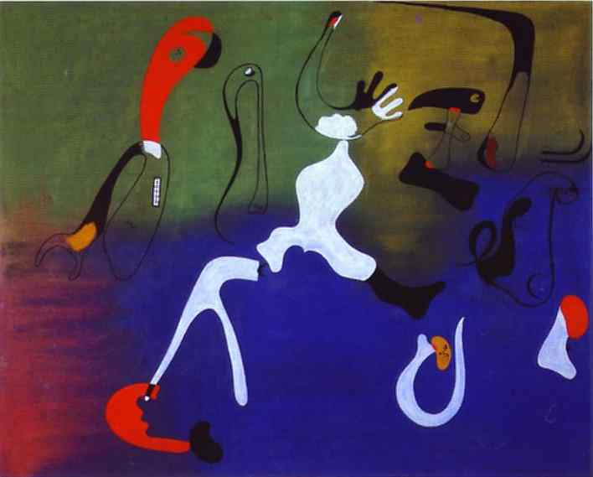
JOAN MIRÓ (spanish 1893-1983)

Slide 21
Miró Black and Red Series
Go to the following website. Make sure you type every letter and mark exactly as you see it.
http://moma.org/exhibitions/1998/miro/artistic_context.html
Read the introduction to Surrealism, following the arrows bottom right. At the bottom of page three are icons leading your to other areas of study. You must read and look through Creative Process and Technique, and Social and Political Context: Spanish Civil War. You may read through the other areas as well, if you like.

Slide 22
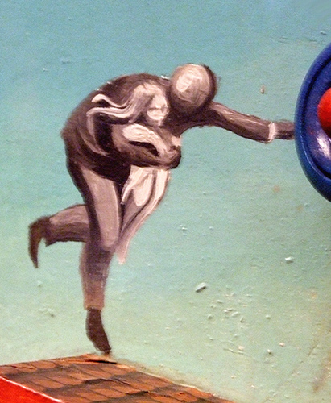
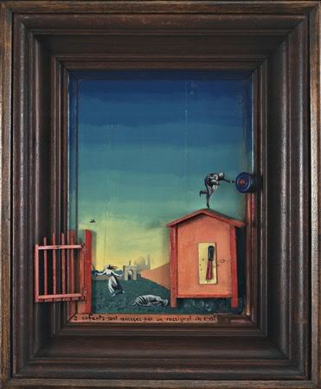
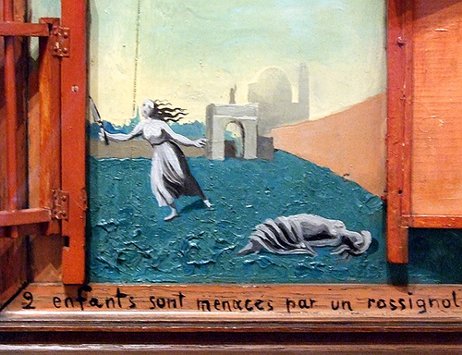
MAX ERNST (German 1891-1976)

Slide 23
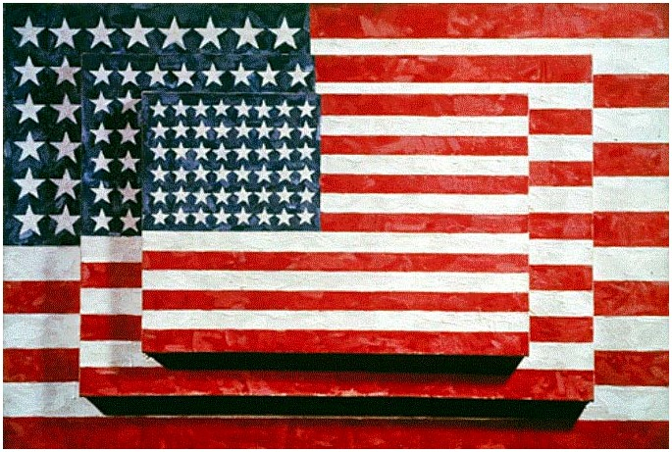
POP JASPER JOHNS (American 1930- )

Slide 24
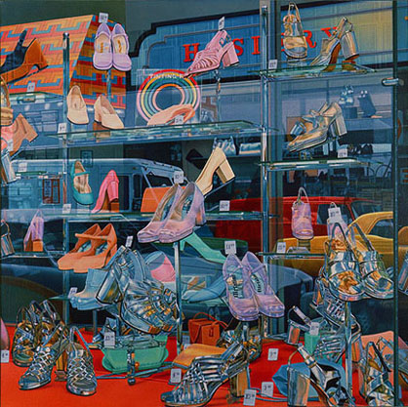
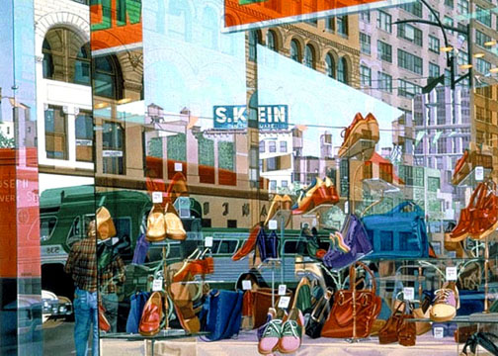
DON EDDY (American 1944- )

Slide 25
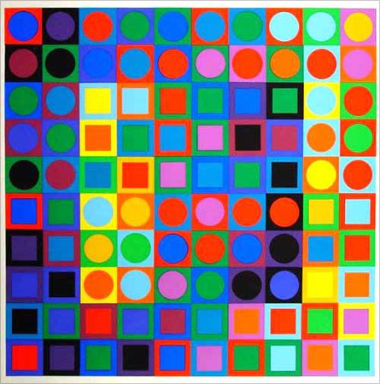
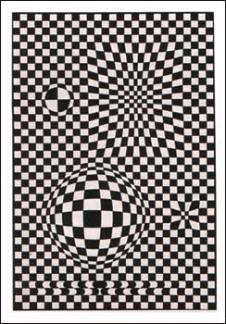
VICTOR VASARELY (Hungarian 1908-1997)

