Slide 1
ART 10 ART HISTORY II
Realism, Impressionism,
and Post-Impressionism

Slide 2
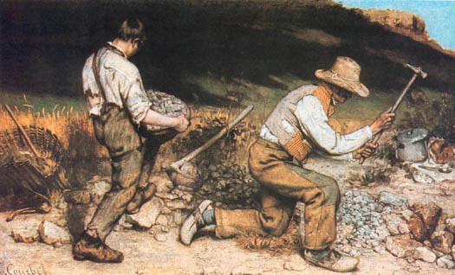
REALISM (1850-1860s)

Slide 3
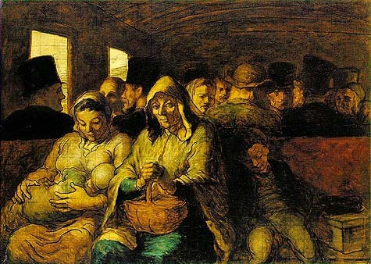

Slide 4
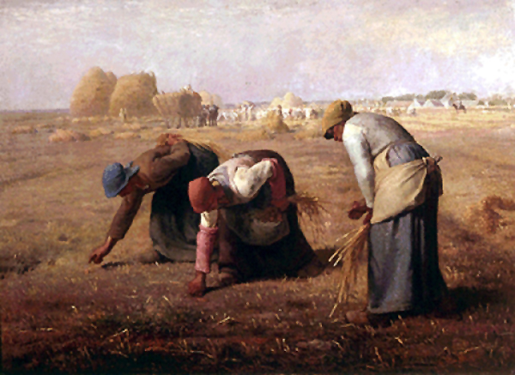

Slide 5
Notes p.6
Courbet The Stone Breakers
Two men preparing stones for road-bed; almost life-size. Courbet, in a letter, called the scene the “most complete expression of poverty”. What does C communicate?
Poor men in tattered clothes, doing heavy labour.
Faces averted (hidden), no sympathy asked, not individuals but represent a class.
Hill in backgr. Blocks sky – no hope or freedom.
“Alas, in labour such as this, one’s life begins that way, it ends the same way.”

Slide 6
b) Daumier Third Class Carriage
Interest in urban poor; had genuine
affection for working people.
Horse-drawn bus in Paris.
3 generations – grandmother, mother,
2 children, therefore represent whole class.
Contemplative faces and large hands at rest reflect hard physical labour – these people are worthy of respect.
Pyramid form of group unites then in contrast to separateness of nodding, gossiping heads of middle class passengers behind.

Slide 7
c) Millet The Gleaners
Grew up on farm, and moved back among peasants after 10-12 yrs in Paris. Peasant women picking up gleanings (leftovers after harvest).
Women involved in hard, back-breaking labour(only the very poor must glean) – but they are solid, strong, and capable. Atmosphere is almost soothing.
Faces hidden – represent all poor.
Repetition of curving shapes
in haystacks emphasize
bending backs.

Slide 8
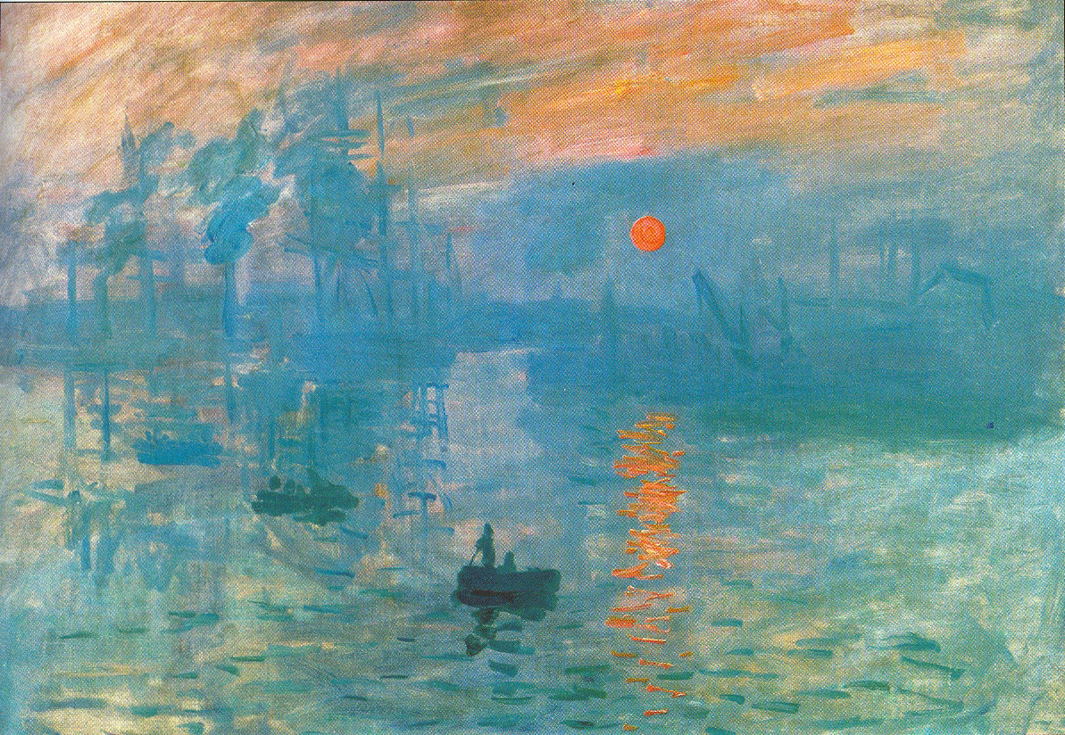
IMPRESSIONISM (1860s-1880s)

Slide 9
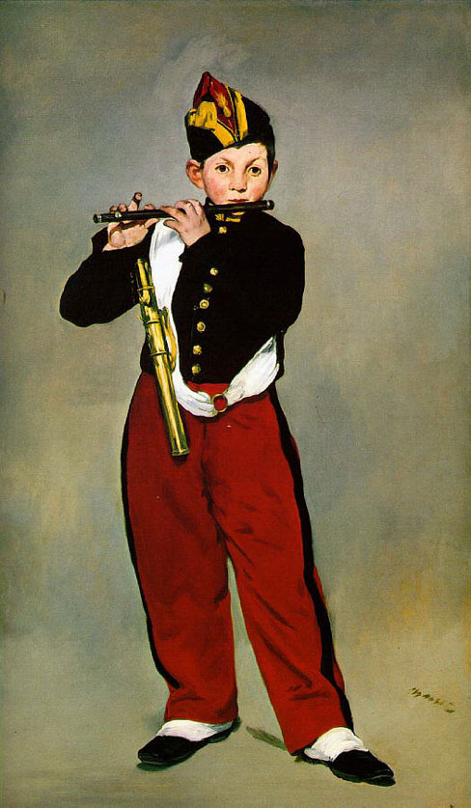

Slide 10
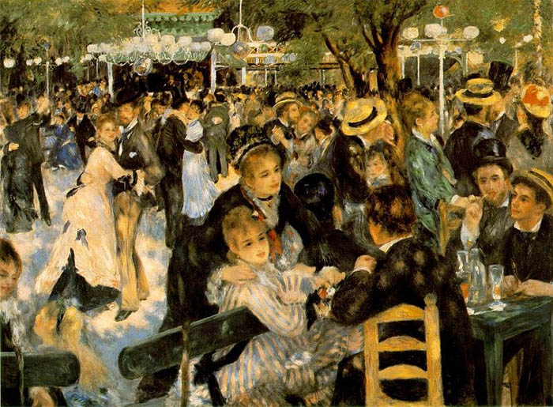

Slide 11
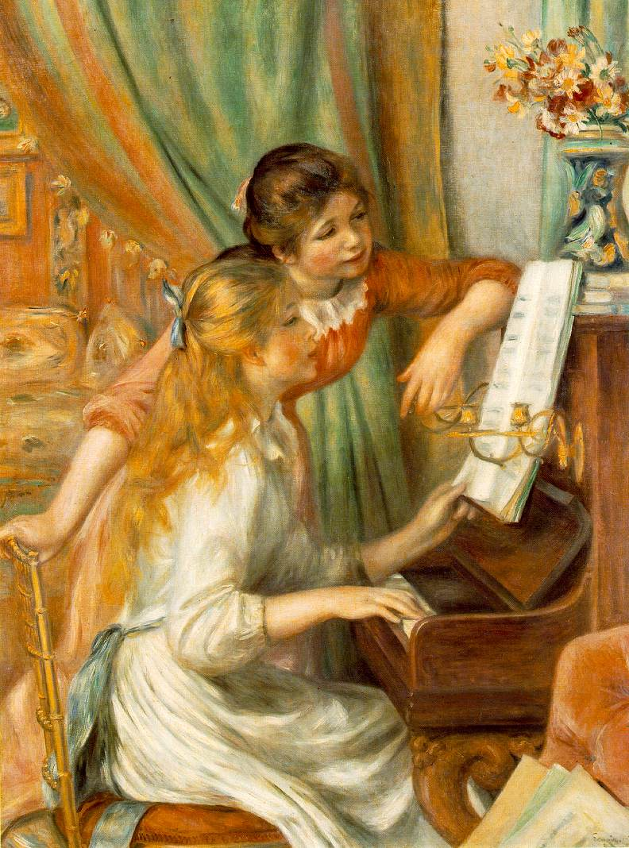

Slide 12
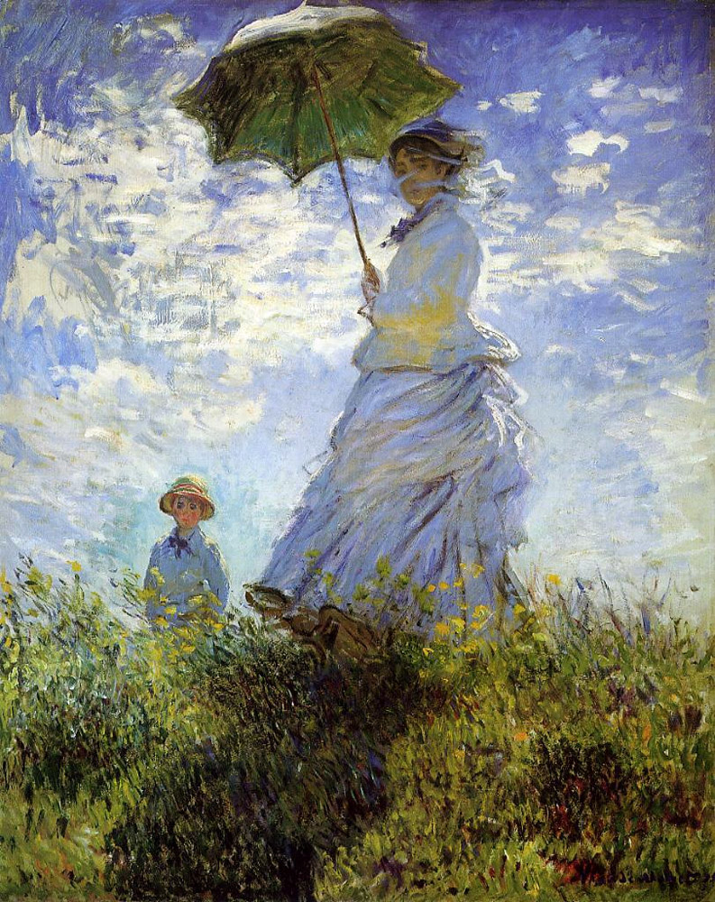

Slide 13
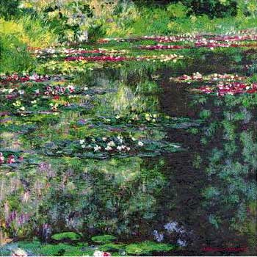
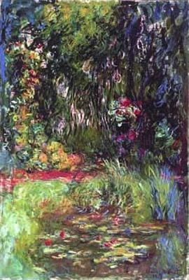
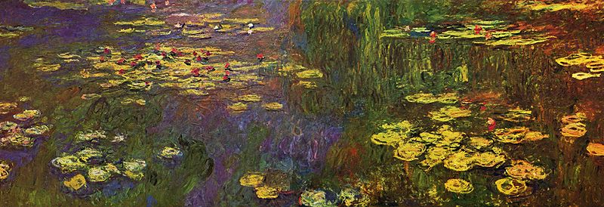

Slide 14
Notes p.7
Manet The Fifer
Ptg is “realistic”, ie. it is the real things, but its
treatment is not traditional. How is it different?
Lack of chiaroscuro and lack of extensive modeling; no backgr.
Outlines suggested
Areas of even colours
Result is FLATNESS – the canvas no longer a window but a screen made up of flat patches of colour. Subj. matter not important; it is vehicle thro’ which Manet develops his style.

Slide 15
Renoir Moulin de la Galette
Renoir and Monet among first to paint entire ptgs. Outdoors (due in part to invention of TUBED paints), in an attempt to capture effect of SUNLIGHT AND ATMOSPHERE on COLOUR.
1. Fairly quickly painted – lively impression, “slice of life”.
2. Short, choppy strokes of pure colour
(ie. Not muddied with lots of other colours)
3. Dapples sunlight increases sense of movement and spontaneity.

Slide 16
Notes p.8
Monet Woman with a Parasol
Painted in one afternoon – of his wife, Camille, and son, Jean.
Also “slice of life, ie. a passing moment.
Short strokes of pure colour define a bright, sunny day.
Ptg. has sense of immediacy and freshness in feeling of breeze captured in swift brush strokes.

Slide 17
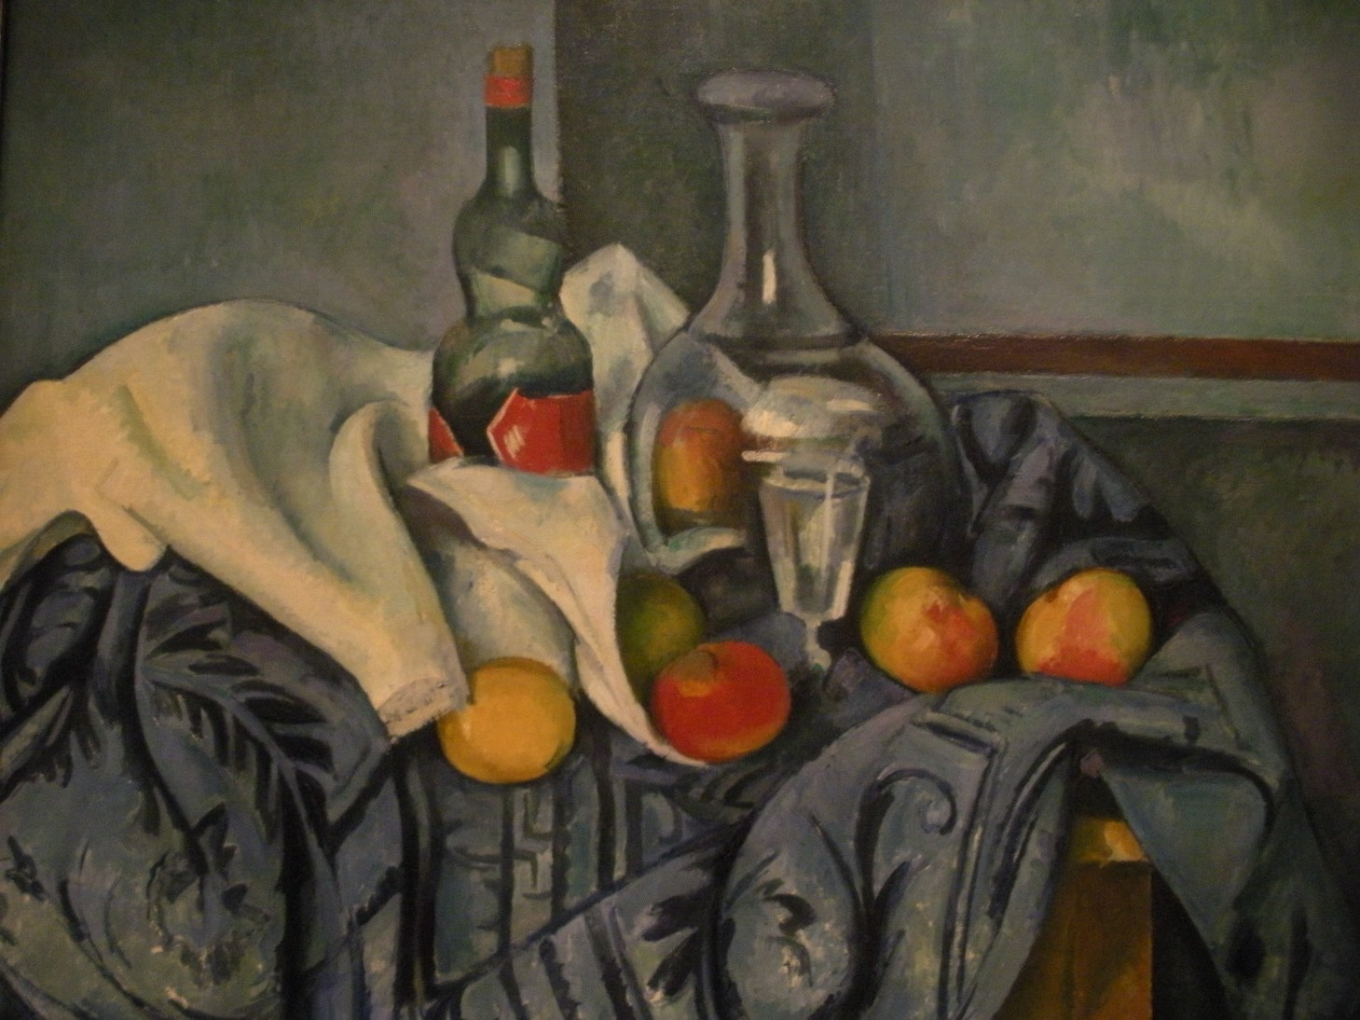
POST-IMPRESSIONISM (1880s-1900)

Slide 18
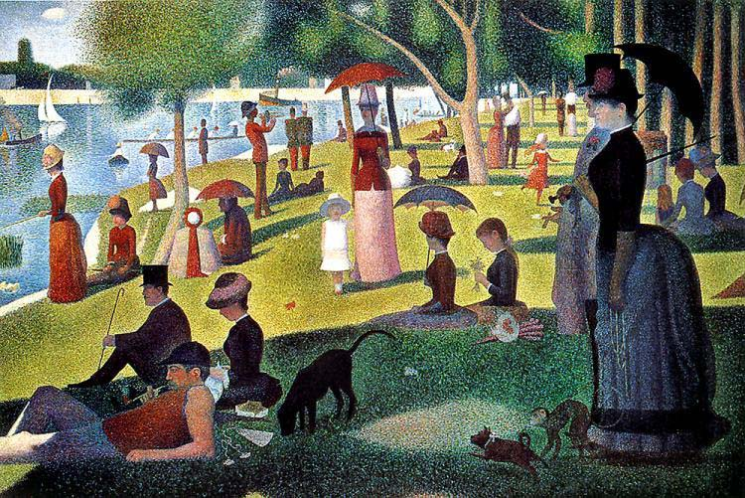

Slide 19
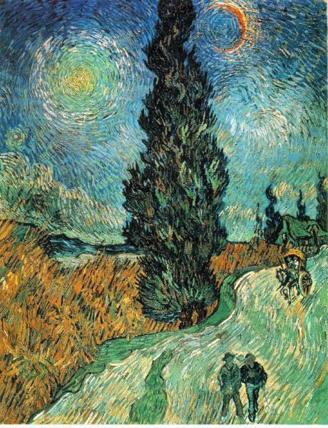

Slide 20
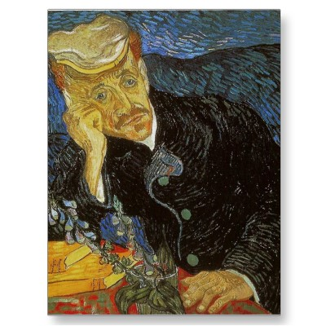

Slide 21
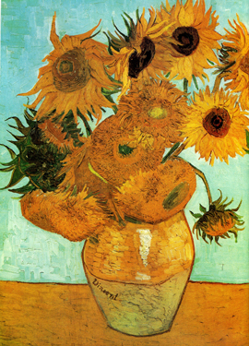
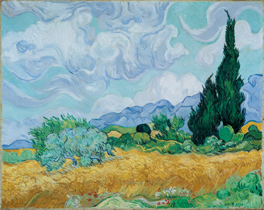

Slide 22
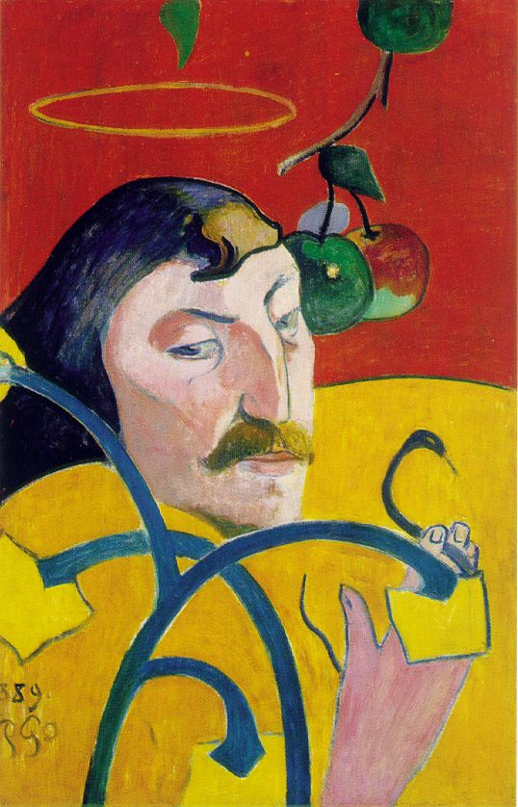
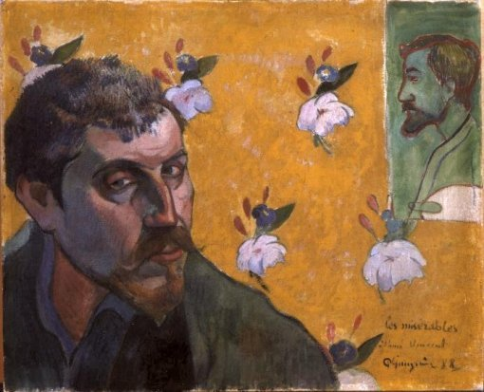

Slide 23
Notes pp.8,9
Cézanne Still Life with Peppermint Bottle
C. said of Monet, “Monet is only an eye,…tho’ a magnificent eye”. Whereas Monet was interested in surface, optical effects of light on colour, C. wanted to get back substance, to “make of Impressionism something solid and durable, like the art of the museums”.
What makes this solid and durable?
Blocky brushstrokes – built up look.
Subj. matter is traditional, timeless
Ambiguous space, ie. Comp. both shows depth and is flat at the same time; the fruit looks as if falling off table. In C.s later work, 2D is emphasized more; he becomes a “forerunner “ of Cubism.

Slide 24
Seurat Afternoon on the Grande Jatte
How does he make Impr. “solid and durable”?
Use of POINTILLISM – in-depth understanding of colour theory; colours put on in small dots blend in the eye from distance; however, because ptgs. so large, they look like mosaics and don’t blend as intended.
Stiff, formal figs. – all in profile or “en face” – seem frozen in space.
Though subj. matter is Impressionist, S’s style results in stillness and timelessness (and not a “slice-of-life” look).

Slide 25
Van Gogh Road with Cypresses
Intense, sensitive personality; fiercely devoted to ptg.; had form of epilepsy which caused seizures and illness. Committed suicide at 37.
Is this “solid and durable”? No. Van Gogh makes Impress. expressive of his emotions and responses to nature. How?
1. Parallel, undulating brushstroke – continual agitation of sky and land, cypress tree like flames.
2. Intense colour – uses Impr.’s pairing of complementary colours for strongest colour effect, esp. blue and gold.
3. Symbolism: cypress tree represents death and eternal life; sun is symbol of God’s presence in nature.

Slide 26
Paul Gauguin Self-Portrait
Began movement called “Symbolisme”, introducing depth of meaning back into ptg. (Remember, Impr. appeals to “eye” more than to “mind”). How symbolic”
Refers to story of the “Fall” – fruit, halo, serpent, lily (purity)
Represents himself as Lucifer, the fallen
Angel – yellow wings on red, hellfire
Backgr.
3. Post-Impr. Style – flat areas of colour,
outline, little modelling (ptg. is unfinished).

