Slide 1
BRITAIN’S RESPONSE TO THE LOWER AND UPPER CANADA REBELLIONS

Slide 2
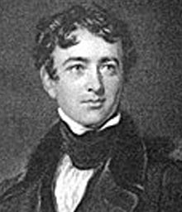
LORD DURHAM (aka “Radical Jack”) arrives in 1838 to figure out what is going on and how to fix it!
He stays five months as Governor-General, then goes home and tells British Parliament the main problem is – what’s new?- the power struggle between the English and the French.

Slide 3
Lord Durham is a true Brit, believing British ways are superior however much he admires the French. He still thinks the French should be ASSIMILATED.
He makes THREE recommendations to Britain on what they should do in the Canadian colonies.

Slide 4
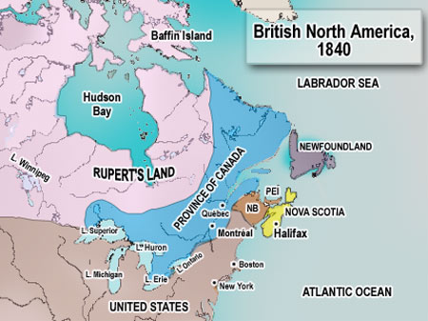
#1
Take Upper and Lower Canada, which had been created through the Constitution Act of 1791, and turn it back into ONE province, to be called the PROVINCE OF CANADA.

Slide 5
#2
Separate British affairs from local Canadian affairs, so that Canadians could make their own laws. (Ie., relating to anything not involving Britain)

Slide 6
#3
Grant
RESPONSIBLE GOVERNMENT!
(What’s that? Wasn’t the government already responsible??? Well, no, not according to the official definition.)

Slide 7
#1 WAS accepted!
The ACT OF UNION was passed in 1841.
This meant that:
a. U. and L. Canada became the Province of Canada (and were now referred to as Canada West and Canada East – but we will keep calling them U. and L. Can!)
b. Both parts of the Province would have an equal numbers of assembly seats (42), even though L. Canada had a much larger population.

Slide 8
c. The official government language would be ENGLISH.
(Ouch! You know who did not like that!)
d. The Governor would appoint his councils.
(And therefore, the elected assemblies would still not have the most say.)

Slide 9
#2 WAS accepted!
The government no longer had to answer to Britain.
HURRAY!

Slide 10
#3 was NOT accepted!
Britain would not grant “responsible government” to her Canadian colonies.
So, what IS that, anyway?
Responsible Government means decisions cannot become law without the support of the majority of elected representatives.

