Slide 1
Unit 4A UPPER AND LOWER CANADA (THE CANADAS)
1815-1850s

Slide 2
Immigration
Part One

Slide 3
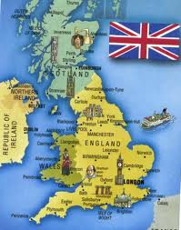
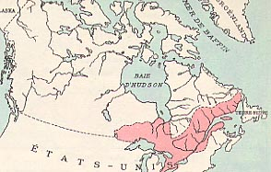
English
Scottish
Irish
Welsh

Slide 4
Why did so many British people immigrate?
Most immigrated to Upper and Lower Canada or the Maritimes because of
POVERTY
or, at least for economic reasons!

Slide 5
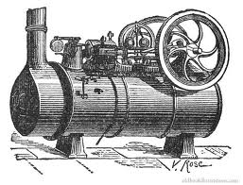
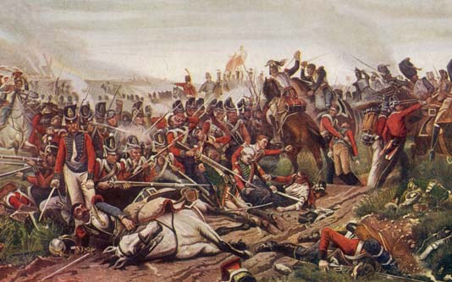
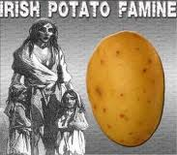
What caused such poverty in Britain?
The Industrial Revolution: human labour
was replaced with machine labour, therefore
people lost their jobs.
Steam Engine
The end of the Napoleonic Wars
brought economic depression and
unemployment.
The Battle of Waterloo
A POTATO famine in Ireland

Slide 6
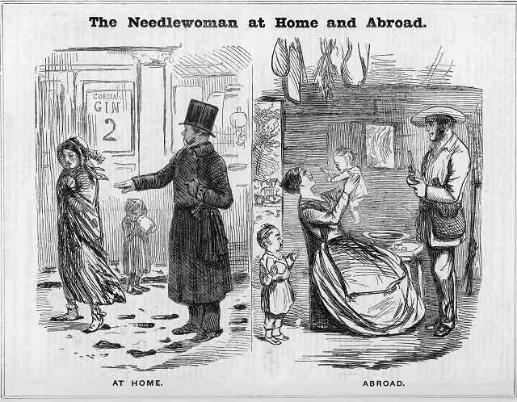
And also…
Britain wanted lots of British people in the colonies in order to increase the colonies’ loyalty to Britain!
It was a great way to start over and create a new life.

Slide 7
However, the trip was not a pleasure cruise…
People endured
BAD FOOD AND WATER
POOR SANITATION
VERY LITTLE SPACE
DISEASE
And therefore, many did not survive the voyage.

Slide 8
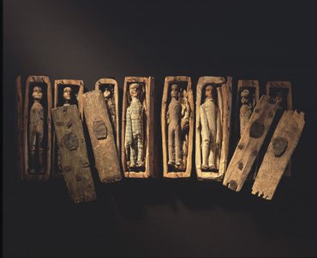
In fact, the vessels were nicknamed
COFFIN SHIPS

Slide 9
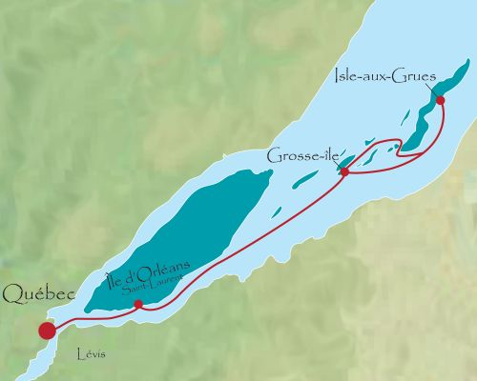
Grosse Île
was the quarantine island near Quebec City where all immigrant ships stopped, in order to check all immigrants for sickness.
Many people died of illness on Grosse Île, and in spite of efforts to prevent it, many epidemics still occurred in the cities of Upper and Lower Canada.

Slide 10
Part Two
Politics in Upper and Lower Canada

Slide 11
Was the colonial government in “the Canadas” a democracy?
Sort of, but not really…

Slide 12
Although there was an elected assembly, as in all British-run colonies, very few people could vote. You had to be
Male
Over 21
A property owner
(or a widow who owned property)

Slide 13
Remember British colonial government?
Britain (monarch and parliament)
Governor (appointed by Britain)
Councils (appointed by governor, advised governor)
Elected Assembly (elected by voters, advised councils)
Voters (elected the assembly only)

Slide 14
Was everyone in Upper and Lower Canada happy with their government?
NO!

Slide 15
In Lower Canada…
The Governor’s council English Protestant merchants
(nicknamed the “Chateau Clique”)
The Assembly Mostly French Catholics
Uh oh…
A group calling themselves the Parti Patriote, began to fight for a more democratic form of government from 1820 on.

Slide 16
In Upper Canada
The Governor’s council Wealthy English Canadians
(Nicknamed “The Family Compact” Can you guess why?)
These men stood for loyalty to Britain and the authority of the Church of England, and form the beginnings of the Conservative Party, or “Tories”.
Many people, including many settlers from the United States who were not loyal to Britain, objected to the Family Compact having all the power, and wanted a more democratic form of government.
They established the REFORM PARTY.

Slide 17
The result of all this discontent in Upper and Lower Canada was…
VIOLENT REBELLION

Slide 18
What, by the way, IS a DEMOCRACY?
Look in the glossary of your blue textbook, find the definition of democracy, and write the definition here.
Open blue textbooks to pp. 210-211, and read various PERSPECTIVES on democracy.

Slide 19
REBELLIONS of 1837-38
I LOWER CANADA
Lower Canada in 1800s made up of: Francophones (Canadiens): Habitants, Fr. Middle Class, R.C. Clergy
Anglophones: Br. Merchants
2. The governing “council”: Controlled by Anglophone Protestants (CHATEAU CLIQUE)
The Assembly: mostly Francophone Catholics
UH OH, THIS MEANS TROUBLE!

Slide 20
3. From 1820s on, there were parties demanding a more democratic gov’t, mostly madae up of Canadiens:
Eg. the Parti Patriotes, who had most of the seats in the Assembly. Violent divisions in gov’t led to 3 Canadiens being shot during an election.
4. Adding to the discontent with gov’t., Br. Immigrants travelling to or through Quebec brought a cholera epidemic, killing almost 5000 people. Lower Canada also suffered four years of crop failures, so that in the winter of 1837 many faced starvation.
(Hungry people become ANGRY people!)

Slide 21
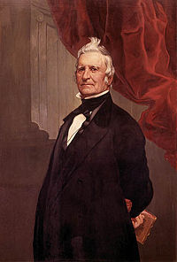
5. LOUIS-JOSEPH PAPINEAU and the Rebellion of Lower Canada (1837)
a. What did Papineau want? A
Francophone-AMERICAN-style
democracy.
P. was leader of Assembly and Parti
Patriotes, opposed to Chateau Clique.
b. What did the Assembly do in 1834,
and how did the Br. respond? Drew
up 92 Resolutions (complaints and
demands); wanted Assembly to control
gov’t.
Br. responded 3 YEARS LATER,
refusing ALL requests!

Slide 22
c. Papineau encouraged the French to do what in response?
Boycott Br. products, eg. Tea and sugar.
Smuggle goods from U.S.
d. The Patriotes wanted a new country; what did they do to this end?
Printed own $, and designed own flag.

Slide 23
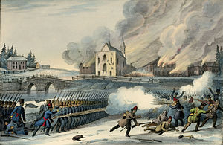
The Rebellion began when some Patriotes ambushed several Br. soldiers and rescued two Patriote prisoners. On Nov. 23, 1837, Patriotes led by Dr. Wolfred Nelson defeated a Br. force at the village of St. Denis. In Dec. 1837, 600 Patriotes were hiding inside a church a St. Eustache. A Br. army of 2,000 soldiers set fire to the church, killing many and causing many to flee. This marked the end of the rebellion, and Papineau
fled to the U.S., then to Paris.
St. Eustache in flames.

Slide 24
YOU TUBE CLIP:
1837 LOWER CANADA REBELLION

Slide 25
II UPPER CANADA
1. Who controlled the gov’t in Upper Canada?
Family Compact
The Family Compact believed:
In the superiority of everything Br., especially its political institutions, the Church of England, and the Br. Empire.
That leaders should be men of high character, wealthy, knowledgeable, intelligent, and loyal.
That ordinary people cd not be trusted.
That democracy was BAD.

Slide 26
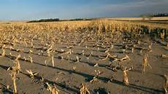
3. In 1836, the governor, through intimidation and bribery, made sure the party HE FAVOURED (ie., NOT the Reform Party – see below) won the majority of seats in the Assembly.
4. Like in Lower Canada, in 1837 there were widespread crop failures.
(Remember what hunger does to people!)

Slide 27
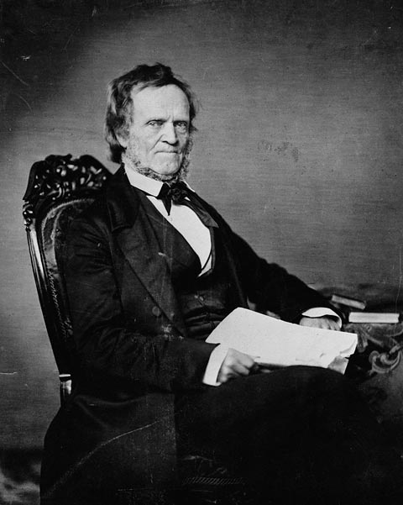
5. William Lyon Mackensie and the Rebellion of Upper Canada (1837)
a. Mackenzie was a hot-tempered,
Outspoken advocate of reform in his
Newspaper, the Colonial Advocate.
He was elected to the Assembly,
Starting in 1828, four times.
b. Mackenzie and others formed the
REFORM PARTY, and tried to make
Upper Canada more democratic.
Read about Mackenzie, p.214 Blue
textbook.

Slide 28
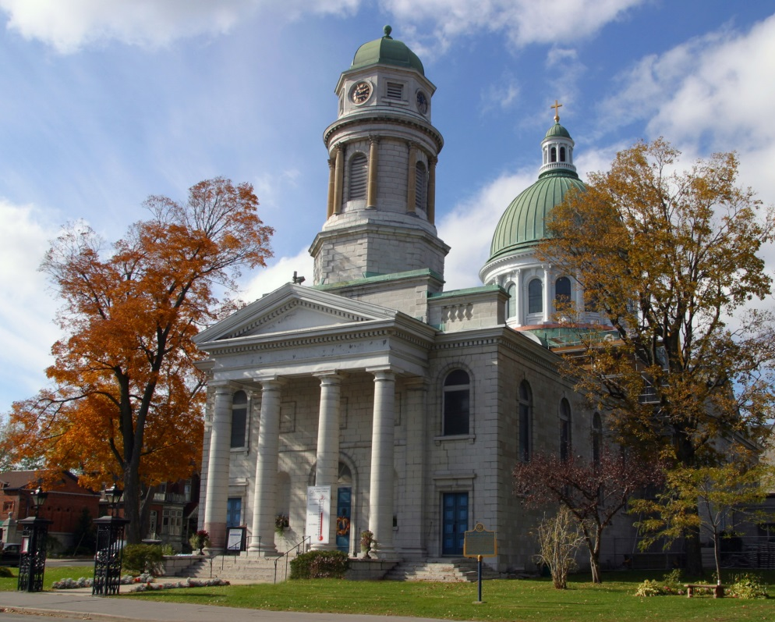
The Reform Party opposed the Family Compact because the Family Compact:
Ignored public opinion
Kept best jobs for friends
Controlled economy for their own profit
Favoured Church of
England
(ie. over other
denominations,
such as Presbyterian
and Baptist)

Slide 29
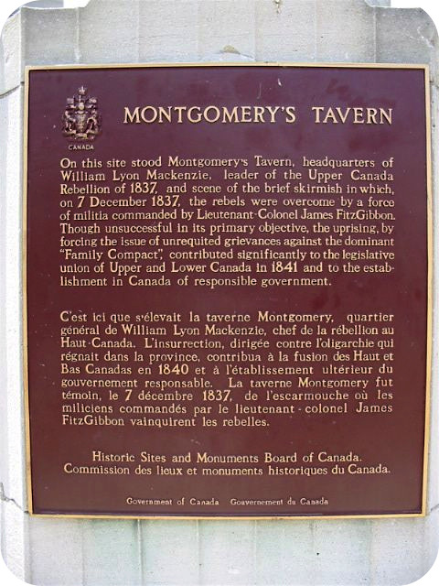
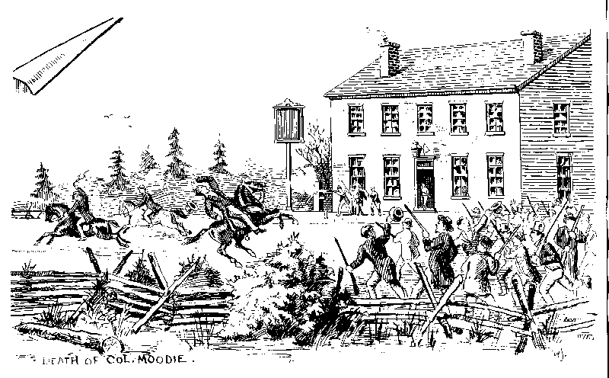
The rebellion began when Mackenzie gathered men about him with the goal of overthrowing the gov’t in York (Toronto). The men met in early Dec. 1837 at Montgomery’s Tavern, just north of the city, and they planned to march into the city and take over gov’t buildings.

Slide 30
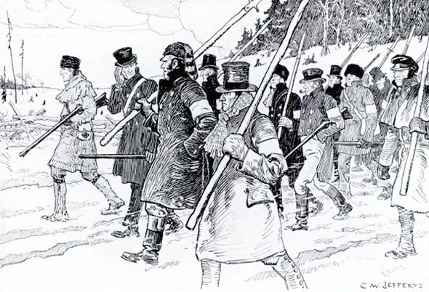
In the end, the rebellion failed, because it was poorly planned, poorly organized, and the men poorly equipped, while gov’t forces and volunteers were far more numerous.

Slide 31
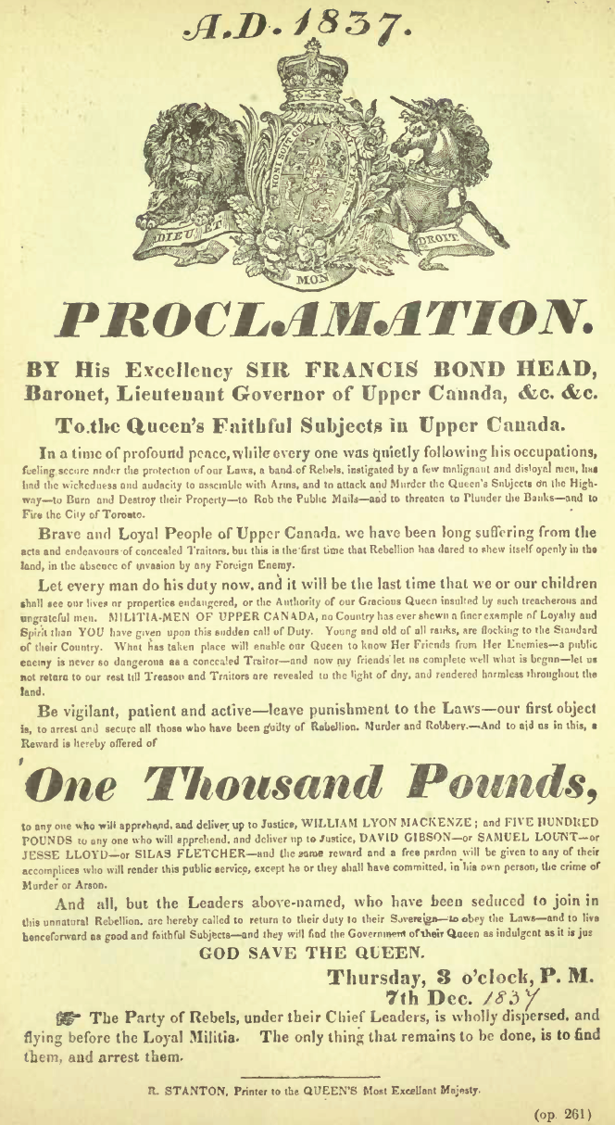
The rebellion was easily put down with only a few casualties and ended in 1838 after several raids were made into Canada from the U.S. where
Mackenzie had fled.
Proclamation posted on
December 7, 1837 offering a
reward of one thousand pounds
for the capture of William Lyon
Mackenzie.

Slide 32
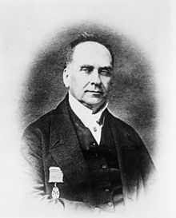
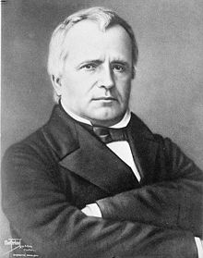
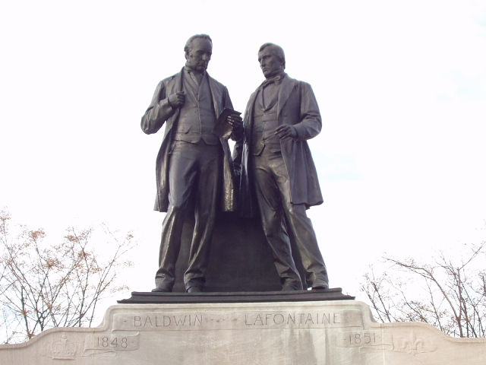
What happened after the two rebellions?
The result of the rebellions was that radical reformers in both Upper and Lower Canada lost public support, and more moderate reformers, such as Robert Baldwin (from U. Can) and Louis-Hippolyte LaFontaine (from L. Can), took the lead in the fight to reform government.
Baldwin Statue of the two on Parliament Hill LaFontaine

Slide 33
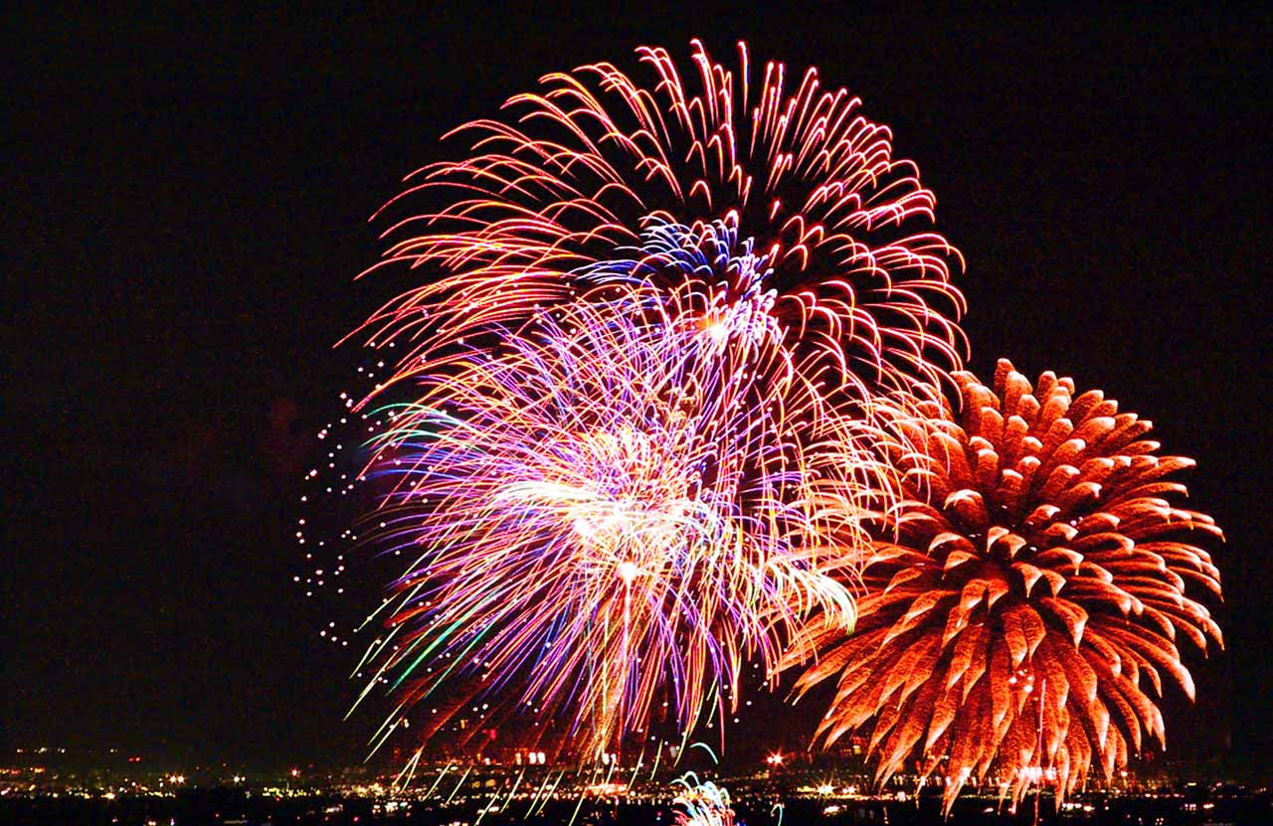
END OF
UNIT
4A NOTES

