Slide 1
SOCIAL STUDIES 7
UNIT 6 IMAGES

Slide 2
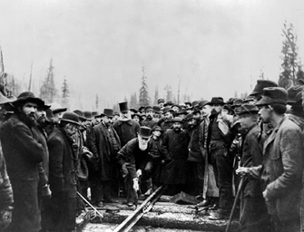
The Last Spike (Completion of the CPR at Craigellachie, B.C.)

Slide 3
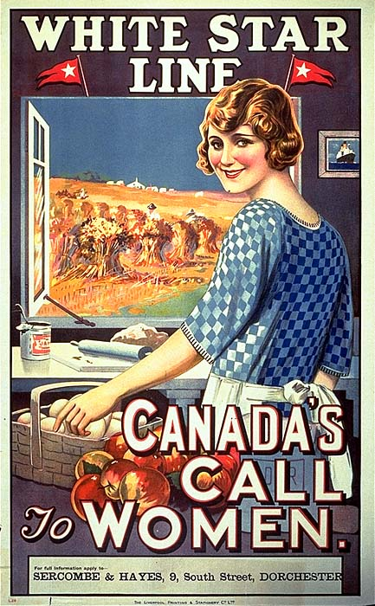
Clifford Sifton’s Posters

Slide 5
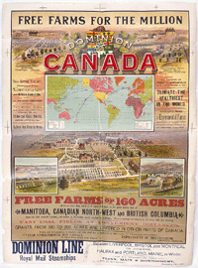

Slide 6
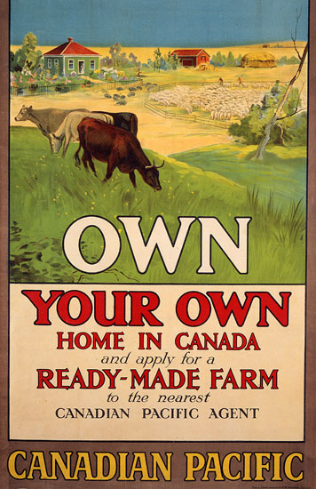
CPR Poster

Slide 7
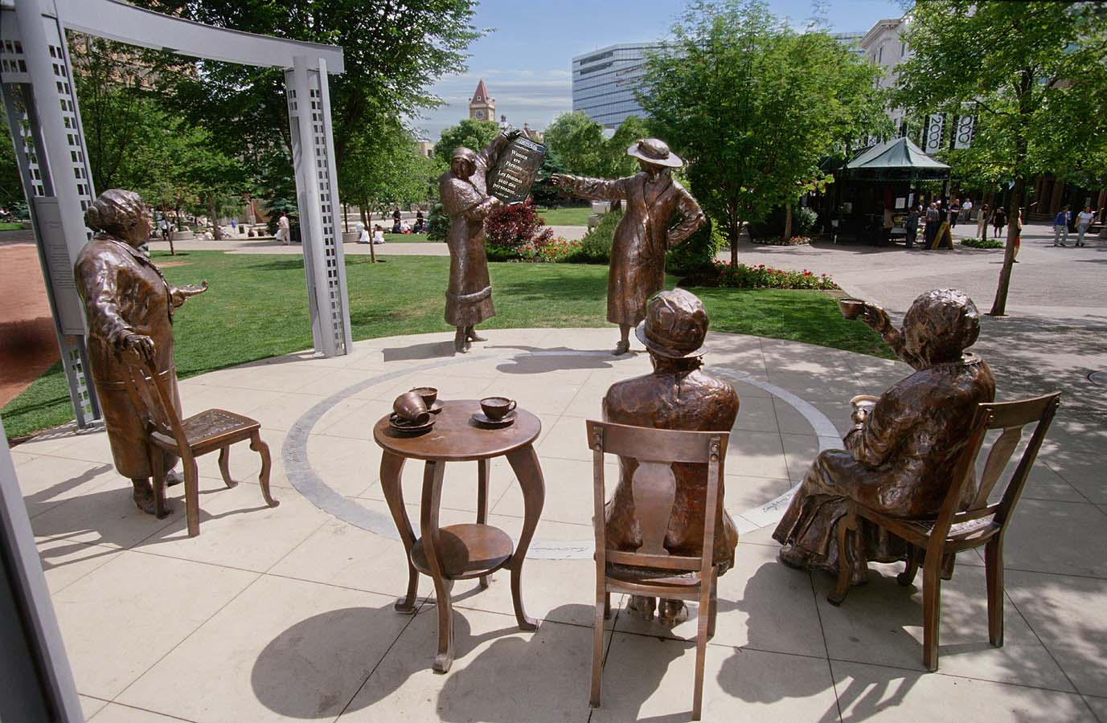
The Famous Five (Nellie McLung, Irene Parlby, Emily Murphy, Louis Mckinney, and Henrietta Muir Edwards)

